Slide 1

Thanks for being here……and for making a difference!!
To our many members
To our municipalities & organizations
To Alma College
Notes:
Speaker: Chuck

Slide 2
HPR’s Mission & Fundamental Focus
HPR’s mission is to help restore the Pine River and its tributaries to a healthy state.
Our Focus is:
    Reduce contamination of the Pine River - from sediment, improper application of livestock manure, and faulty septic systems
    Provide Septic system support to our rural homeowners through a “septic liaison”
    Provide an Outreach Program designed to engage, educate, and inform our public to include communities, townships, schools, and organizations/clubs
Notes:
Speaker: Chuck

Slide 3

A special thank you to Alma College….for their longstanding commitment to our environment, particularly the Pine River
Dr. Murray Borrello & Dr. Tim Keeton - for the many years of water testing
For the research done by Alma College interns on topics related to the river
Dr. Ben Peterson – for his input, and his classes conducting “social surveying” of Alma residents and businesses regarding the Pine River and impoundment
For continuing to advocate and champion events that promote awareness
For providing guidance to the students of the LEAPS program
We would be lost without their ongoing guidance and commitment.
Notes:
Speaker: Garnet

Slide 4
What have years of testing told us about our river?
Very high levels of:
  Nutrients - particularly nitrogen & phosphorus
  Vegetation in spring, summer, and fall due to excessive nutrients including algal mats and blooms
  E.coli, well beyond state standards
  Sedimentation in the Alma impoundment
Very low level of oxygen not helping fish sustainability
Genes in the sediment that demonstrate anti-bacterial resistance
Notes:
Speaker: Brittany

Slide 5
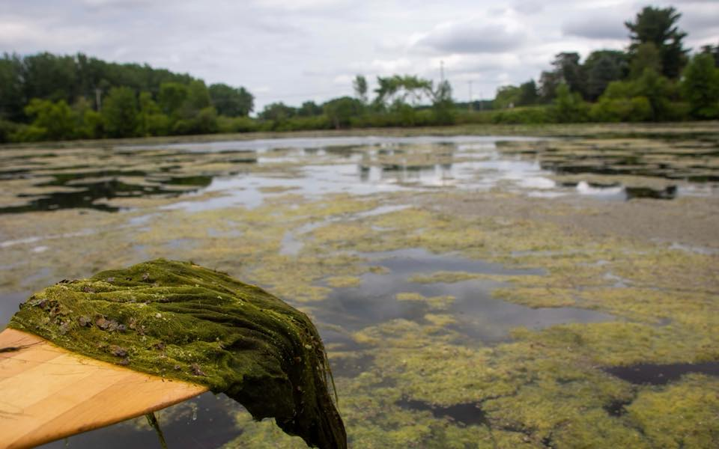
Effects of Pollution
Reduced Recreation (fishing, kayaking, canoeing) due to high levels of E.coli well above state health standards for partial and full body submersion
Loss of Aesthetic appeal due to heavy vegetation
Loss of business/residential development due unsightliness of river
Potential stagnation or loss of property values due to poor condition of the river
Notes:
Speaker: Brittany

Slide 6
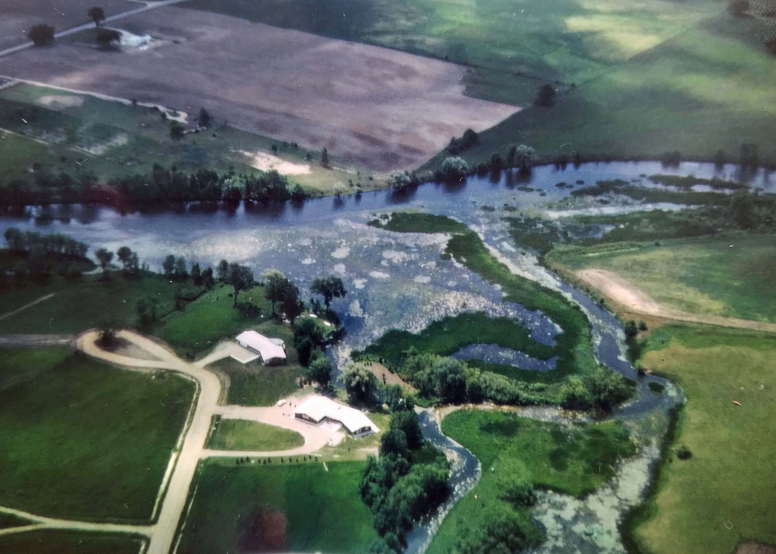
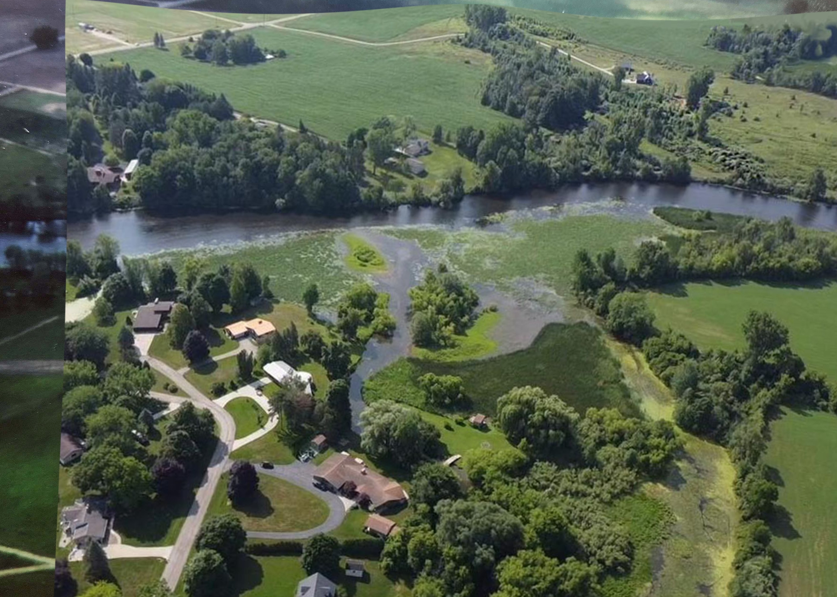
Pine River at
Blue Heron Dr.
1966
-
July 5th 2023
Notes:
Speaker: Dave
change, faster, vegetation, sandbars

Slide 7
Pine River at
Blue Heron Dr.
1966
Pine River at Blue Heron Dr.
July 5th 2023
Notes:
Speaker: Dave

Slide 8
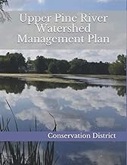
The Upper Pine River Watershed Management Plan
This project was co-sponsored by Gratiot Conservation District & HPR
HPR Board member Jane Jelenek authored a significant part of the UPRWMP in 2018.
Due to her efforts EGLE provided funding to complete the UPRWMP
Streamside Ecological Services completed the plan by completing the “windshield survey” through driving and scrutinizing the Pine River as it flowed through four counties including Mecosta, Isabella, Montcalm, and Gratiot.
The UPRWMP is our guide for restoring the Pine River
UPRWMP Books are available for checking out or purchase.
Notes:
Speaker: Lynn
Thanks to Jane

Slide 9
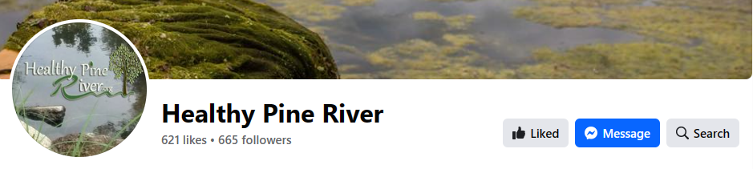
Updating our HPR Website, Facebook, & Instagram efforts
Barbara Chovanac, HPR Board member & Sara Warren, AC Vista Volunteer
Matt Ogle, Ogle Computer for technology oversight and management
Updating outdated information
Highlighting meetings, minutes, and current events
Providing current information regarding HPR and the Pine River
Pictures, People, and your questions answered
Research Information including;
  Poop Study, Fishing Study, MMDHD signage
  2023 Water Testing results
  Barr Engineering Sediment Study (impoundment area)
  Combined water testing results over the years
  MDEQ Test Results from 2018
  Relationship between the State Street Dam & Alma Reservoir
Notes:
Speaker: Barbara
Thanks to Sara & Matt

Slide 10

2023 EGLE Watershed Council grant designed to support “capacity building” & specific focus areas
Faulty Septic Systems in our rural areas within our watershed
  An E. coli source
Landowner & Farming Community engagement
  To reduce agricultural/livestock sources of nutrient overload
Outreach – to educate and inform our public
  communities, townships, schools, organizations
The $31,400 in grant funds is utilized to cover these areas
Notes:
Speaker: Brittany
Capacity Building - funding work

Slide 11
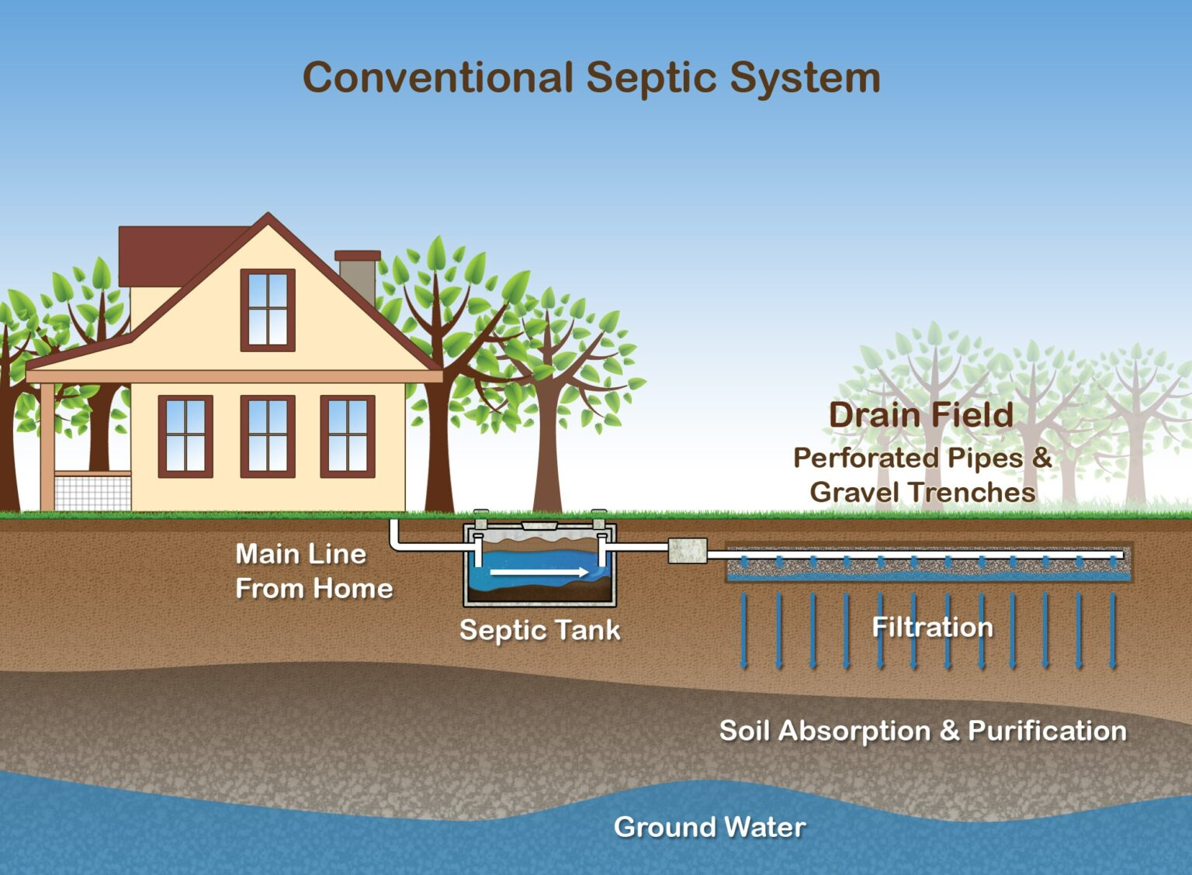
HPR’s septic outreach efforts
Mikie VanHorn our “septic liaison”
  Working with our rural communities; Riverdale, Sumner, Elm Hall, Elwell….and our rural residents
Thank you to the septic business Akers Waste Removal
Thank you to the Mid Michigan District Health Department
The “beat goes on”
Notes:
Speaker: Brittany
Thanks to Mikie

Slide 12
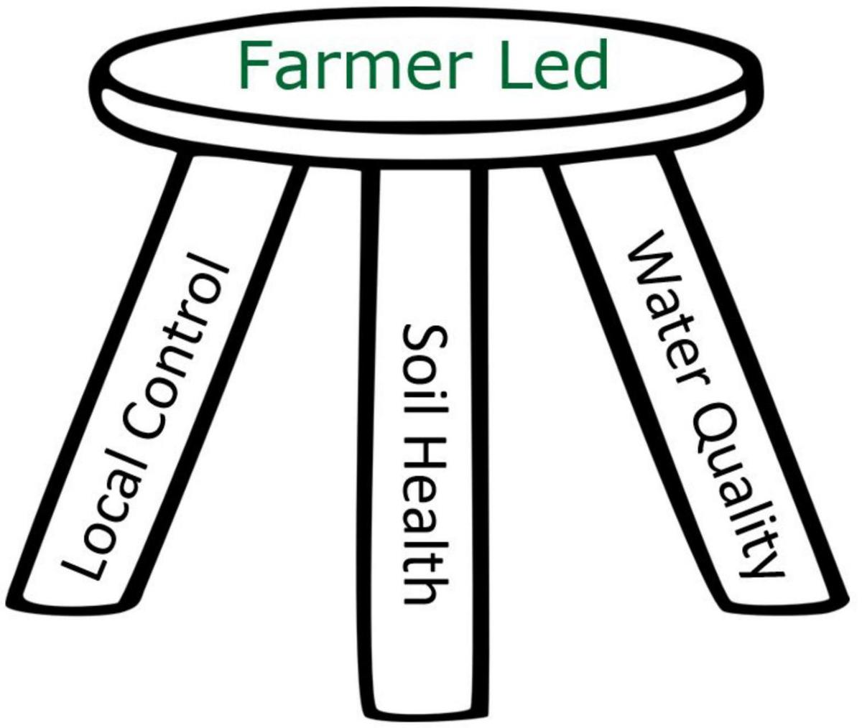
The Landowners Advisory Board
Thanks to Ladean Anderson, chair – Gratiot Conservation District
What is the Upper Pine River Landowners Advisory Board ?
What is next?
12
Notes:
Speaker: Ladean
Slide: The Landowners Advisory Board
What is the Upper Pine River Landowners Advisory Board?
● The explanation:
○ The Gratiot CD participated in a four year Farmer-led outreach and education
program as part of the nearly 1 million dollar Accelerating Nutrient Management
Adoption project in the Saginaw Watershed. (2019-2023)
○ This project, administered by the Institute of Water Research at MSU had the
goal to improve water quality and optimize nutrient inputs in the Saginaw River
watershed through an innovative network of farmers.
○ The idea was to create Peer-to-Peer Farmer led groups
■ Giving the group local control
■ that would hold events highlighting conservation practices highlighting
Soil Health and Water Quality thus...
■ decreasing the nutrient load and sediment contamination in the Saginaw
Bay watershed.
○ The project did not go as planned, due to COVID. But we did learn that the best
way to teach conservation practices is through meetings led by Food Producers
themselves.
○ There are agencies already involved in this type education:
■ MSUE - educators
■ Farm Bureau
■ Farm Bureau Young Farmers
■ And Conservation Districts and Watershed Councils located in the
Saginaw watershed.
○ So when your board member Chuck Sandro asked the Gratiot Conservation
District to partner in education efforts outlined in the work plan of the watershed
council grant you were awarded, we were more than happy to assist since we are
also working towards conservation education in the whole of Gratiot County.
● How to start:
○ To begin with, educational events need planning. Who better to plan than a few of
the very people who are the boots on the ground conservation participants.
○ Landowners, county commissioners, and agency partners have all been invited
to gather around the table.
○ Meetings are every other month
■ We have reviewed the Upper Pine River Watershed Management Plan
■ We have talked about how to get Food producers involved.
■ We are exploring Educational meeting possibilities.
● Next steps: Continue the discussion
■ There is no easy way to get education efforts, on the scale needed,
started
■ The Gratiot CD has been involved in other watershed management plan
projects of this nature and we feel confident this board will be successful
in planning events.

Slide 13
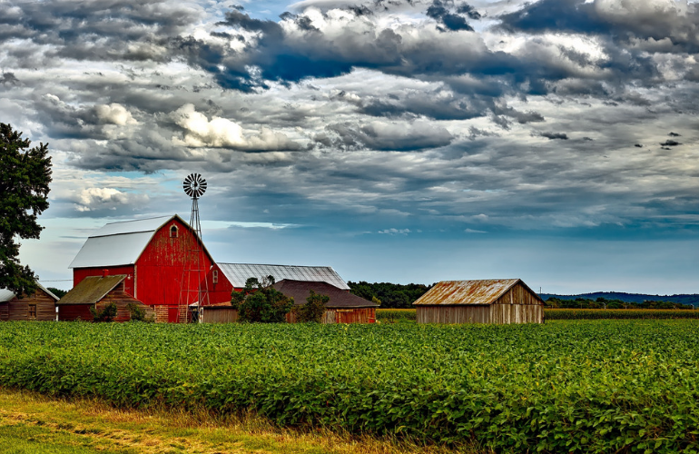
Farming Community Engagement
Working with individual farmers and farmer groups focusing on engaging the farming community and seeking their environmental support as to how we can reduce contaminants into the watershed waters
Amish farming community efforts are on-going
Our county farm agencies have been helpful as well
Notes:
Speaker: Ladean
Chuck meeting with area farmers/FB

Slide 14
HPR Outreach efforts – to inform & educate
Develop materials and presentations that help inform & educate our public including:
  Our communities (counties, cities and townships) within the Pine River Watershed
  Service organizations & clubs
  Our area schools in our watershed
  It is impossible to seek healthy change without the factual information to consider those changes.
Notes:
Speaker: Chuck
Thanks Erika Kemler - Forest Hills Nature Center

Slide 15
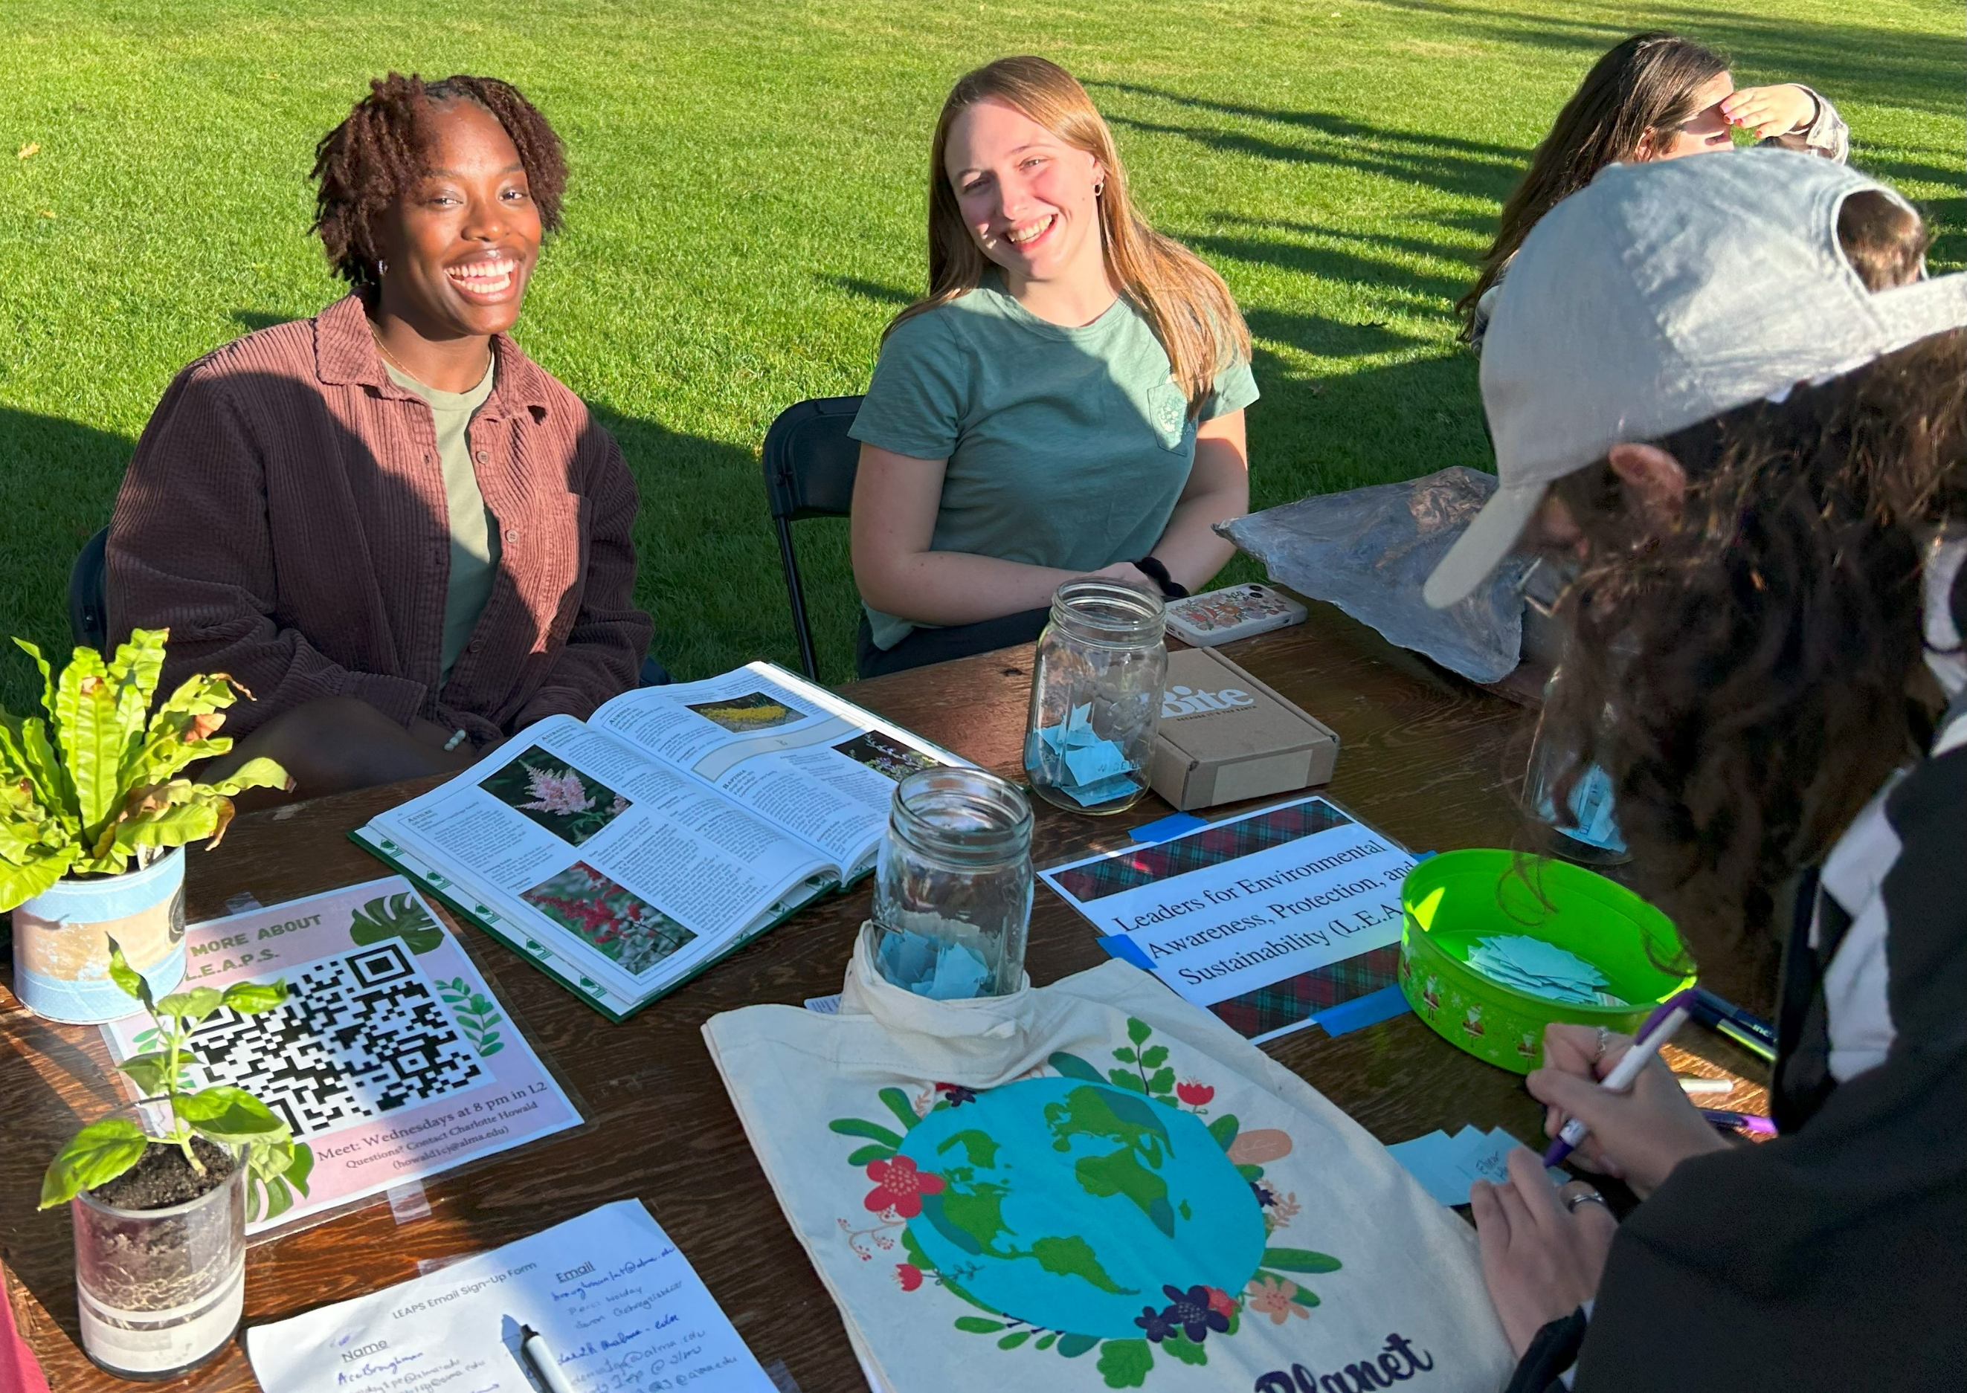

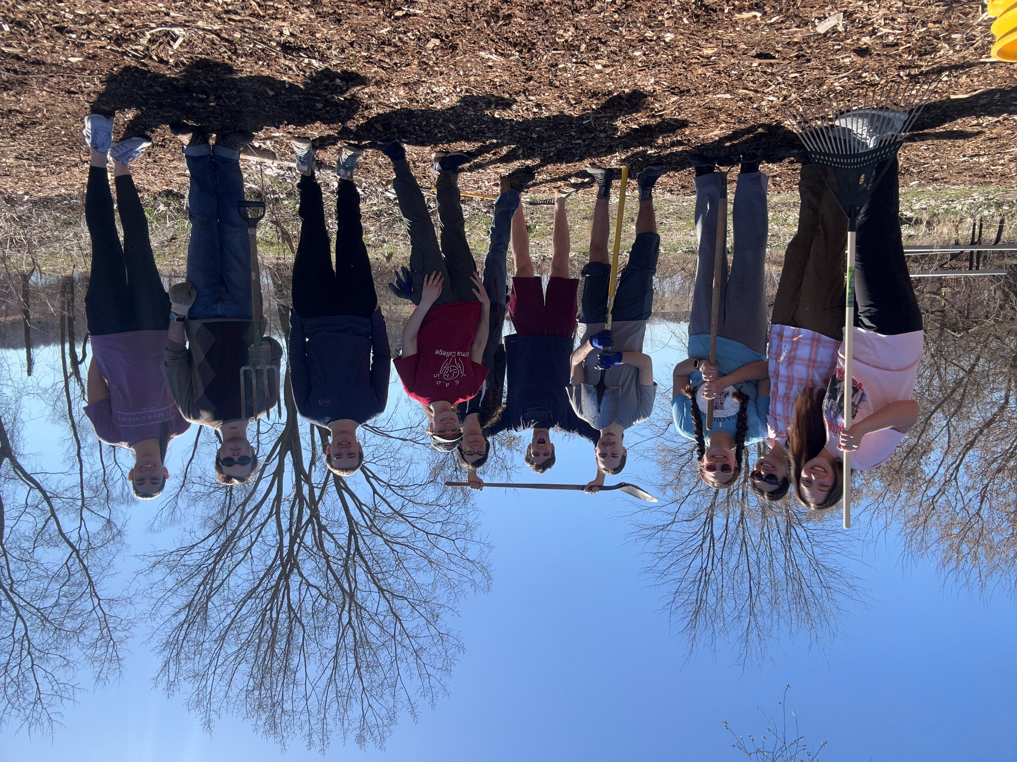
Alma College’s LEAPS student organization
Leaders of Environmental Awareness & Sustainability
LEAPS has joined HPR as a representative group that brings younger perspectives, knowledge, and expertise to our organization
LEAPS students have been involved in summer water testing and various research projects for HPR
LEAPS host numerous events throughout the school year at the college
Next Year they hope to become more community involved
Notes:
Speaker: Shadain
Annoucment $$ contributions

Slide 16
Research is fundamental to what HPR does….
These are projects by Alma College interns, some funded by HPR
Studying the relationship between the State Street Dam & Alma Reservoir (impoundment) – Faron Grossman & Jaci Dietz (HPR interns)
The Poop Study – Chelsea Faber (AC intern)
The Fishing Study – regarding E.coli
Understanding the Pine River & Upper Pine River Watershed – Margaret Selmon & Karalyse Hagan (AC interns)
HPR funds the Summer Water Testing conducted by Alma College
Notes:
Speaker: Shadain/Charlotte
Faron/Jaci Dam-Impoundment relationship

Slide 17




We are thankful for our Municipal Support
For the Funding, grant letters of support, continued direction
City of Alma – City Manager Aeric Ripley, Mayor Greg Mapes, City Services director Dave Ringle
City of St. Louis – Kurt Giles – city Manager, Mayor,
County Commissioner – George Baily
County Parks & Recreation Director – Jonathon Rayburn
Notes:
Speaker: Tim
negative impact communties & rec

Slide 18



HPR believes in Advocacy for our environment….getting involved
We belong to these networks
HPR belongs to:
Michigan Environmental Council (MEC) – the largest and strongest environmentalist group in the state (lobbying group in Lansing)
MI Nonprofit Association – assisting 501(c)(3) “not for profit” organizations like HPR in how to move forward and build capacity.
River Network – a nationwide organization of groups like HPR that exist solely promote and support healthy rivers throughout our country.
Notes:
Speaker: Dave
New to River Network & MI Nonprofit Assoc.

Slide 19
The process of Opening up the Confluence between
Honeyoye Creek & County Drain 96 has involved the following….
County Drain Commissioner – Bernie Barnes
Triterra, Alma Office – Director, Garnet Johnson
Streamside Ecological Services – Mike Nurse
EGLE officials – Jeff Pierce & Nick Padula
Property owners along Honeyoye Creek
An EGLE permit is obtained by the drain commissioner to allow the removal of sediment through dredging is essential.
The confluence area is plugged with 6’ of sediment. The removal of the sediment will restore flow, navigation, recreation, and drain function.
Notes:
Speaker: Garnet

Slide 20
HPR continues to seek grant funding at the regional, state, and federal level related to our mission and goals…
A Tough Reality in the grant writing world….it is very competitive. HPR has written many grants between 2018 and the 2022.
2023 saw 3 grant awards:
    Michigan Nonprofit Association – Grant for $10,000 for Covid-19 relief
    Gratiot County Community Foundation grant for water testing and research $7,500
    EGLE Watershed Council grant for capacity building for $31,400
    EGLE Dam Risk Reduction grant request - Feasibility Study for $500,000
Notes:
Speaker: Chuck

Slide 21
Developing Relationships in Gratiot County
We are thankful for the Guidance, Direction, and Support given to HPR regarding grant development and project/priorities assistance
Greater Gratiot Development – Jim Wheeler, Kasey Zehner
St. Louis Downtown Development Authority – Phil Hansen
Gratiot Area Chamber of Commerce – Sara Bonnacci
Thanks for the many grant letters of support, funding guidance, and project/priorities direction
Notes:
Speaker: Tim

Slide 22
HPR strives to bring into each membership meeting a speaker with expertise on topics related to our river and environment. We are very appreciative of our speakers at our monthly membership meetings.
Speakers this past year:
Dr. Murray Borrello, Alma College (Annual Water Testing updates)
Dr. Tim Keeton, Alma College (anti-bacterial resistance)
Dr. Ben Peterson, Alma College (Social Surveying)
Meredith Lapointe, TV 9 & 10 News – Cadillac (the state of the Pine River)
Megan Tinsley & Ellen Vial - Michigan Environmental Council – (water advocacy)
Jan. 24 – Laura Campbell, Farm Bureau (bio-digesters)
Feb. 24 – Cheri Meyer & Barney Boyer, EGLE (our state waters, CAFO, grants)
Mar. 24 – Logan Banning, Wildlife Biologist, GCD (filter strips & wildlife)
Notes:
Speaker: Mike
those here please stand

Slide 23
HPR’s Friends Campaign coming soon……
Thank you to the following folks we consulted with:
Anne Sanders & Eli Hall – Gratiot/Isabella United Way
Chelsea Holmes Matz, Carolyn Studley, & Tim Lambrecht– Gratiot County Community Foundation
Jim Wheeler & Kasey Zehner – Greater Gratiot Development, Inc.
Dave & Marge Roslund
Jeff Abernathy, Dr. Ben Peterson, Robert Murray – Alma College
Phil Hansen – St. Louis Downtown Development Authority
Sara Banacci – Gratiot Area Chamber of Commerce
Garth Anderson – Commercial Bank
Notes:
Speaker: Chuck

Slide 24
A special thanks to our HPR members
Currently numbering over 350 annual dues paying memberships
Your funds pay for the annual water testing by Alma College
Your funds initially paid for our Septic Liaison work
Your funds helped us hire our part-time Director
Your funds helped contribute to Alma College interns conducting research
Your funds helped fund part-time work for outreach projects like this
Notes:
Speaker: Barbara

Slide 25
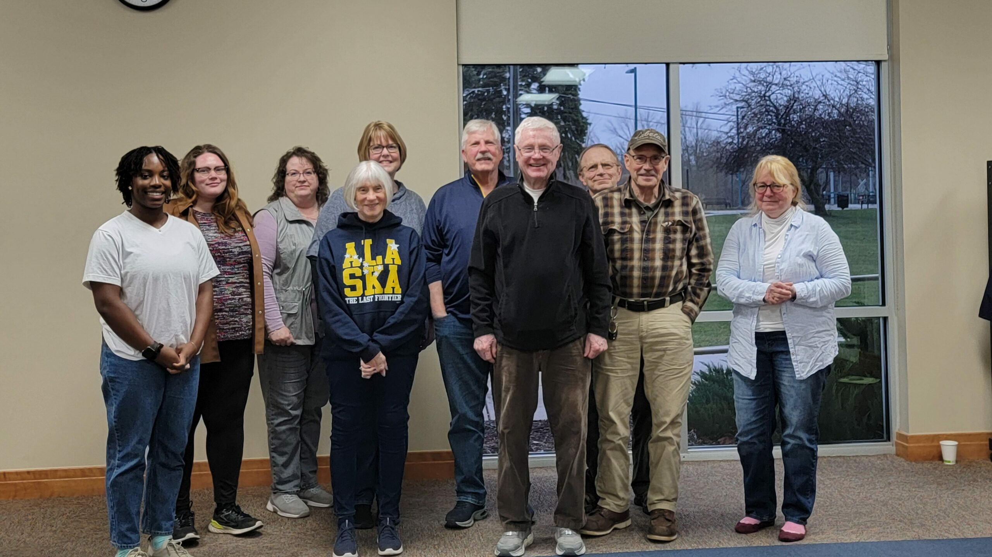
Thanks to our HPR Board & Officers
For the extra meetings, hours, work, and the caring and sharing!
HPR Board members/officers & Organizational Representatives
Ladean Anderson, GCD
Garnet Johnson, Triterra
Murray Borrello, Alma College
Shadain Pink, LEAPS rep
Justin Barnaby
Tim Lambrecht
Barbara Chovanac
Mike Oberlitner
Brittany Sommerville, Director
Lynn Sandro, Treasurer
Sue Joyce, Secretary
Dave Shephard, Vice Chair
Gary Rayburn, Co-Chair
Chuck Sandro, Co-Chair
Notes:
Speaker: Brittany

Slide 26
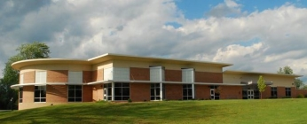
Thank you to the Alma Public Library
For allowing us to use their meeting room after hours.
Assistance with the setup of our meetings.
Providing and helping with equipment.
Notes:
Speaker: Sue

Slide 27
What are our real goals?
To see a canoe/kayak livery on the river in the Alma/St. Louis area
To see more boats launched at Pine River Park & St. Louis Leppien Park
for fishing and recreating
To see the Alma & St. Louis impoundments free of excessive vegetation and Alga matts/blooms.
To see fishing contests that are full of participants fishing in a clean river
To see an annual Pine River Cleanup & Celebration Day!
To see more frogs and turtles….and water wildlife on/near the river
To navigate the Pine River Canoe Trail without log jams and litter
To see development along our river that makes a positively impact
When viewing the Pine River it is seen as a beautiful natural resource that is aesthetically appealing and there is a desire to live on or near the river
Notes:
Speaker: Chuck

Slide 28
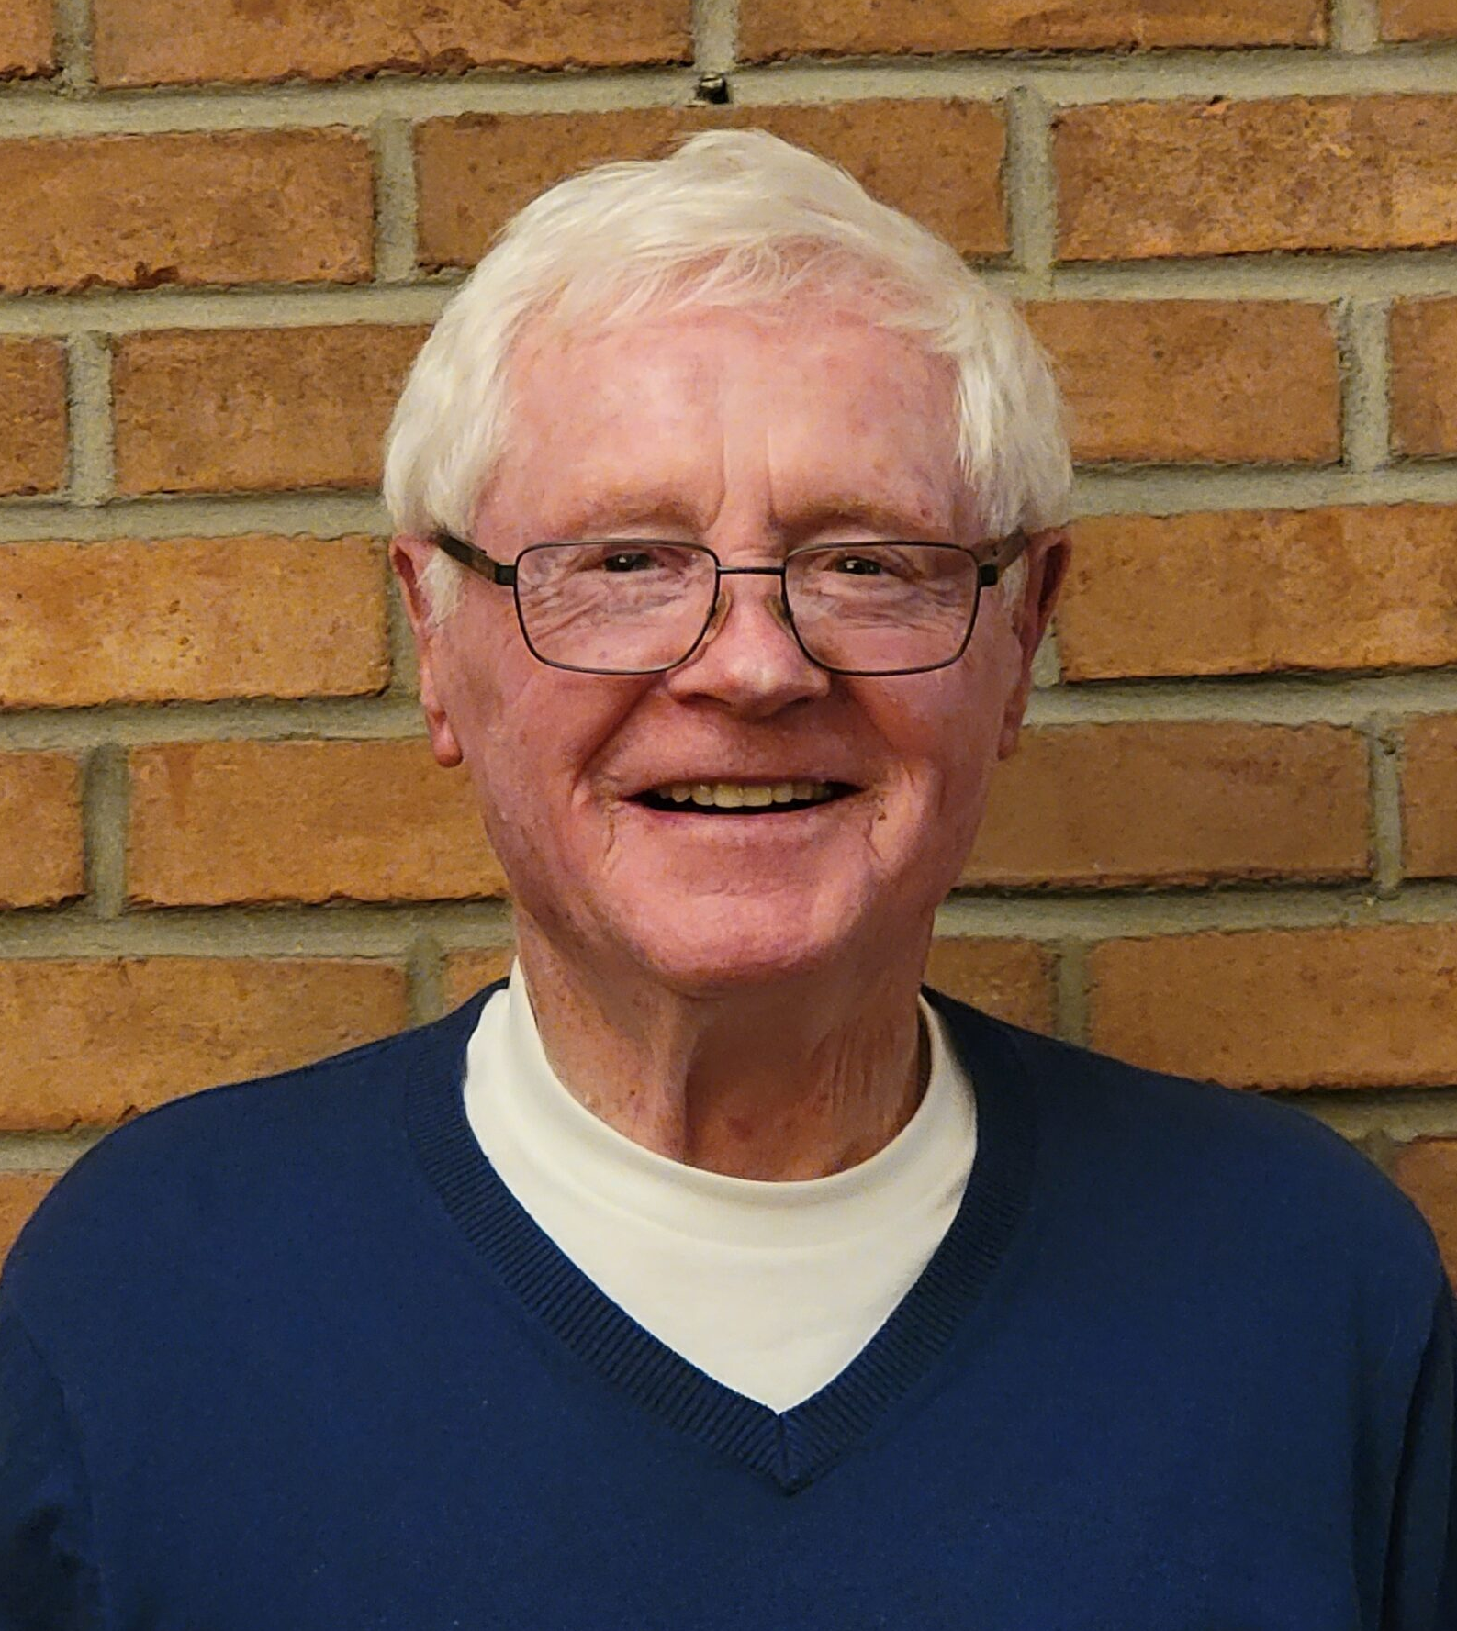
A special thanks goes to our Chairperson Gary Rayburn
Who with the help of some concerned neighbors formed HPR in 2015 as an incorporated “not for profit” 501(c)(3) organization.
Gary’s vision and drive has pushed our current HPR membership to over 350 annual dues paying members…who also donate too.
His willingness to seek help and collaborate has led to a special partnership with Alma College.
His ongoing commitment to HPR has truly made a difference!
Thanks to Gary for “living” his special quote from Margaret Mead:
Notes:
Speaker: Sue/Lynn
glasses & treats

Slide 29
The quote Gary has lived and led by….
“Never doubt that a small group
of thoughtful, committed citizens
can change the world, indeed,
it’s the only thing that ever has” Margaret Mead
Notes:
Speaker: Chuck
Plaque

Slide 30
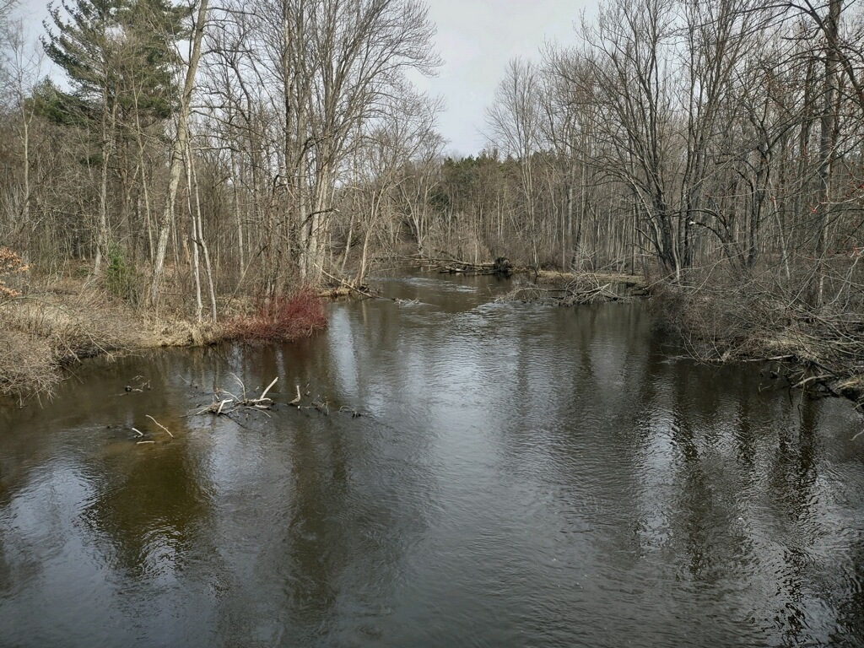
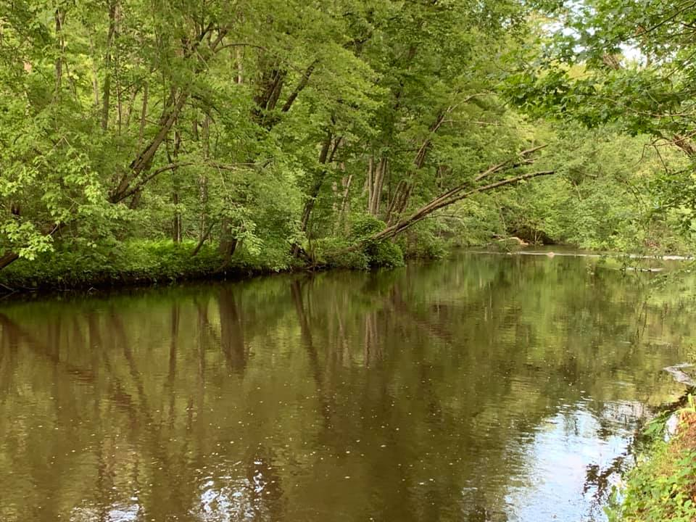
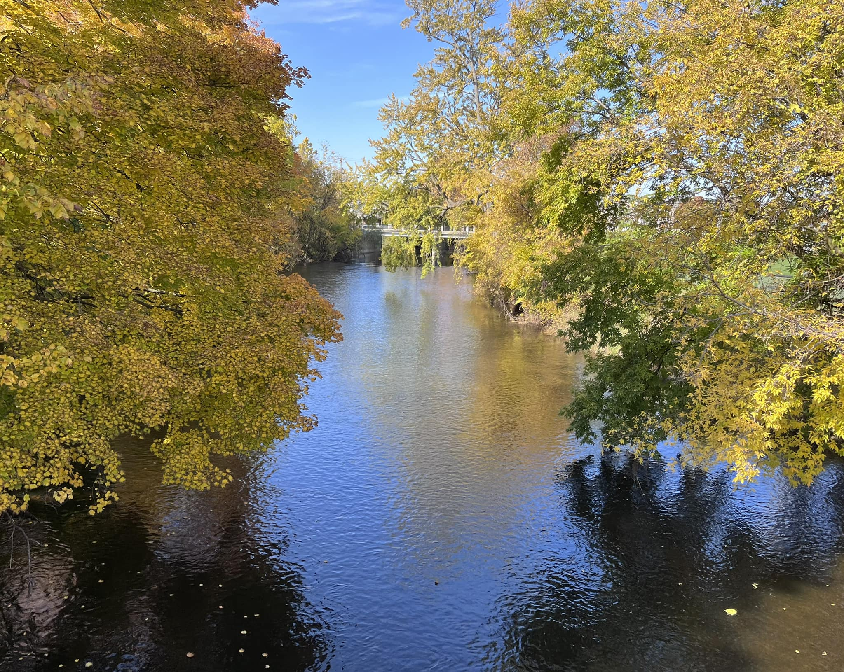
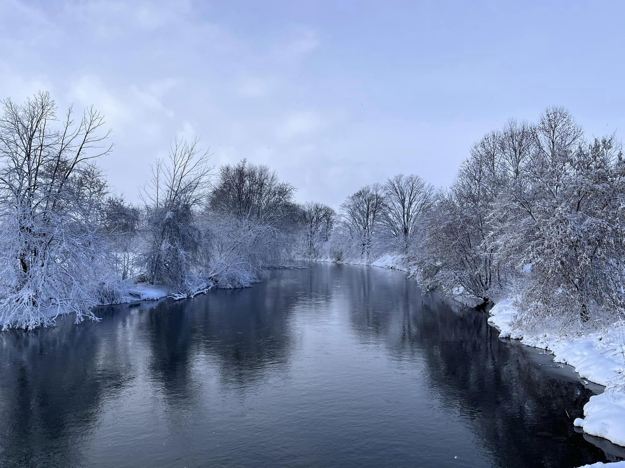
We Need your help….please give thought to helping us make a difference by volunteering for HPR.
“Being involved in HPR is not
the easy or convenient thing to do….
but it is the right thing to do….
For our river, for our environment,
But most of all for our kids, and their kids.”
Notes:
Speaker: Brittany

