Slide 1
Summary of Data from Summer, 2023 Testing on Pine River, Upper Saginaw River Drainage Basin
Central, Lower Peninsula, Michigan
Alma College Program of Environmental Studies
Alma College Great Lakes Watershed Institute
M. Borrello, Director and Chair

Slide 2
Introduction
Sampling sites were selected based on previous sample results
Funding was supported by Alma College, and the Healthy Pine River Group
Focus was given to downstream sites as St. Louis residents have complained about recent algal blooms
Equipment used was calibrated and new water sources were installed for deionized water

Slide 3
Methodology
Followed State of Michigan and U.S. EPA field and lab protocols
  See Mitchell and Stapp, 1997
Error bars were less than what would appear on graphs
Statistical Analyses were conducted (ANOVA and t-tests for significance)
For more information, contact M. Borrello at borrello@alma.edu

Slide 4
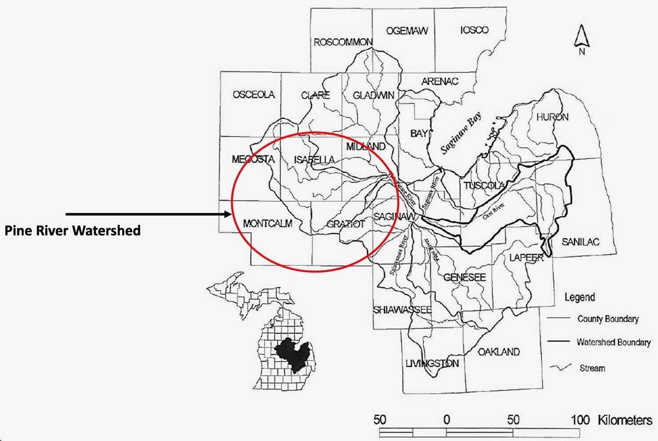
Field Area: Sampling Area
SAGINAW RIVER DRAINAGE BASIN

Slide 5
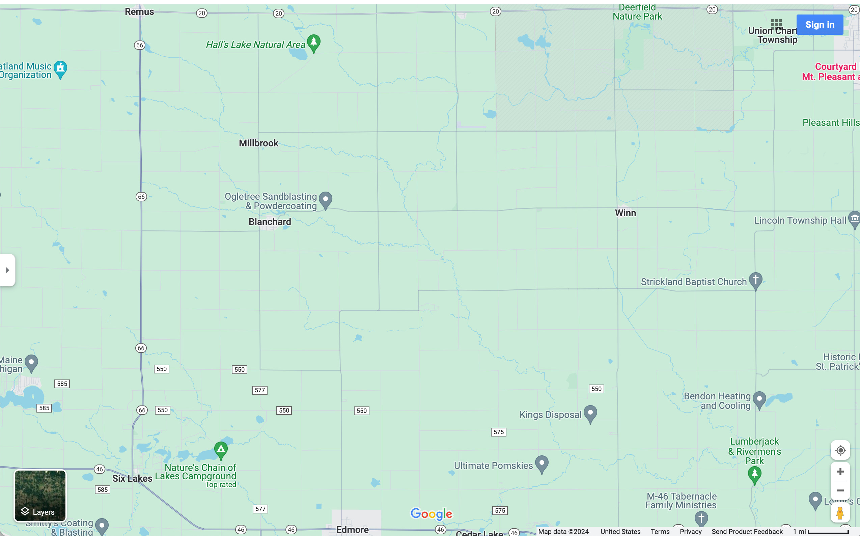
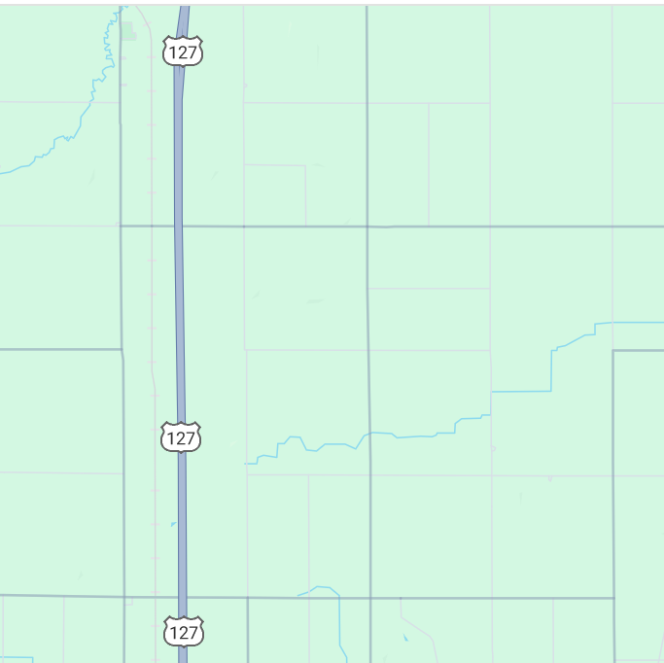
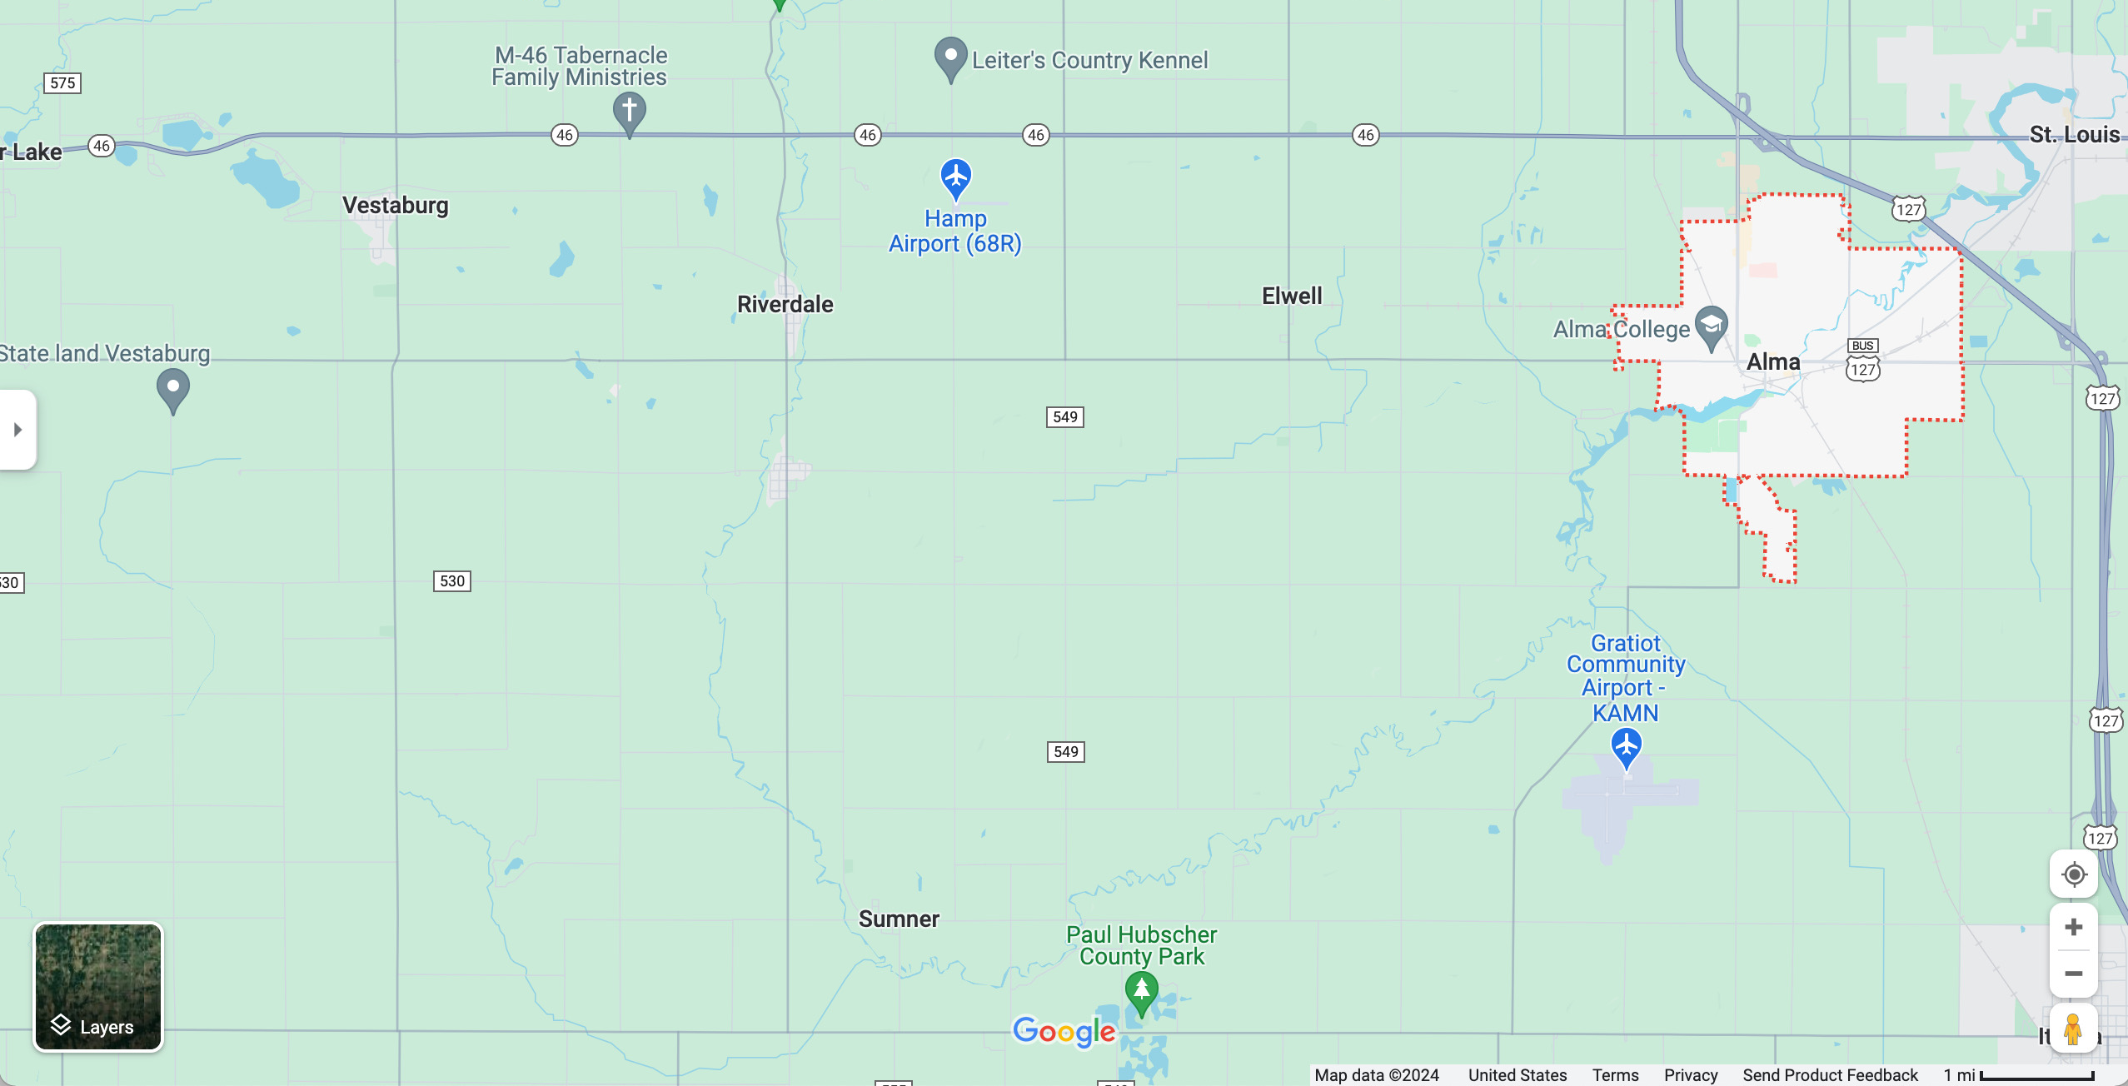
S. Rolland Rd
Thatcher Cr. At Blanchard Rd
Thatcher Cr. At Freemont Rd
Upper Watershed
Sampling Sites
Downstream
Sampling Sites
Lumberjack Park
Sugar Cr. Sites
Control Sites
PR at Cheesman
Horse Cr at Evergreen
Riverdale
PR at Bridge St.
Honeyoey Cr.
Alma Boat Launch
McBride Rd (PR)
Harrison Rd (PR)
Mid-Section
Sampling Sites

Slide 6
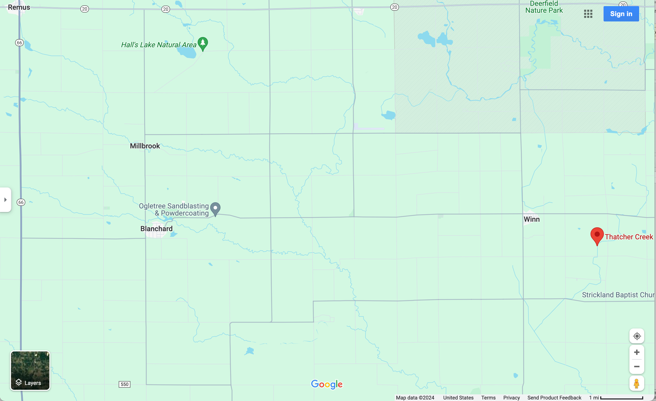
UPSTREAM SITES (HEADWATERS) OF PINE RIVER
S. Rolland
Thatcher Cr. At Blanchard
Thatcher Cr. At Freemont

Slide 7
Nutrient Results: Upper Pine River Watershed w/ Sampling Sites
Nutrient Concentrations
for Healthy Stream
Mg/L

Slide 8
Results: Nutrient Averages for Upper Pine River Watershed
Mg/L
Nutrient Concentrations
for Healthy Streams
Mg/L

Slide 9
Results: Thermotolerant E. coli Upper Pine River Watershed w/Sampling Sites
Concentration Above Which Poses Human
Health Risk for Direct Contact
CFU/100mL

Slide 10
Thermotolerant E. coli Concentration Averages for Summer, 2023 – Upper PR Watershed
CFU/100mL
Concentration Above Which Poses
Health Risk for Direct Contact

Slide 11
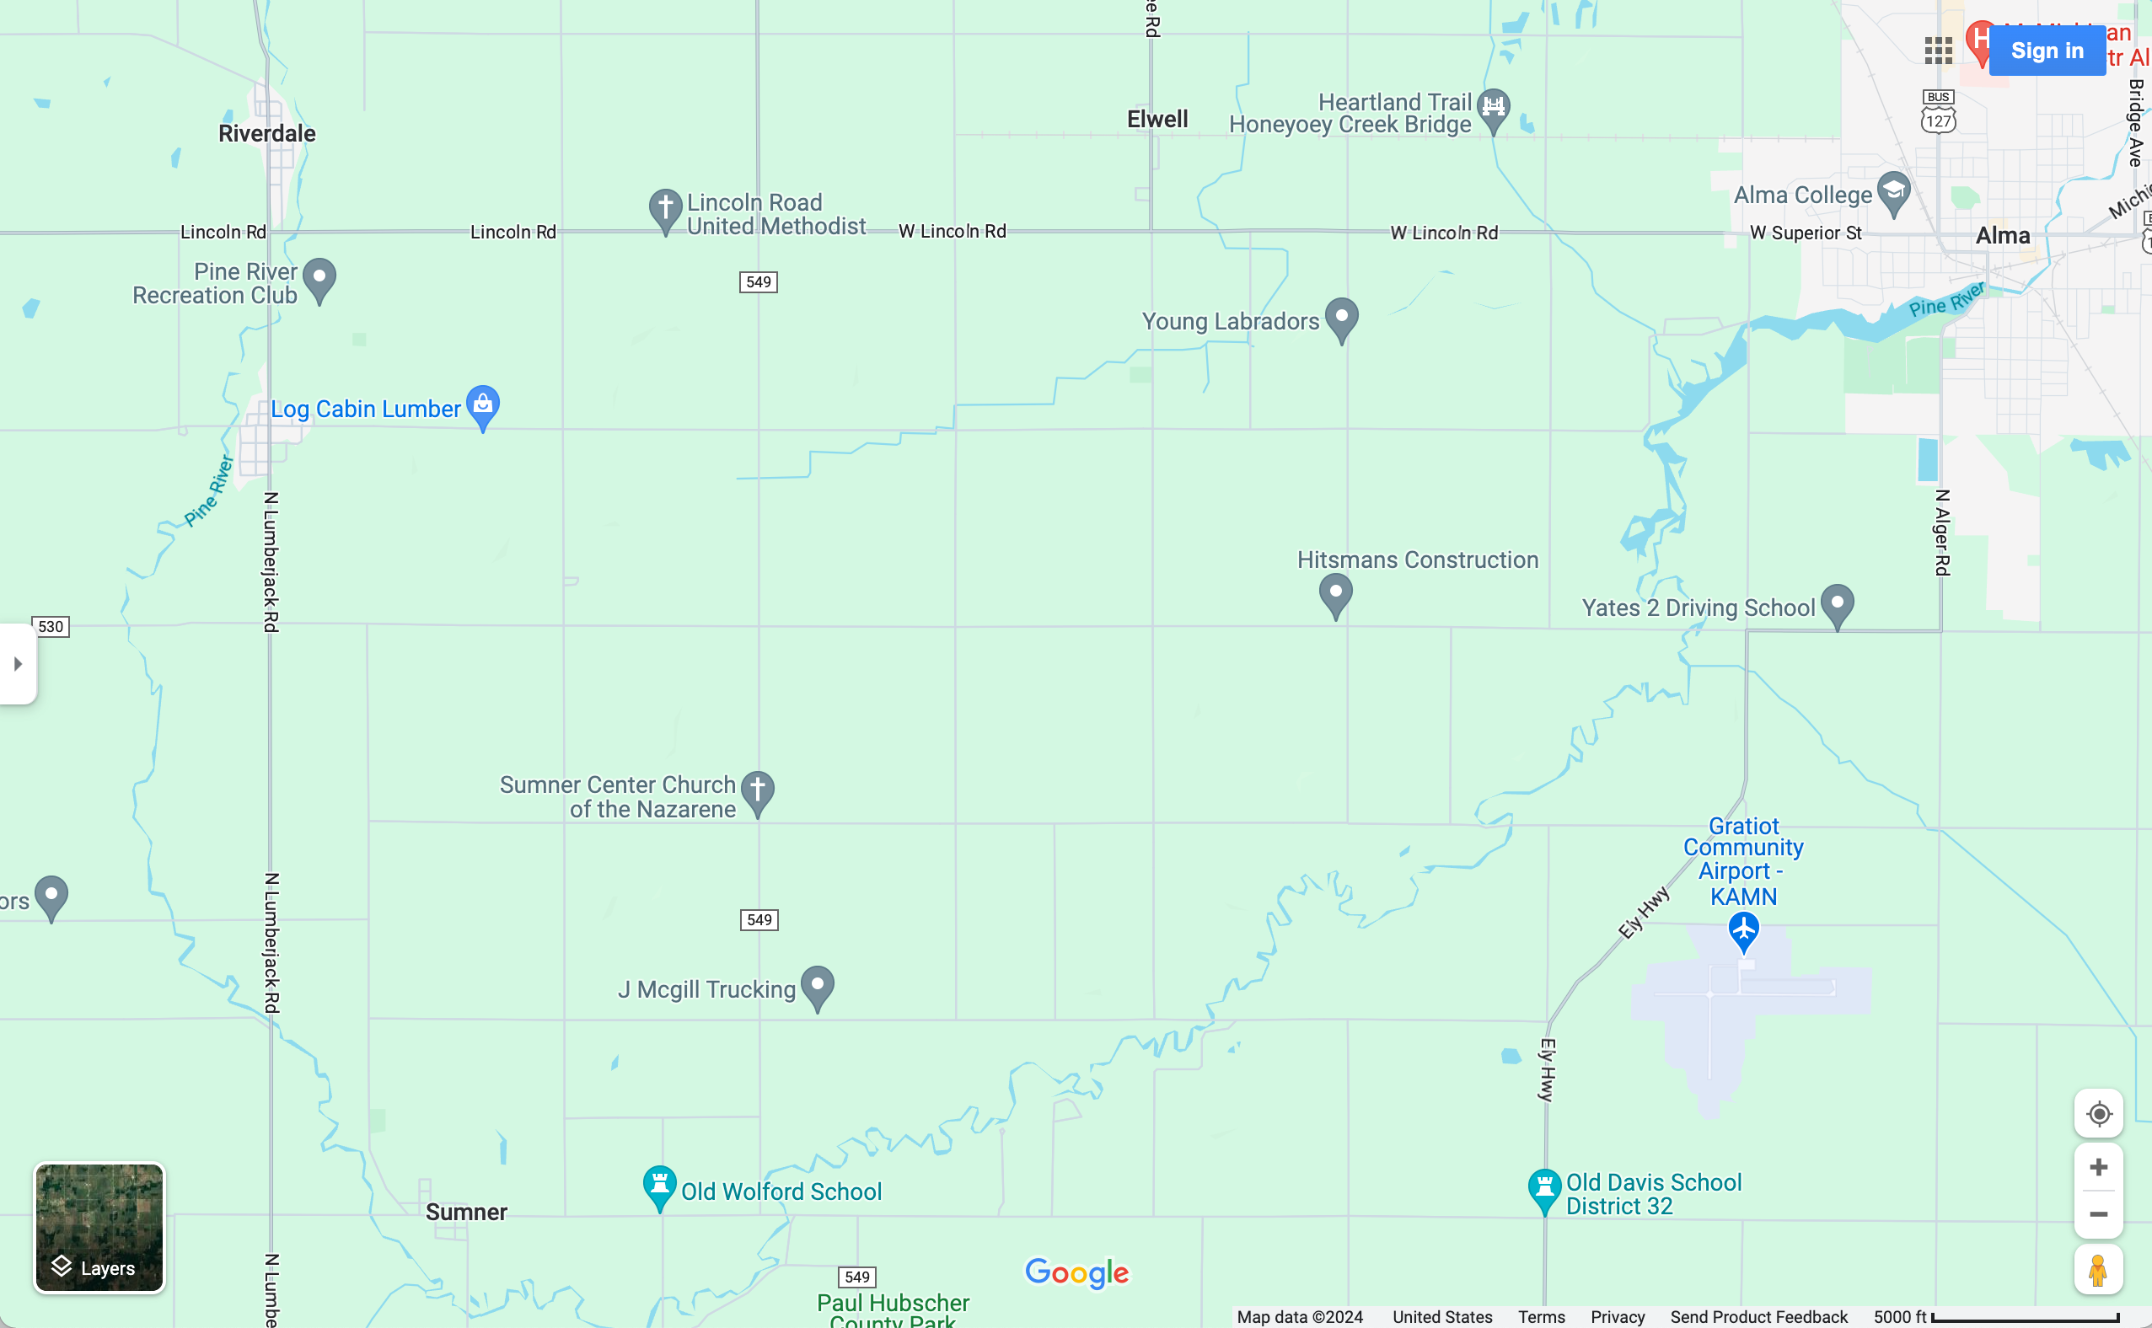
MID-SECTION SITES OF PINE
RIVER WATERSHED
Honeyoey Creek
Alma Boat Launch
PR at McBride
PR at Harrison Rd

Slide 12
Results for Nutrients: Mid-Section of Pine River Watershed with Sampling Sites
Nutrient Concentrations
For Healthy Streams
Mg/L

Slide 13
Results: Nutrient Averages for Mid-Section Pine River Watershed
Nutrient Concentrations
For Healthy Streams
Mg/L
Nutrient Concentrations
For Healthy Streams
Mg/L

Slide 14
Results: Thermotolerant E. coli Concentrations – Mid-Section w/Sampling Sites, PR Watershed, Summer, 2023
Concentration Above Which Poses
Health Risk for Direct Contact
CFU/100mL

Slide 15
Thermotolerant E. coli Concentration Averages for Summer, 2023 – Mid-Section PR Watershed
Concentration Above Which Poses
Health Risk for Direct Contact
CFU/100mL

Slide 16
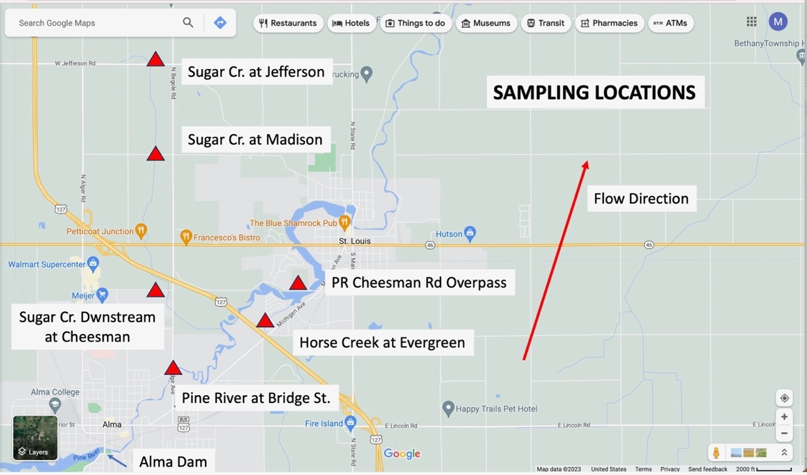
Downstream Sites

Slide 17
Results: Nutrient Concentrations Downstream Sites Pine River Above St. Louis Dam, Summer, 2023
Nutrient Concentrations
For Healthy Streams

Slide 18
Results: Thermotolerant E. coli Concentrations for Downstream Pine River Watershed w/Sampling Sites
CFU/100mL
Concentration Above Which Poses
Health Risk for Direct Contact

Slide 19
Results: Ave. Thermotolerant E. coli Concentrations for Downstream Pine River Watershed Above St. Louis Dam, Summer, 2023
CFU/100mL
Concentration Above Which Poses
Health Risk for Direct Contact

Slide 20
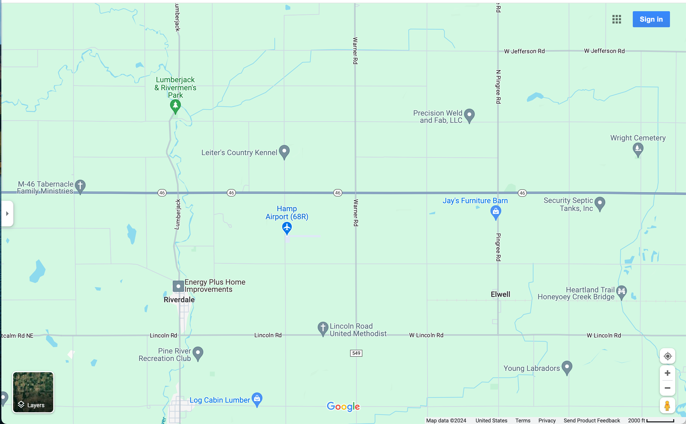
CONTROL SITES OF PINE
RIVER WATERSHED
PR at Lumberjack
PR at Riverdale

Slide 21
Results: Nutrient Concentrations Control Sites, Pine River Watershed, Summer, 2023
Mg/L
Nutrient Concentrations
For Healthy Stream

Slide 22
Results: Thermotolerant E. coli Concentrations for Control Sites, Pine River Watershed, Summer, 2023
Concentration Above Which Poses
Health Risk for Direct Contact
CFU/100mL

