Slide 1
Too Much Waste for Available Space?
Murray Borrello and Chelsea Faber
Alma College, Alma, MI 48801
A

Slide 2
Livestock -Human Equivalent Population
Notes:
DEEP BREATH!

Slide 3
Population
Livestock- Human Equivalent Analysis
Notes:
TWO PARTS DOWN, TAKE A BREATH

Slide 4
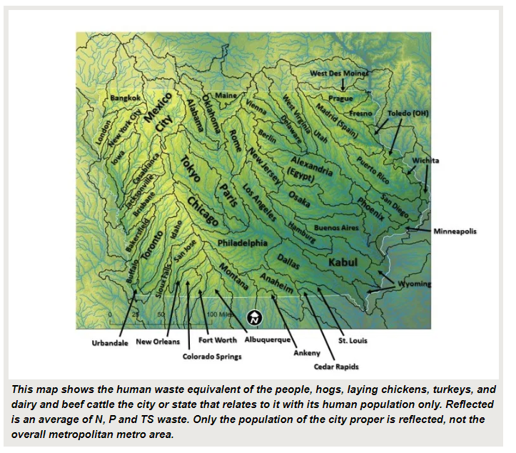
Iowa Study
Chris Jones
Using USDA Census of Agriculture data and livestock/human waste models to establish relative populations within a watershed
Main point: if all waste created in Iowa was created by humans and not humans + livestock, how many people would that equate to?
https://www.iihr.uiowa.edu/cjones/iowas-real-population/

Slide 5
Approximate Nutrient Content Conversion Models
Livestock Data from Midwest Plan Service (MWPS)
Human Data from Iowa/Jones source
After consideration, the two sources were not considerably different.
MWPS included key components not listed in Iowa/Jones.

Slide 6
Livestock Data from Midwest Plan Service
https://www.canr.msu.edu/uploads/files/ManureCharacteristicsMWPS-18_1.pdf

Slide 7
Human Data from Iowa/Jones Study
http://agrienvarchive.ca/bioenergy/facts.html#Approximate_nutrient_content

Slide 8
Livestock - Human Equivalent Population
Sorted by County
Calculated for each county that had a CAFO (42 total)
Separated into:
CAFO/AFO
Non CAFO/AFO
All farms
Compared to 2017 human population
2017 used due to USDA Ag Census data
Notes:
DOING SO GREAT! BREATHE SISTER!

Slide 9
Livestock - Human Equivalent Calculation: Dairy
Nitrogen
$24,675 AU×\frac{260 g N}{9.1 g N}=705,000 Humans$
Phosphorus
$24,675 AU×\frac{55 g P}{1.8 g P}=753,958 Humans$
Total Solids
$24,675 AU×\frac{7100 g Solids}{160 g Solids}=1,095,953 Humans$
Average of these three values results in total dairy equivalent population

Slide 10
Livestock - Human Equivalent Population
$$Dairy Eq. + Beef Eq. + Swine Eq.+ Layer Eq. =Total Livestock Equivalent$$

Slide 11
Livestock - Human Equivalent Population
$$Dairy Eq. + Beef Eq. + Swine Eq.+ Layer Eq. =Total Livestock Equivalent$$

Slide 12
Livestock - Human Equivalent Population
$$Dairy Eq. + Beef Eq. + Swine Eq.+ Layer Eq. =Total Livestock Equivalent$$

Slide 13
Quantity of Waste and Nutrients Produced

Slide 14
Quantity of Waste and Nutrients Produced
Used MWPS conversion factors and USDA Census of Agriculture (2017) statistics
Found mass of waste produced per county: in lbs/year and converted to kg/year

Slide 15
Volume of Nutrients Calculation - Dairy
Total Solids:
$$20328 AU ×\frac{14.3 lbs/day}{1 au}×\frac{365 days}{1 year}=106,101,996 lbs/year$$
Total Nitrogen
$$20328 AU ×\frac{0.72 lbs/day}{1 au}×\frac{365 days}{1 year}=5,342,198 lbs/year$$
Total Phosphorus
$$20328 AU ×\frac{0.37 lbs/day}{1 au}×\frac{365 days}{1 year}=2,745,296 lbs/year$$
Notes:
HERE COMES THE EXCEL SHEET, BREATHE

Slide 16
Volume of Nutrients Calculation

Slide 17
Application Rates

Slide 18
Application Rates
Found kg/acre year and lbs/acre year through MRA data (USDA)
Considering Phosphorus:
Land available (Manure Acres USDA Census of Agriculture)
Phosphorus removed from soil upon harvest (MSU Report)
County average yield (USDA 2017)
Corn
Soybeans
Wheat
Sugar Beets

Slide 19
Application Rate Calculation
$County Avg yield×P Removed =Rec Amount/Acre$
$\frac{Total P /ManureAcre}{Reccommended Amount/Acre}=Percent Over/Under$
Notes:
B R E A T H E

Slide 20
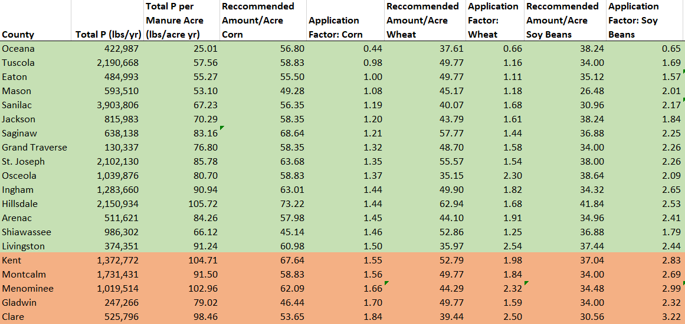
Correlating P Produced With P Required for Selected Crops

Slide 21
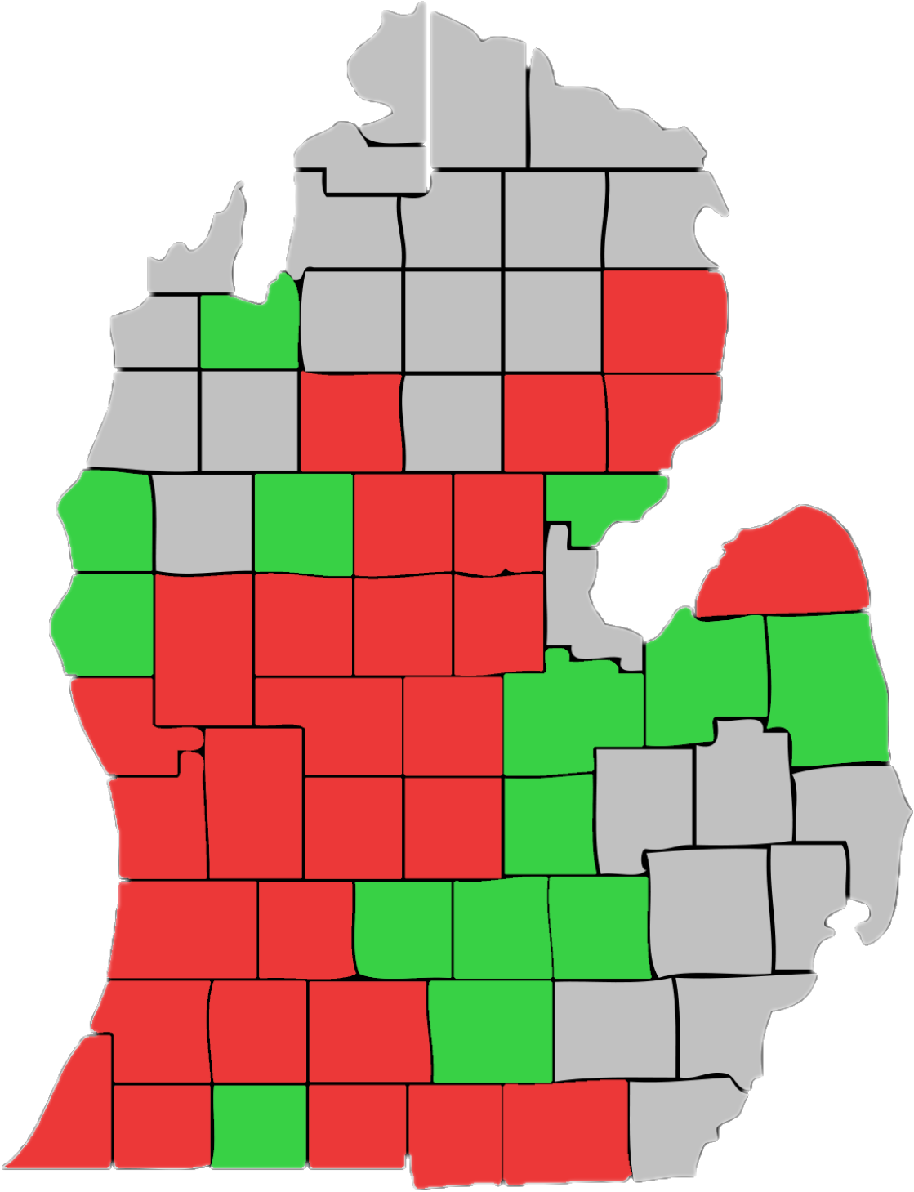
Phosphorus Application Rates: Corn
RED: Counties in which Total Phosphorus from CAFO waste is applied to fields in tonnage of 150% (and up) more than what is required for corn
Green: Counties in which Total Phosphorus from CAFO waste is applied to fields in tonnage less than 150% of what is required for corn
Notes:
ON THE HOMESTRETCH:
BREATHE!!!

Slide 22
County Comparison
 | Allegan | Gratiot | Clare | Ogemaw | Tuscola
Percent MRA | 5% | 9% | 1% | 3% | 7%
MRA (Acres) | 30,845 | 32,116 | 5,340 | 9,948 | 38,057
Total P (lbs/yr) | 9,994,655 | 4,479,174 | 525,796 | 1,138,642 | 2,190,668
% P Applied v P Required | 494% | 244% | 184% | 231% | 98%
(100% is a 1:1 Application Ratio)
Notes:
ALMOST DONE! TAKE A BREATH!!

