Slide 1
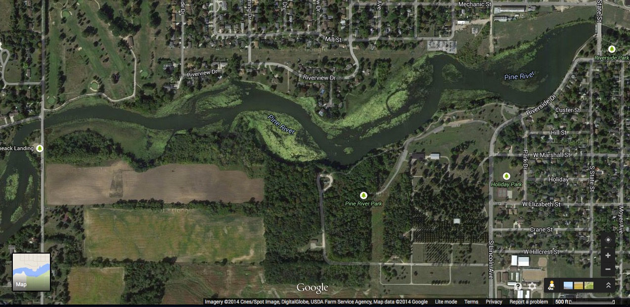
The (Not So) Healthy Pine River
HPR Files
1
By Margaret Selmon for the Healthy Pine River group

Slide 2
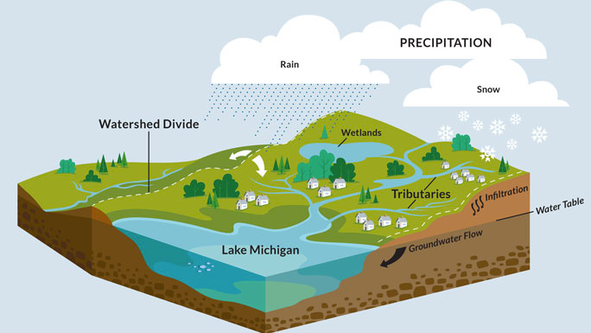
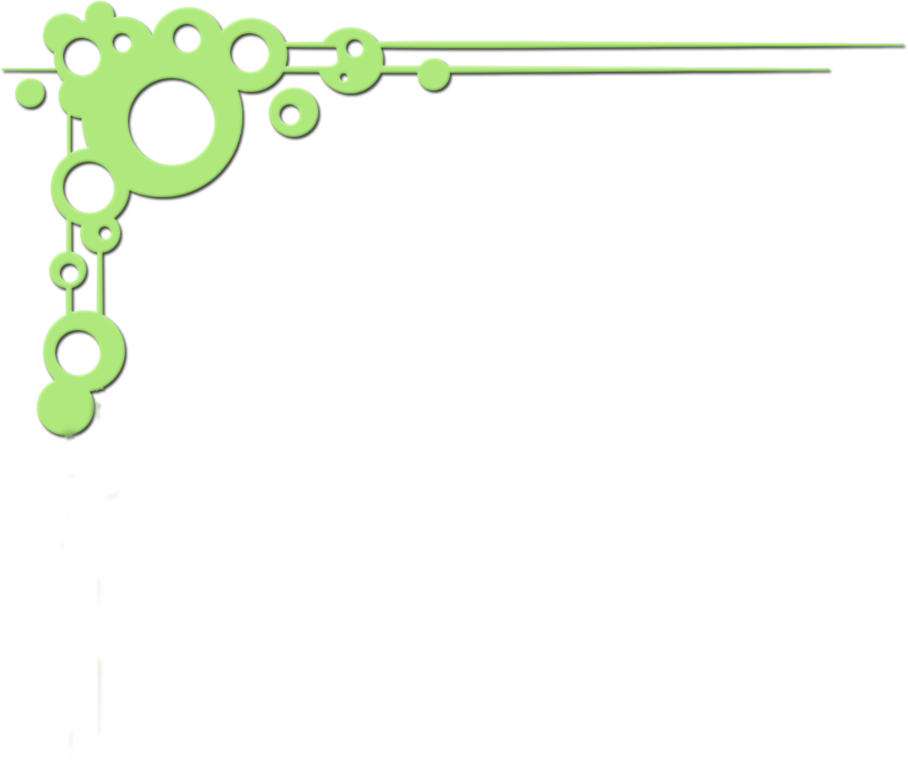
What is a Watershed?
Land area that channels water inflows to a larger surrounding body of water
Water Inflow: Rain, snow, snowmelt
Larger Water Bodies: streams, rivers, lakes, oceans, etc.
2

Slide 3
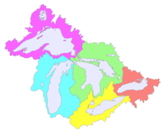
What is a Watershed?
All land is a watershed
Surface water always drains to somewhere
Watersheds can be different sizes, scales
Think of watersheds like a Russian nesting doll
3

Slide 4
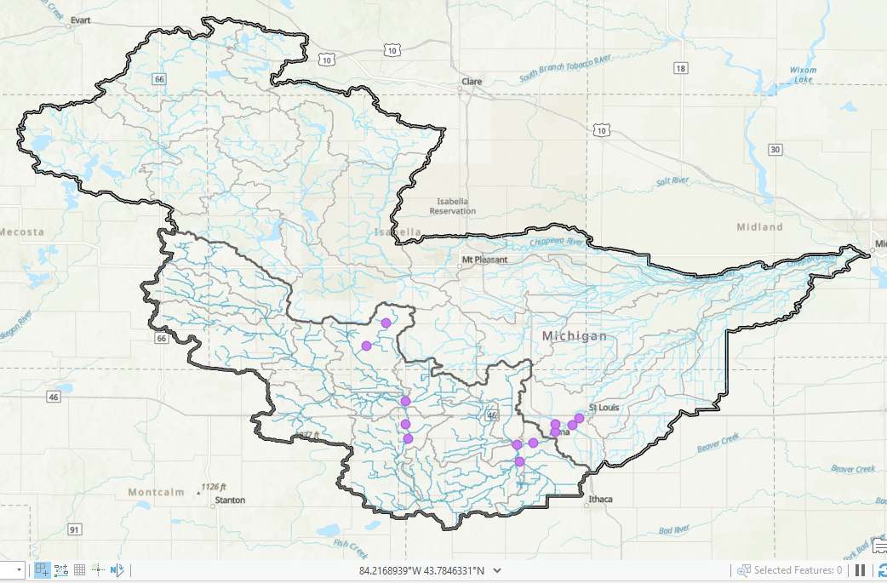
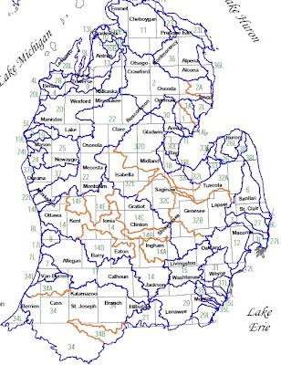
What is a Watershed?
4
5

Slide 5
Upper Pine River Watershed
(UPRW)
309 square miles
12 Sub-watersheds
Parts of Gratiot, Isabella, Mecosta, Montcalm Counties
Approx. 50 miles of Pine River, 45 miles of tributaries
Majority agricultural land use
6

Slide 6
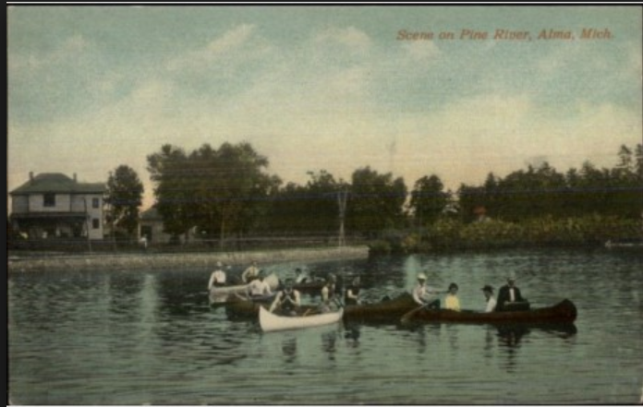
UPRW Water Quality
All state surface waters expected to meet designated uses:
Habitat
Year-Round Partial-Body Contact
Seasonal Full-Body Contact
Agriculture
Public Water Supply
Navigation
Fisheries
7

Slide 7
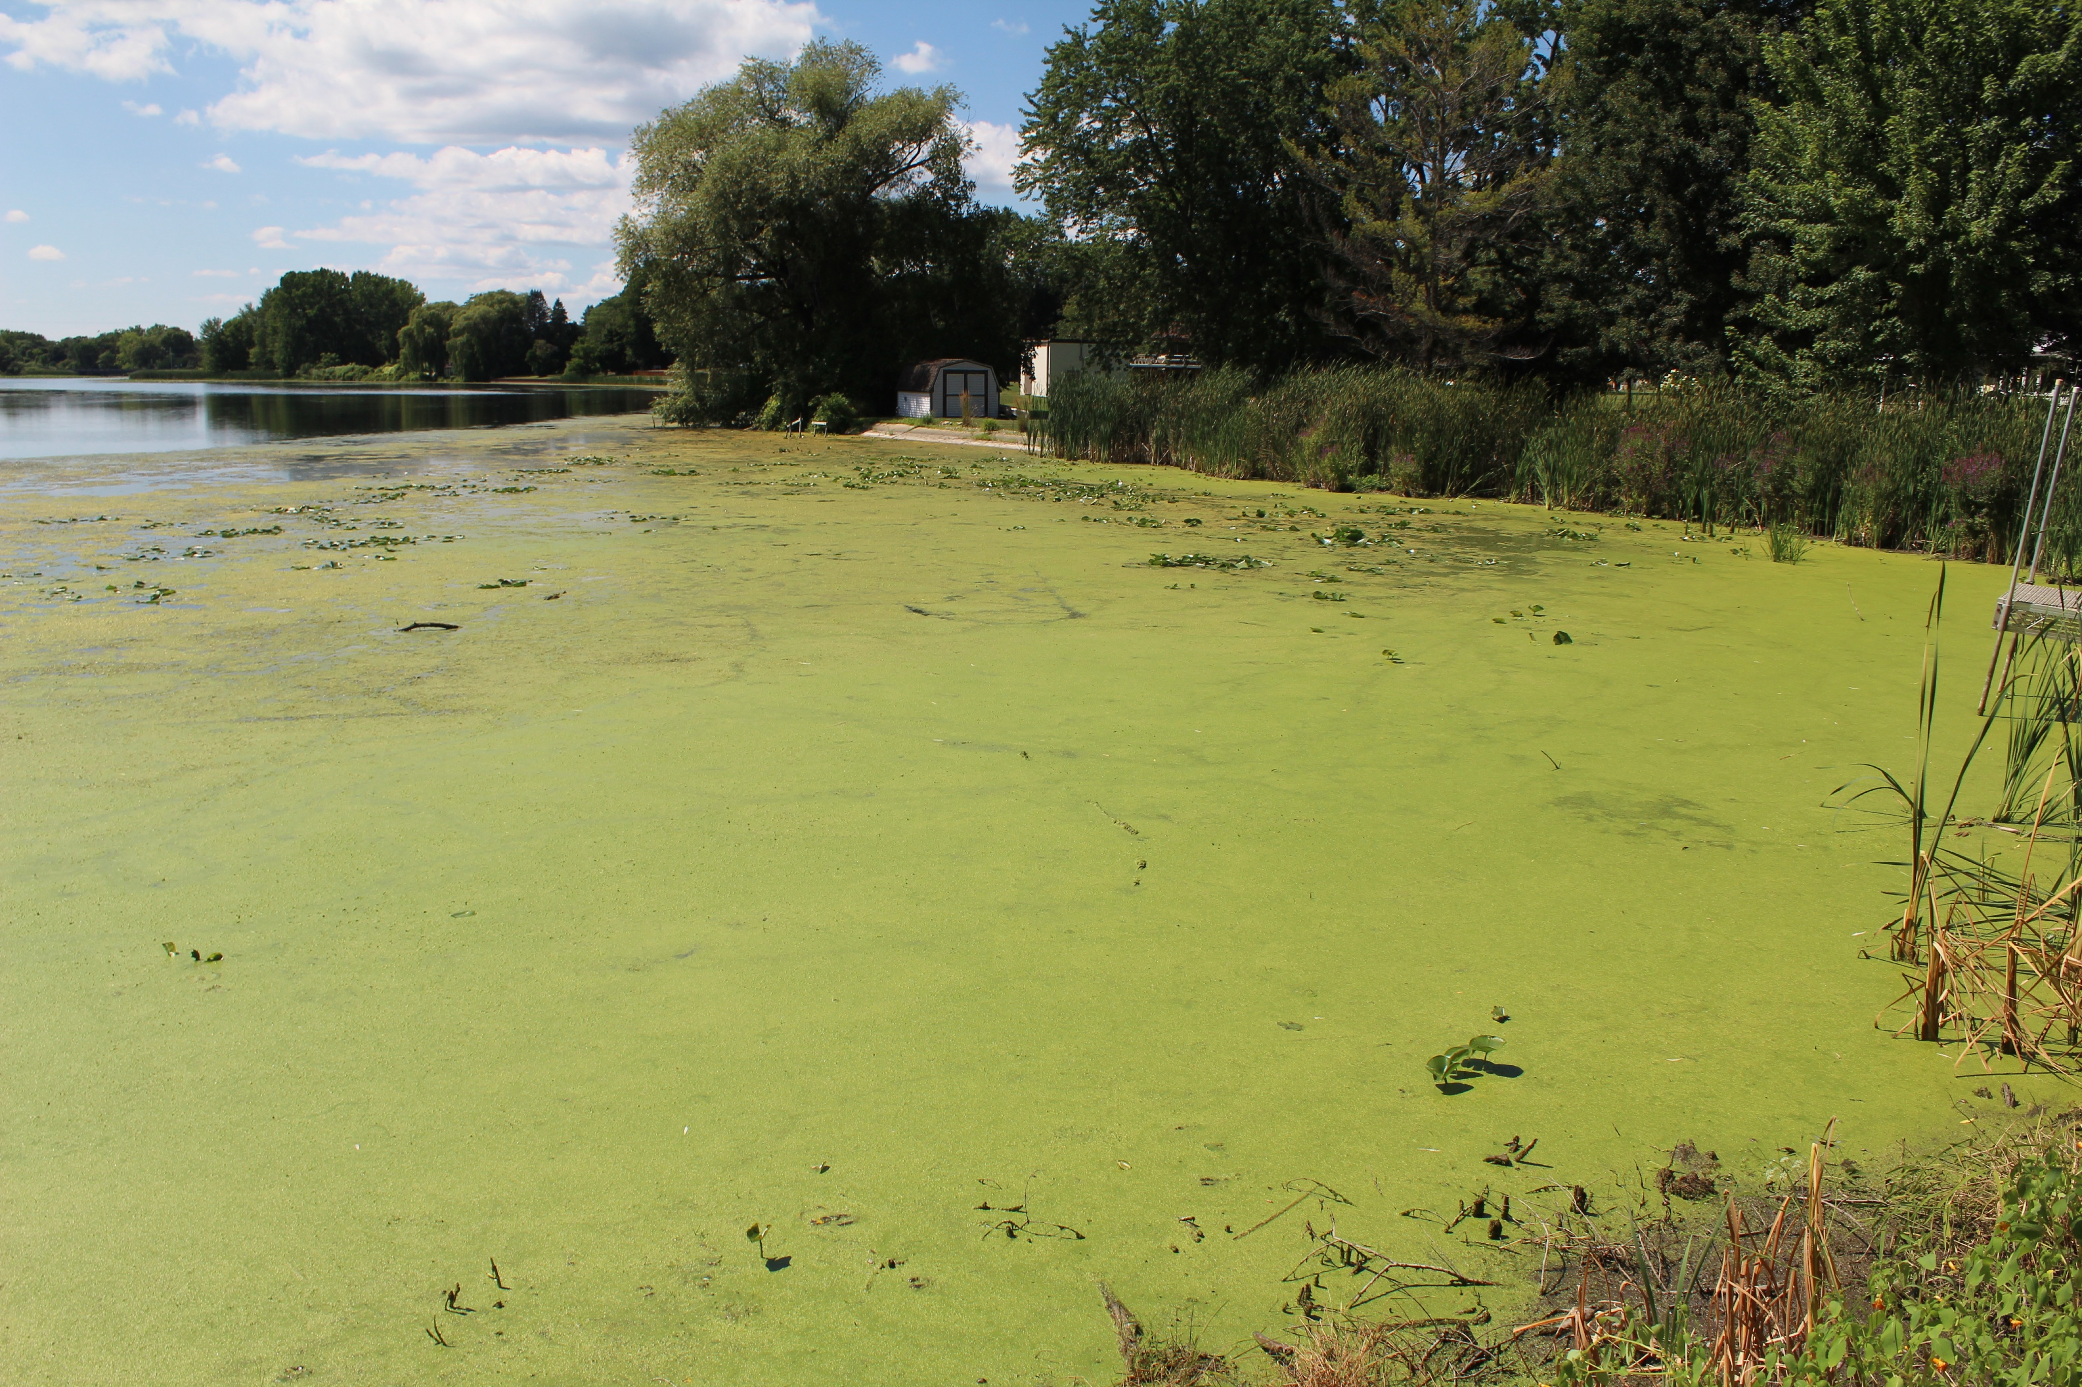
UPRW Water Quality
If ANY use not met, waterway is impaired
Water quality assessed through different metrics
e. coli
nutrients
disolved oxygen
solids
8

Slide 8
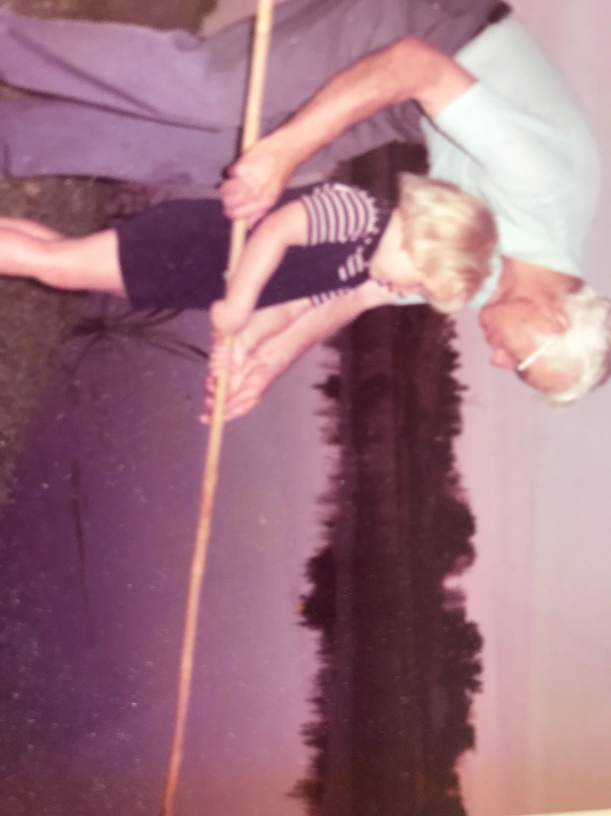
UPRW Water Quality
Impaired / Threatened designated uses:
Total body contact
Fish consumption*
Partial and total body contact
Public water supply
Habitat
Fisheries
Photo Credit: Jane Keon

Slide 9
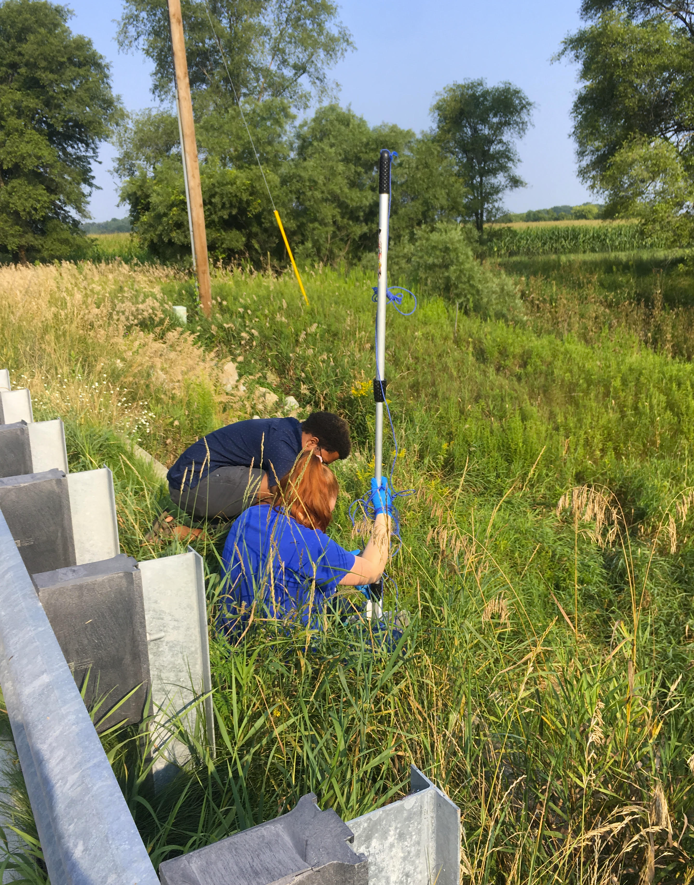
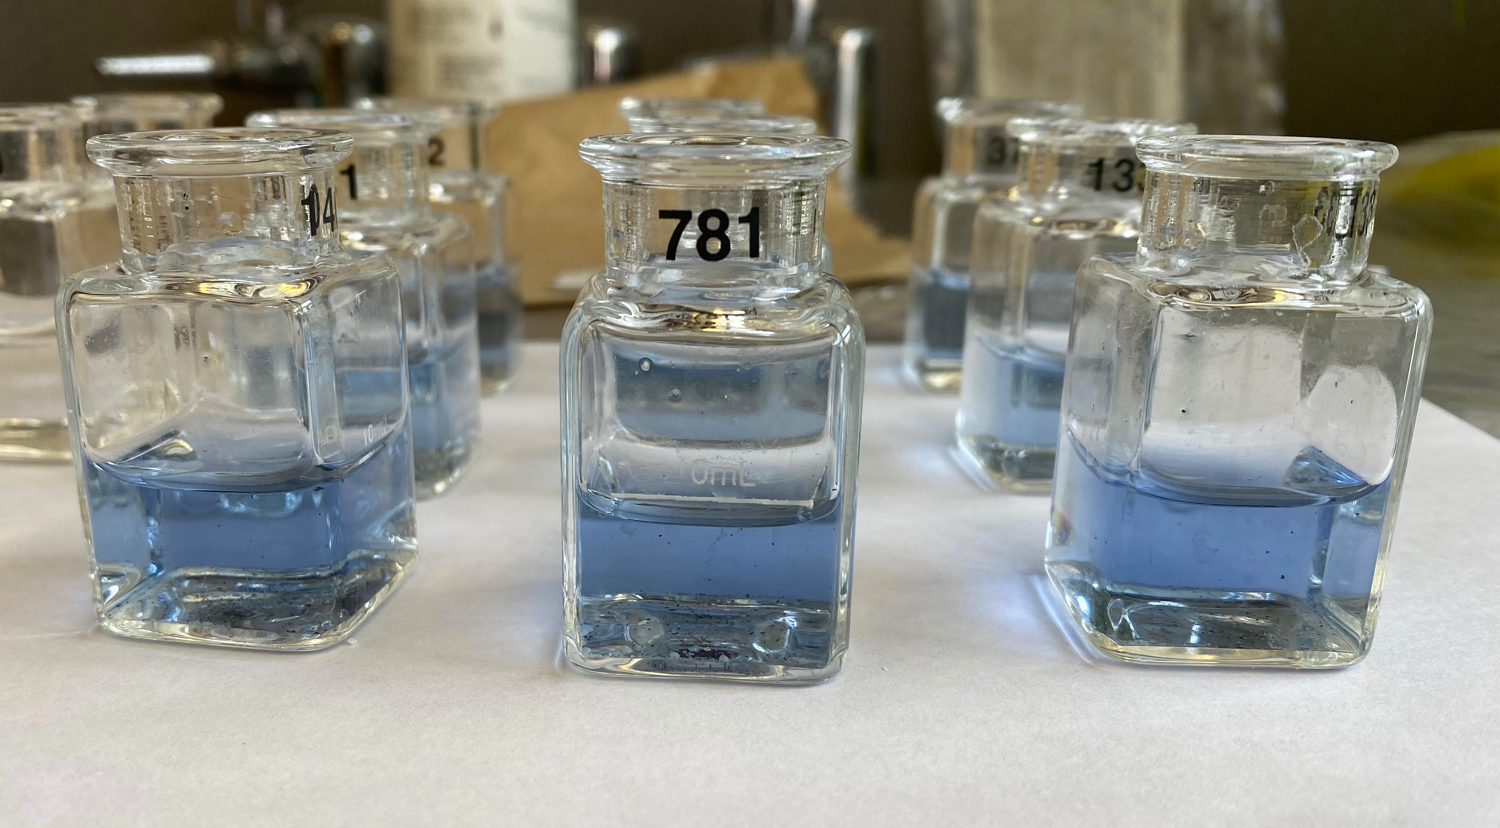
Water Quality Metrics
Bacteria
Nutrients
Solids/Sediments
Oxygen
Temperature
9
10

Slide 10
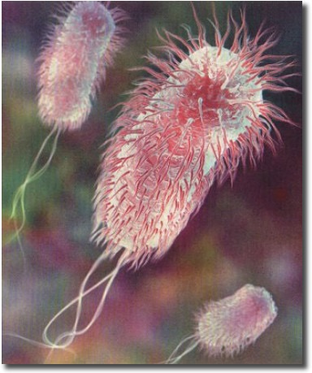
E. Coli
Bacteria in mammal guts (intestines)
Most harmless, but not all
Transmission from feces
Contaminated food or water
11

Slide 11
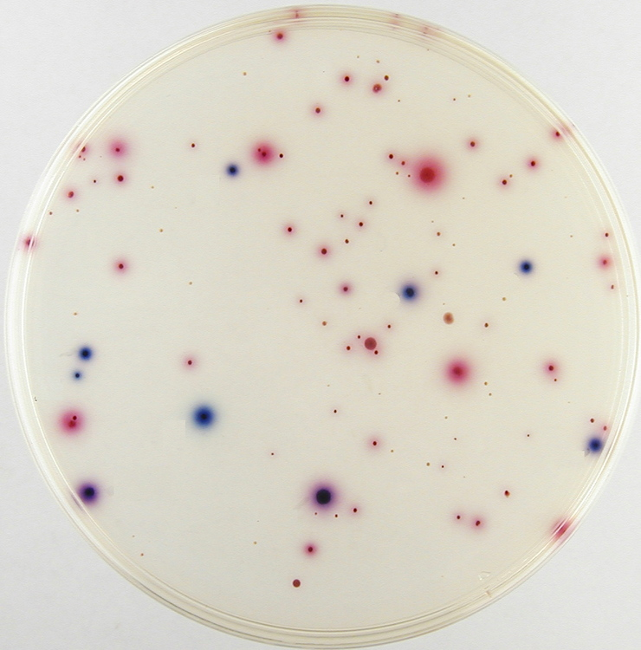
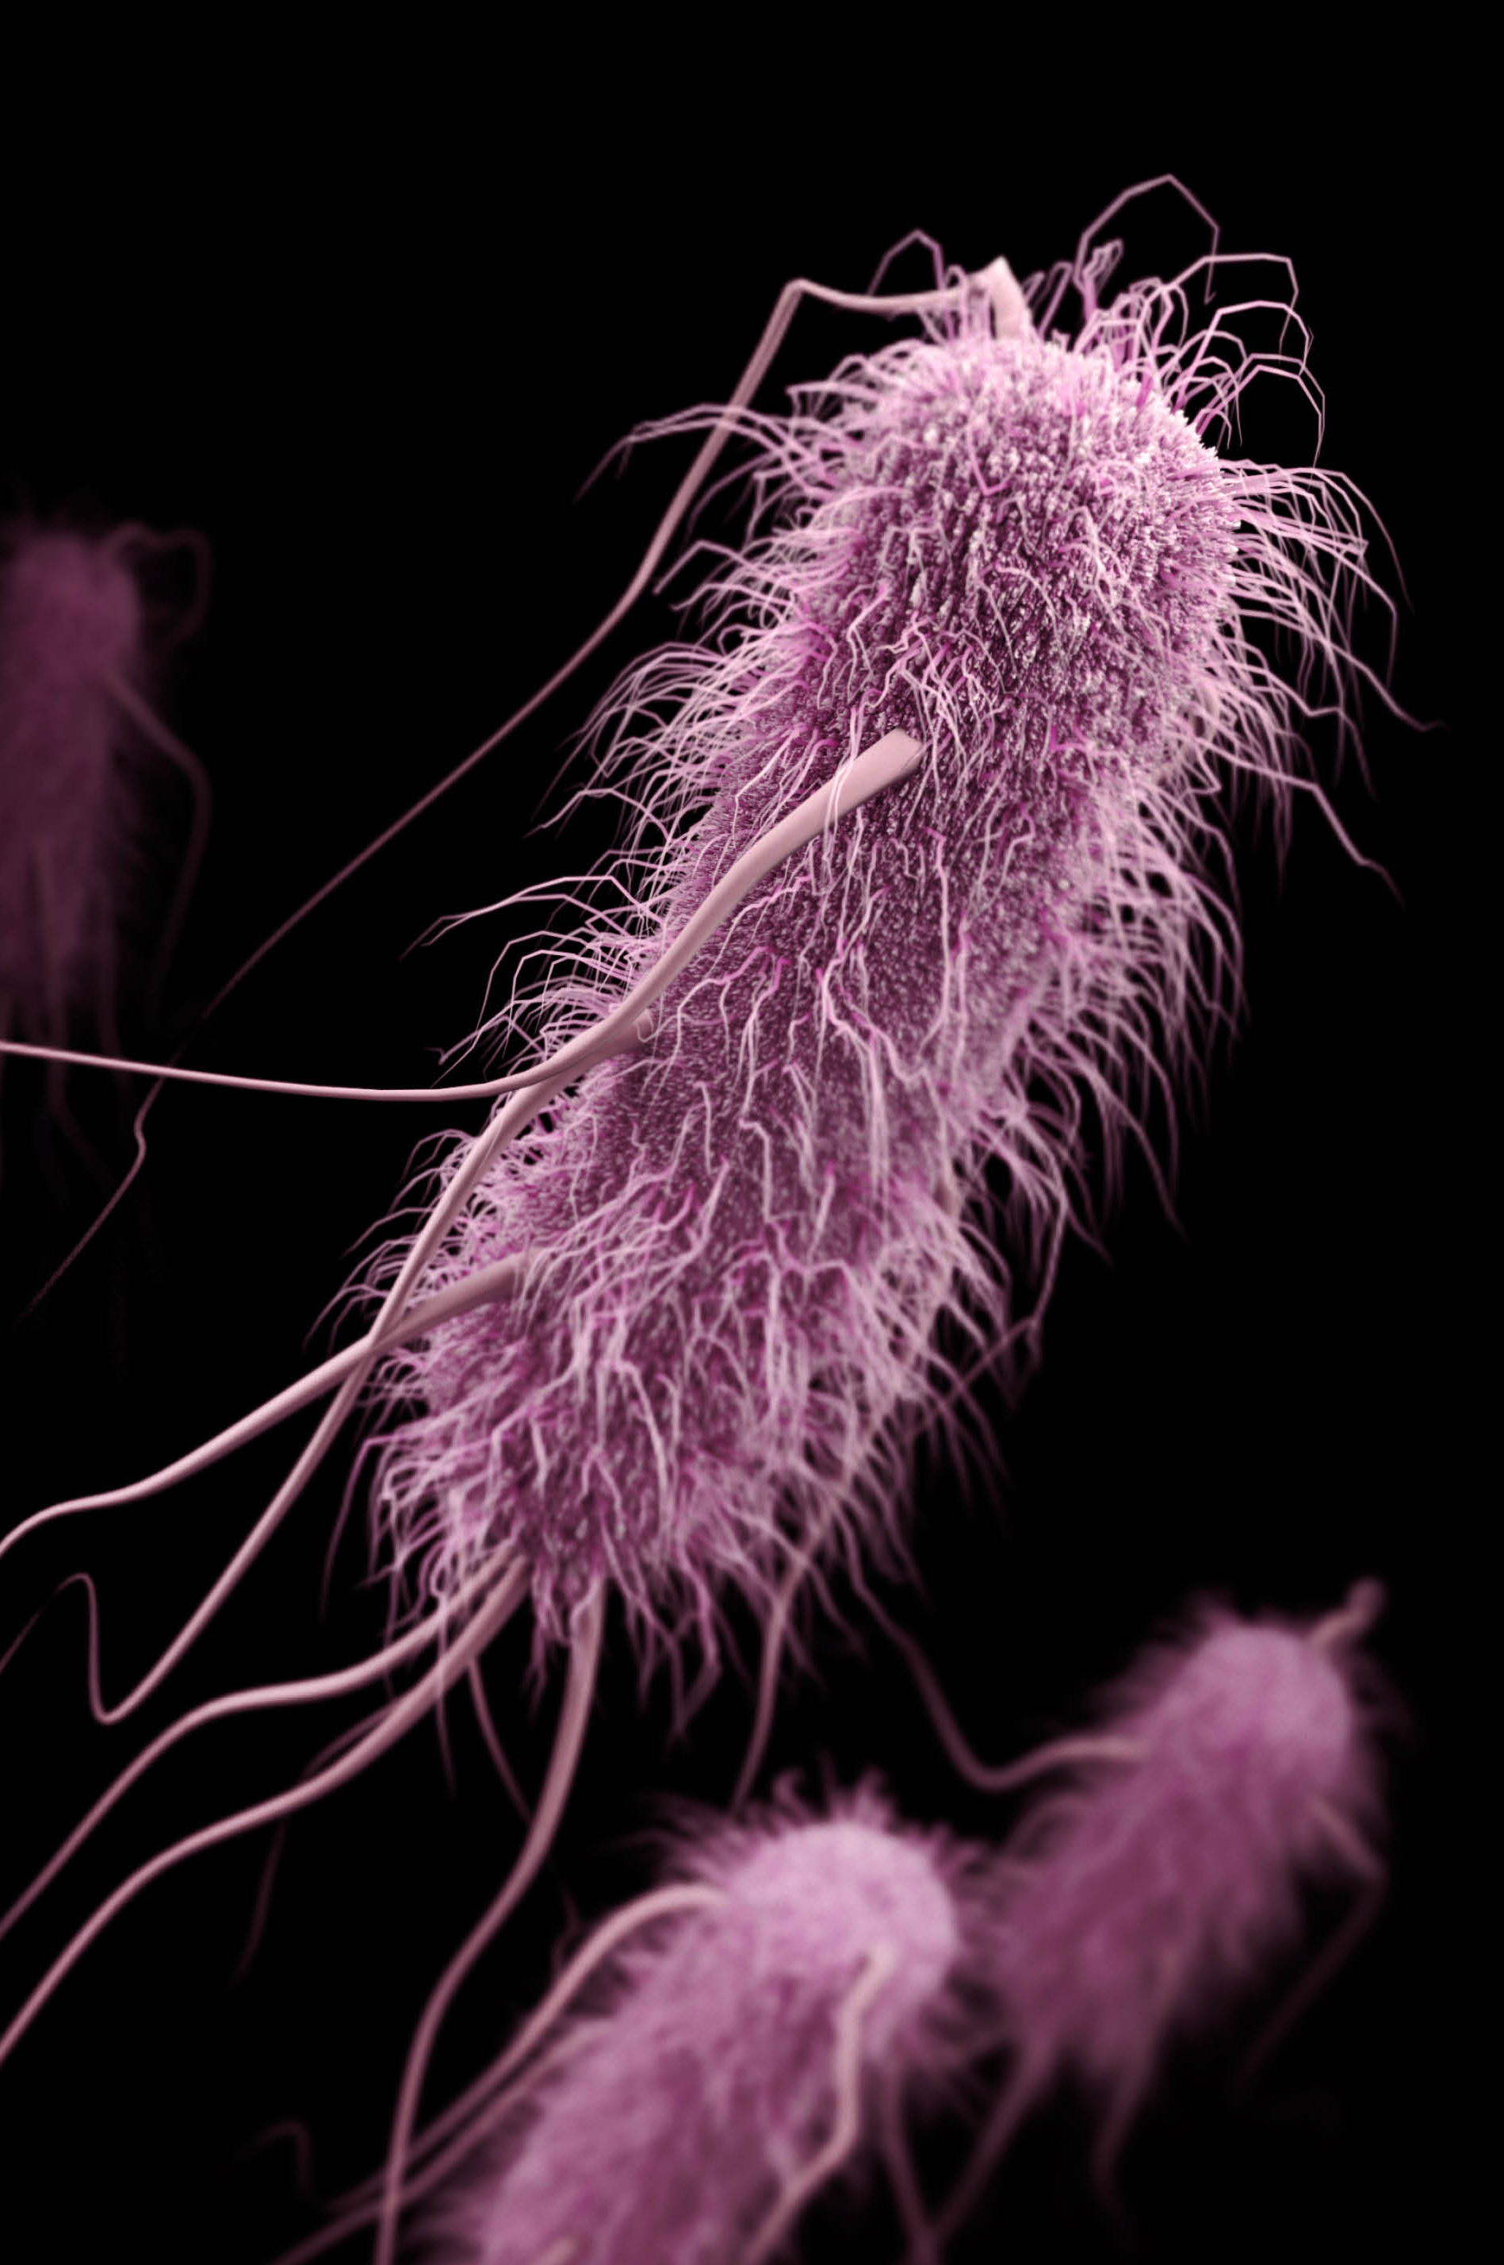
E. Coli
Most strains are fine, but some can make you sick
Fever, vomiting
Cramps, diarrhea
Severe cases
Kidney failure, death
12

Slide 12
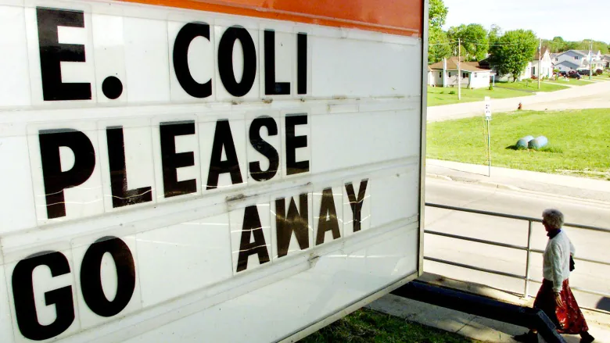
E. Coli Outbreak
May 2000, Walkerton, Ontario, Canada
E. coli contamination in municipal water supply
7 dead, 2300 sickened
13

Slide 13
Nutrients
Manure full of nutrients
Phosphorus, Ammonia, Nitrogen compounds
Fertilizer—helps plants grow
Not only on land, but also in water

Slide 14
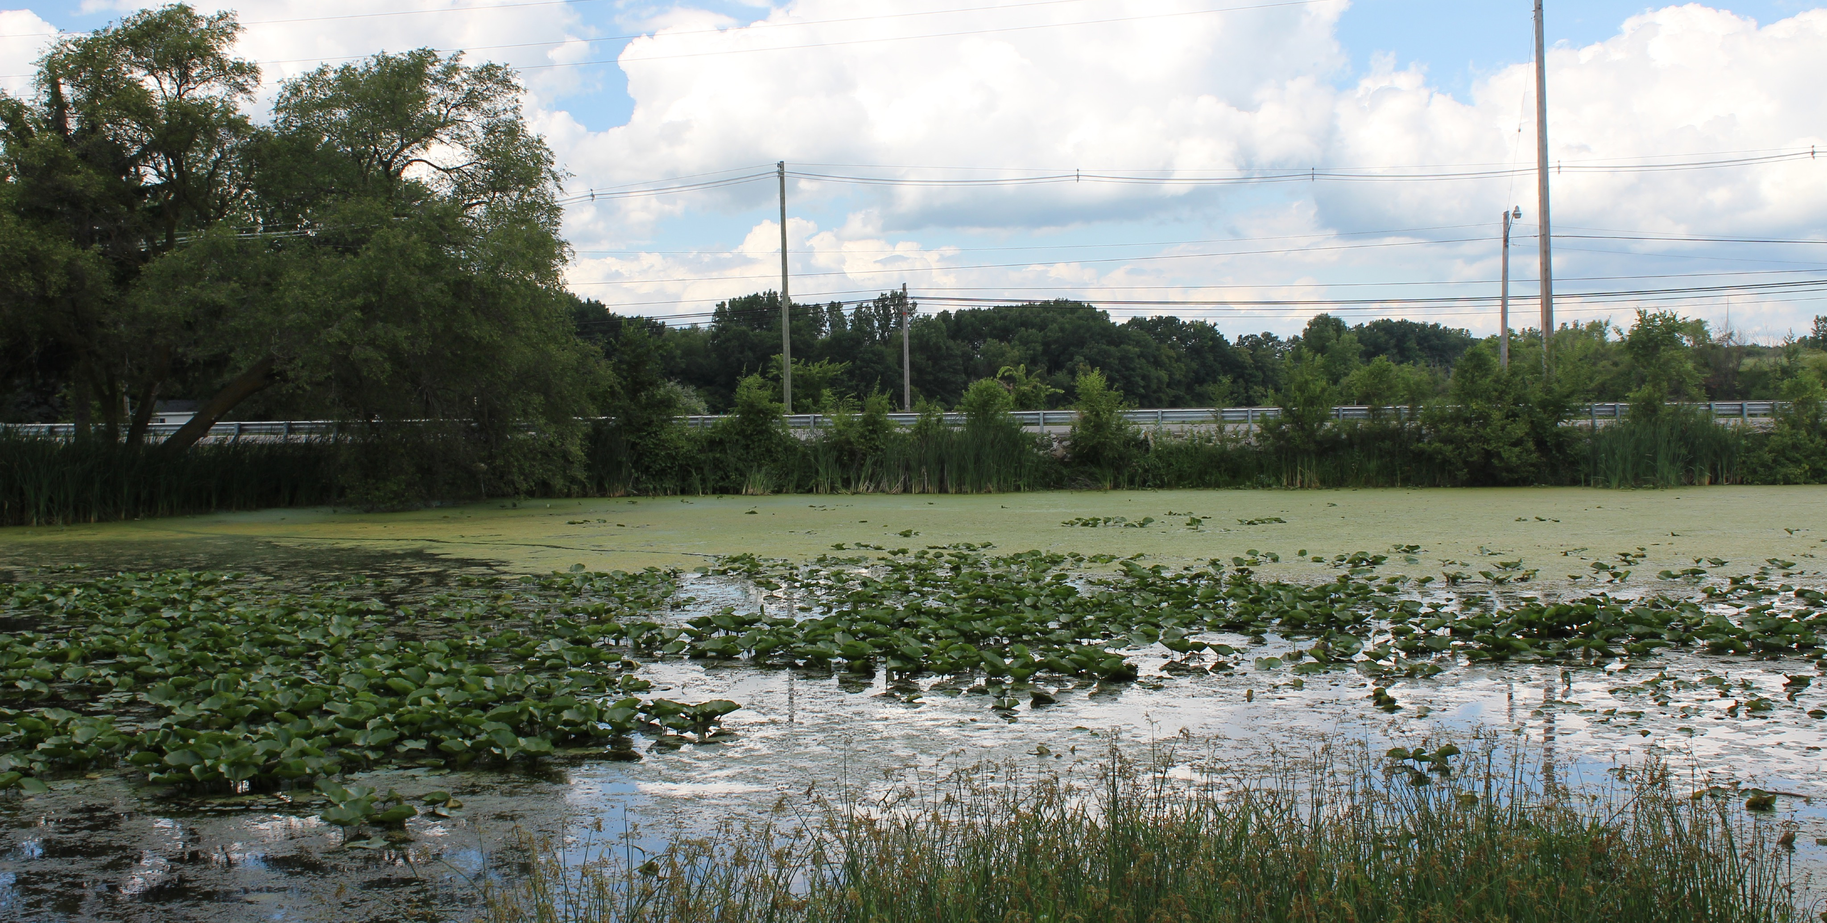
Nutrients and Eutrophication
Excess nutrients cause excess plant growth
Water choked with algae, aquatic plants (eutrophication)
14

Slide 15
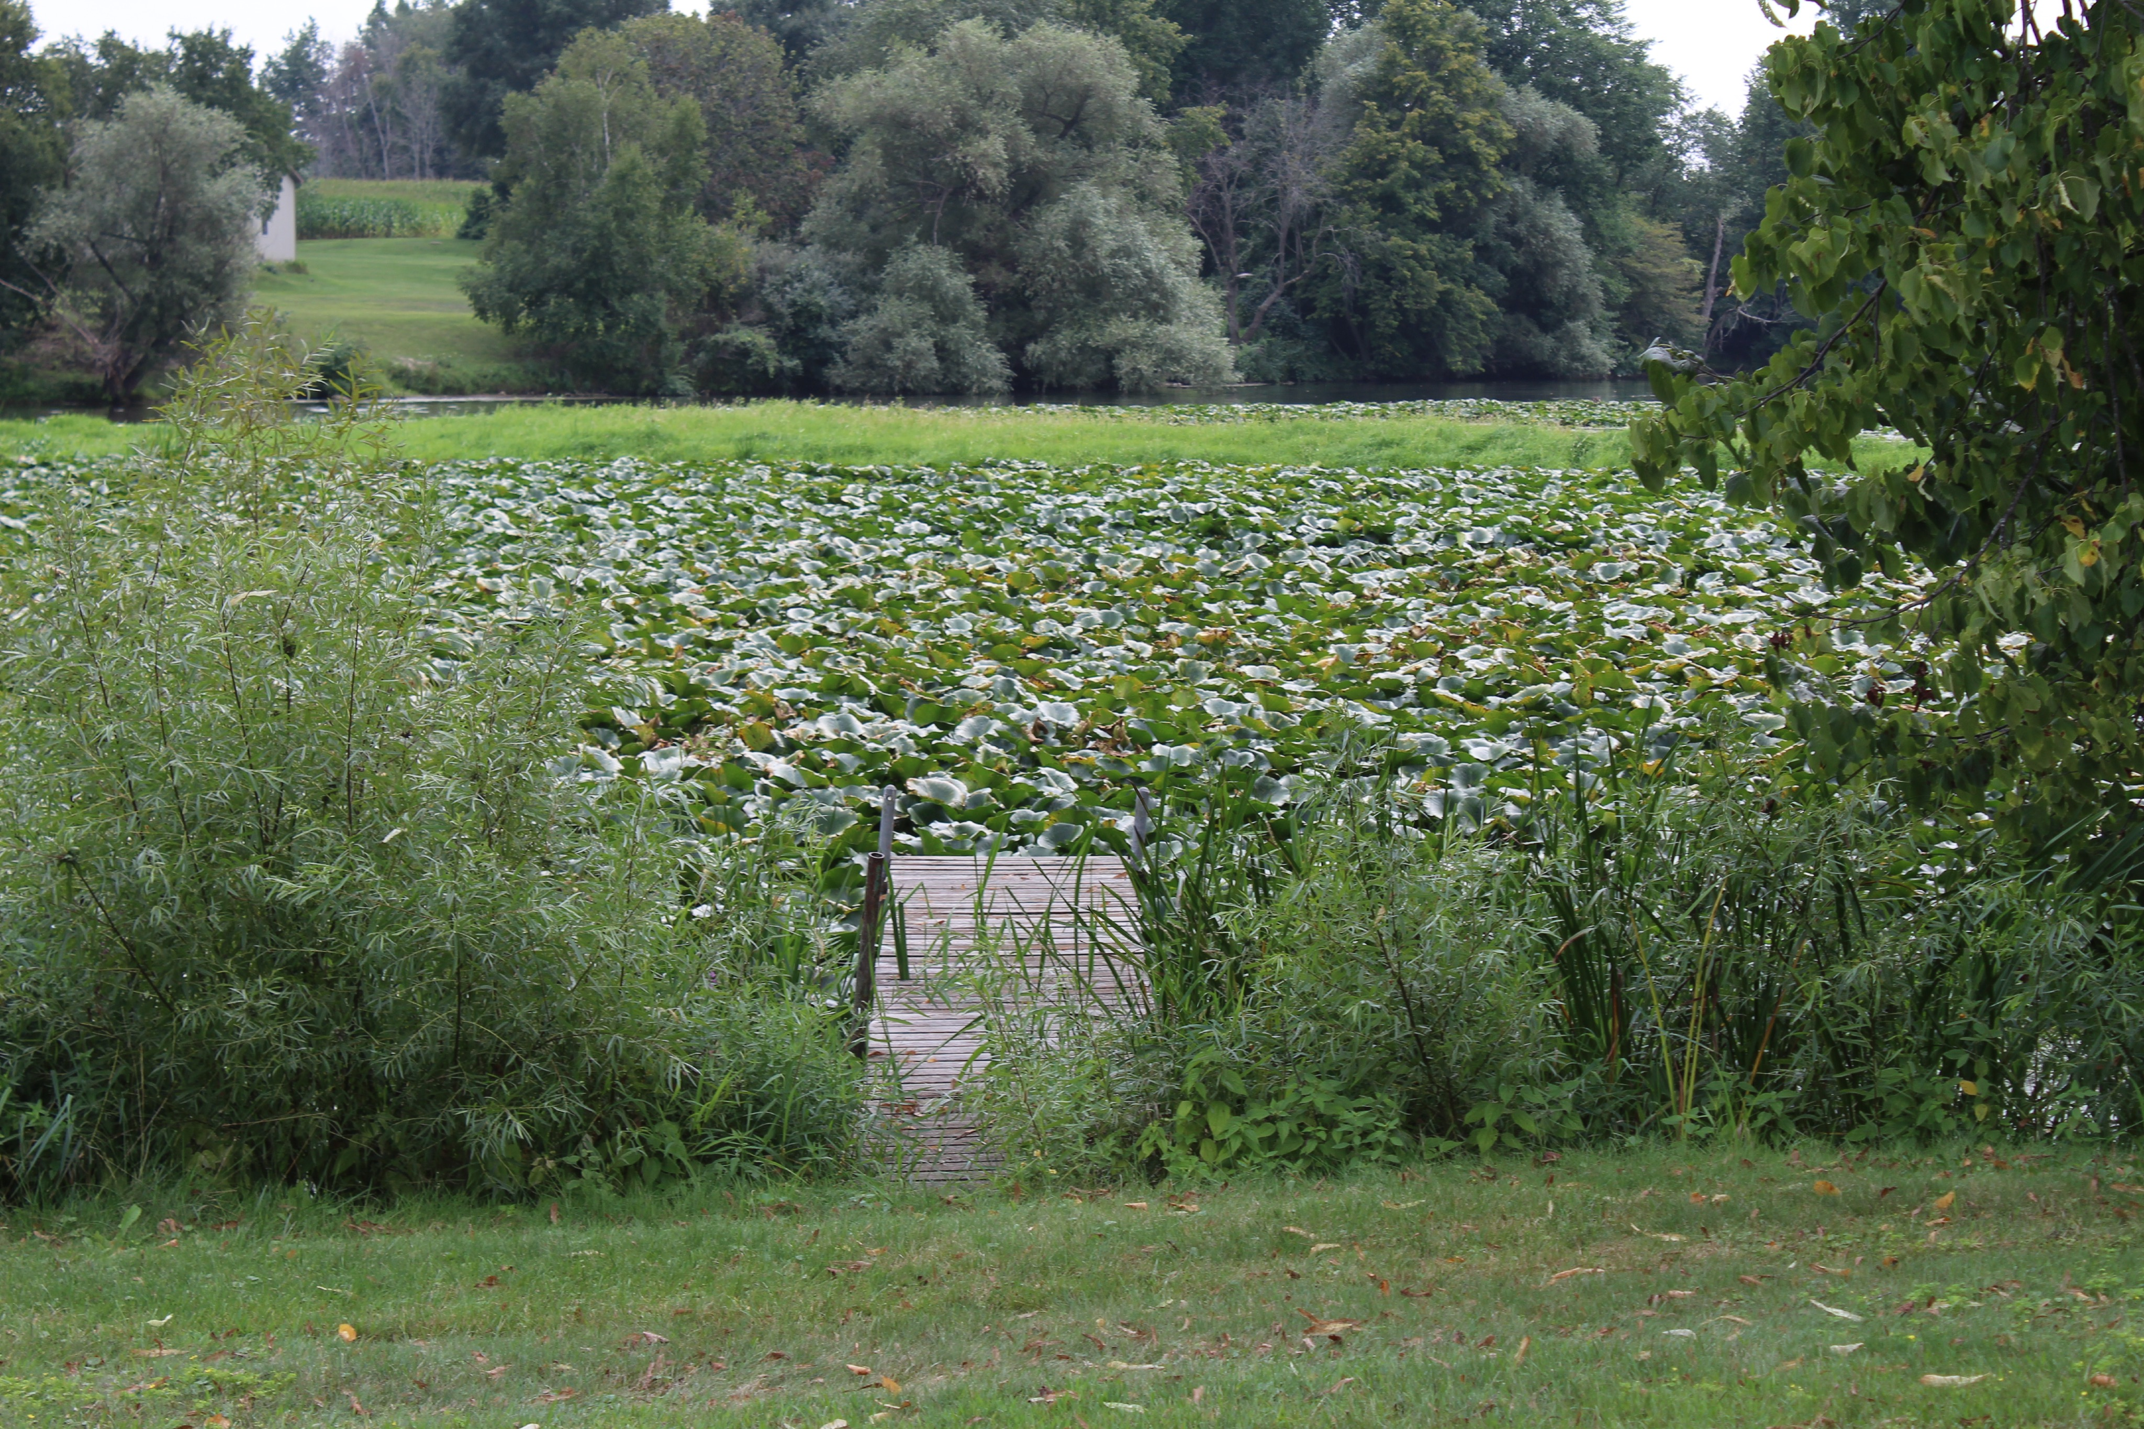
15

Slide 16
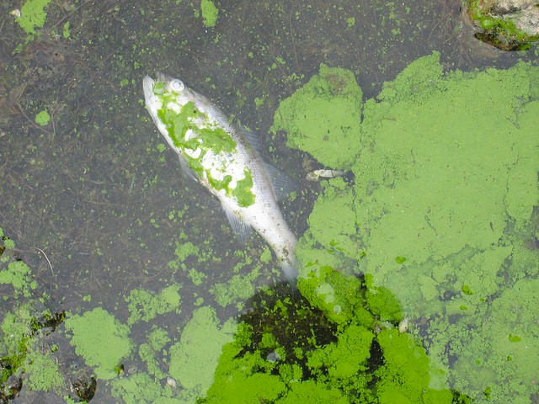
Nutrients and Eutrophication
Plants, algae die
Decomposed by bacteria
Decomposition uses oxygen
↑ Plants = ↑ Decomposition = ↑ Oxygen use
Leaves less oxygen for other organisms
16

Slide 17
Solids
Suspended or dissolved—size measurement
Caught by or passes through filter
Suspended + dissolved = total solids
Sources:
Sewage, fertilizer, manure, runoff, erosion, industrial discharges
17

Slide 18
Total Solids
High concentrations can
Make water “gross”—bad for everyday use
Negatively impact water treatment, industrial use
Decrease water clarity
Light blocked, less photosynthesis
Heats rapidly, holds more heat
Negatively impacts native aquatic life

Slide 19
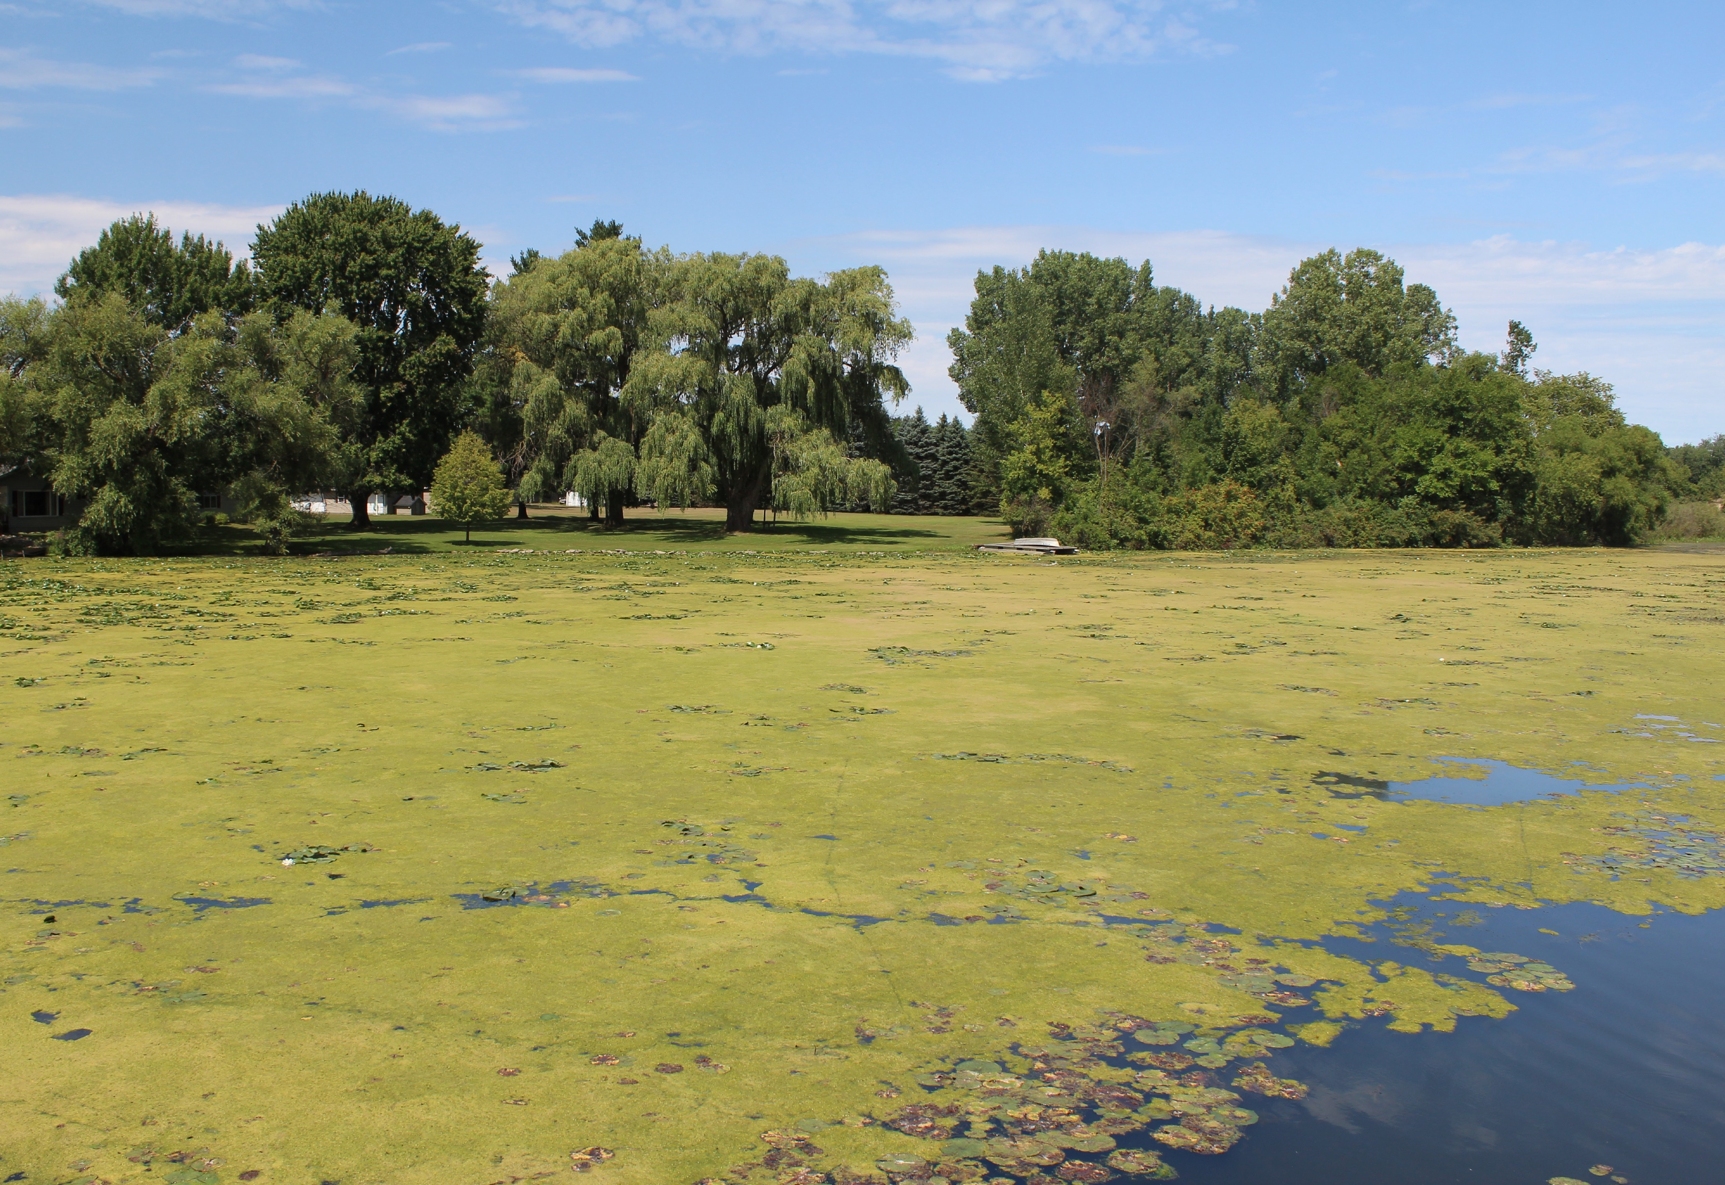
Major Pollution Sources
Agricultural runoff/livestock (main source)
Improperly maintained septic systems
Illicit septic connections
Residential fertilizer misuse
18

Slide 20
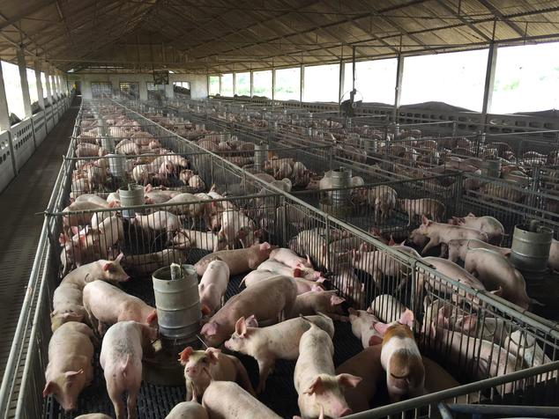
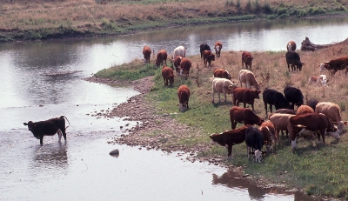
Livestock
Improper manure application
Unrestricted stream access
Improper livestock, manure management
19
20

Slide 21
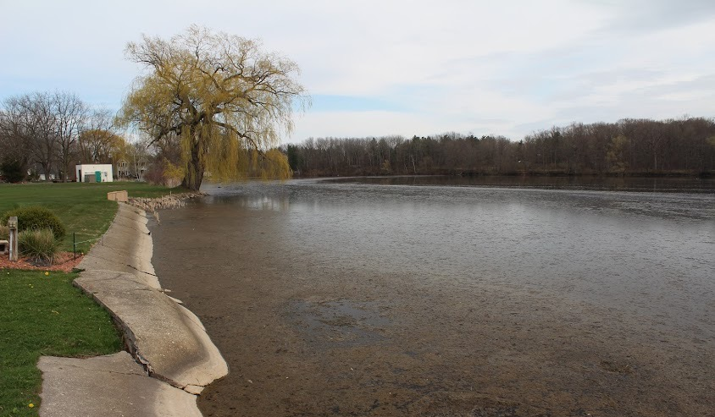
Improper Manure Application
Tile-drained fields
Legal but harmful
Prior to heavy rainfall
Dumping (illegal)
Frozen ground (illegal)
Saturated ground
(That is actual floating poop) →
21

Slide 22
22

Slide 23
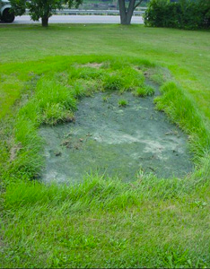
Improperly Maintained Septic Systems
Septic:
Underground tank contains solids
Wastewater to drainage field
6,420 houses on septic in UPRW
est. 642–1,605 systems failing (10-25%)
23

Slide 24
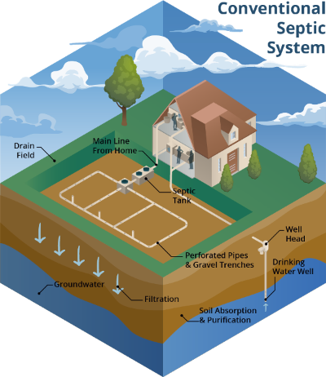
Improperly Maintained Septic Systems
Failure Factors
Age
Maintenance
Systems overtaxed
Land area too small
Poor drainage soil
High water table
24

Slide 25
Illicit Septic Connections
Pipes not connected to septic system
Wastewater directly discharged in environment
Difficult to locate
Often occur when proper treatment is expensive/impractical
25

Slide 26
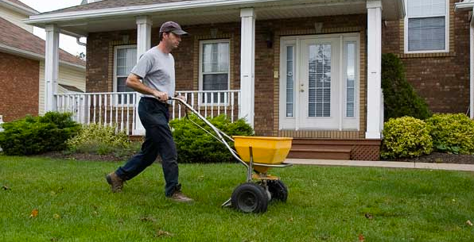
Residential Fertilizer
Overapplication on lawns, golf courses
Fertilizer can enter surface and ground water if not absorbed by landscape
26

Slide 27
Re-Cap
Pine River watershed does not meet key water quality standards
High levels of E. coli and nutrient pollution
Harmful to both human and environmental health
Major pollution source is agricultural runoff and livestock impairment
Animal feces

Slide 28
Future Content: Video
3-4 videos, each 1-2 minutes
Timeline: end of calendar year
Covers impacts of CAFOs
Amount of animal waste
Human population equivalent
Why that is bad
27

Slide 29
Future Content: Video
28

Slide 30
Questions and Comments
Join the Healthy Pine River Group today! Register at healthypineriver.org

Slide 31
Sources
HPR Files
NSRWA.org—Watershed Diagram
Wikipedia—Great Lakes Basin
Michigan Map Library—Watersheds in Michigan
Margaret Selmon—GIS files
Margaret Selmon—GIS files
Old Postcard
HPR Files—Lambrecht 8/10/18
Margaret Selmon—Phosphorous samples 8/6/21
Margaret Selmon—Field Sampling 8/5/21
USGS—e. coli
micrologylabs.com—Coliscan Easygel
Kevin Frayer/Canadian Press—Sign in Walkerton
HPR files—Leppein Park 7/30/19
HPR Files—Keon/Wimmer Dock 8/20/18
conserve-energy-future.com—Dead fish in algal bloom
blogs.worldbank.org—Suspended solids test
HPR Files—Cheeseman Road 8/13/19
nrdc.org—Pig CAFO
omafra.org—Cattle with river access
Les Rosan—Floating poop
Karalyse Hagen—Manure infiltration animation
Illinois.edu—Septic system failure
blogs.ifas.edu—Septic system diagram
Chuck Sandro—Illicit septic connection 08/21
cbf.org—Lawn fertilizer application
Karalyse Hagen—Excerpt from HPR video 1
Karalyse Hagen—Excerpt from HPR video 1

