Slide 1
Update on Pine River Watershed: Headwaters to St. Louis Dam
Healthy Pine River Group
October 10, 2024
Olivia Ayers, Murray Borrello
Alma College

Slide 2
First: THANKS!!!!!
This season’s work was funded by:
HPR: $7500
Small Grants from AC Donors: $2300
What did we do with the money?
Olivia’s salary
Media and E. coli kits
Reagents for running nitrogen and phosphorus testing
Gloves and other incidental necessities
We thought this would make a great “field car.” But decided not to buy it!

Slide 3
Goals for 2024 Season
Continue to monitor watershed:
upstream (headwaters), main trunk, and downstream of Alma Dam
Continue to sample downstream to assess potential algal bloom sources in St. Louis
Put together historical data:
Compare how the river is now with 4 years ago
Do a 20-year compilation of what’s happened in the watershed
Identify potential sites that exhibit impacts after manure application

Slide 4
Before Results: Some Pleasantries…

Slide 5
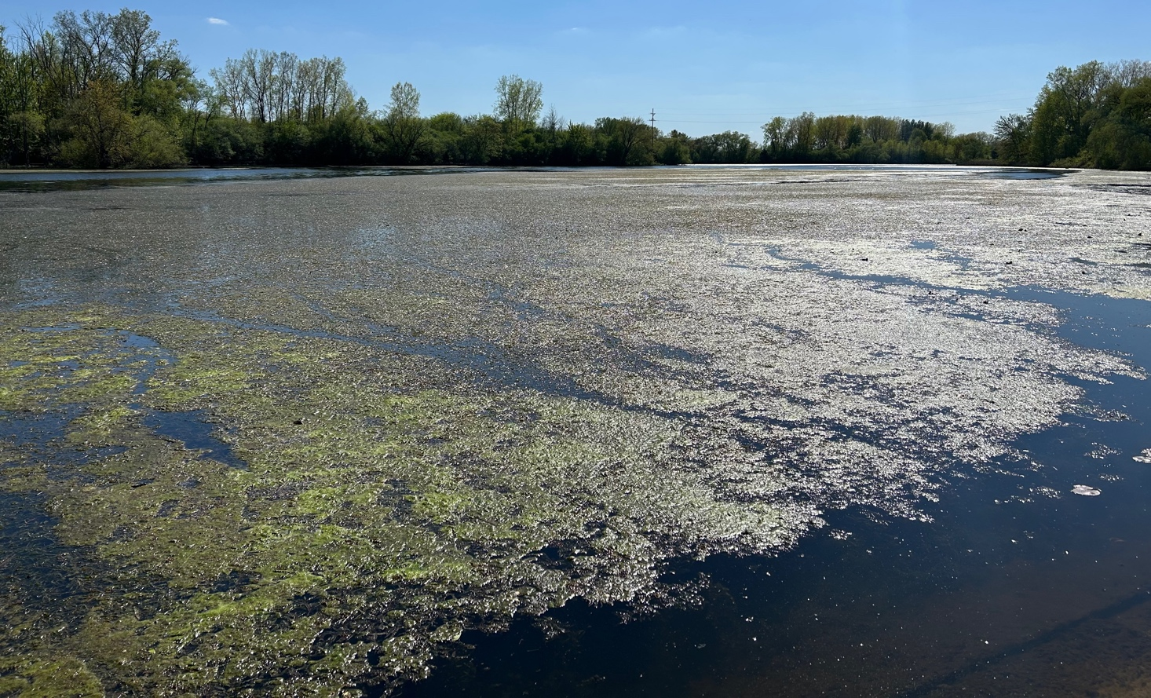
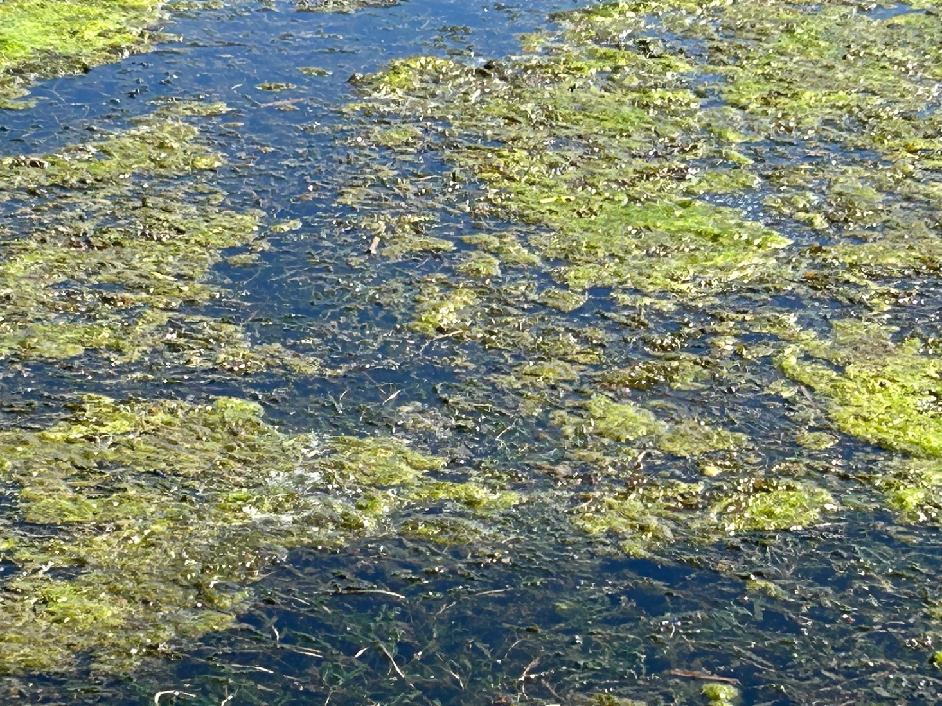
Taken from Gary’s House on Riverview
Pictures of the second manure dump, mid-May, 2024

Slide 6
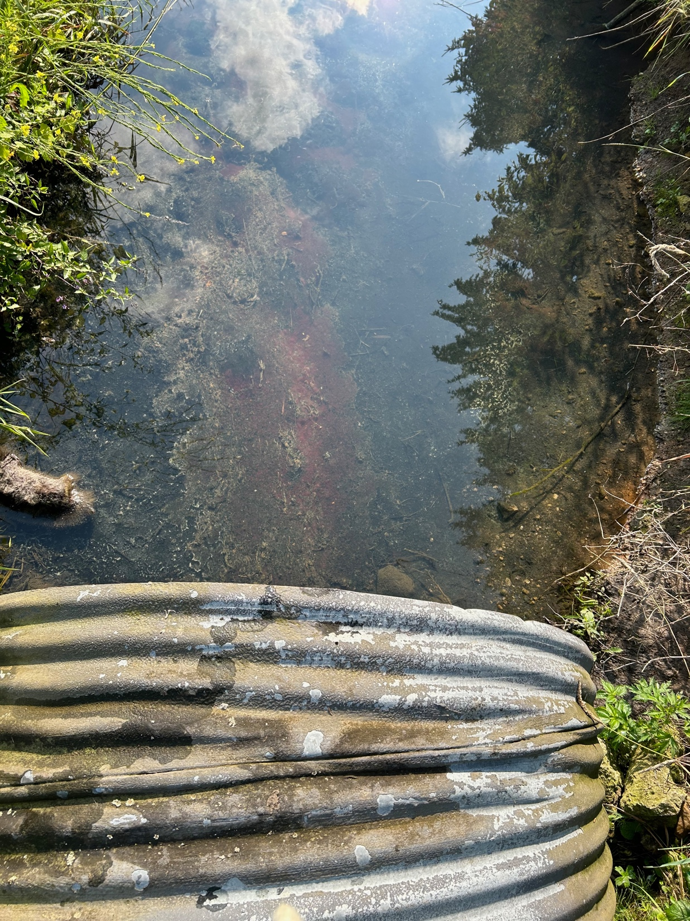
Some “interesting” outflow at Sugar Creek

Slide 7
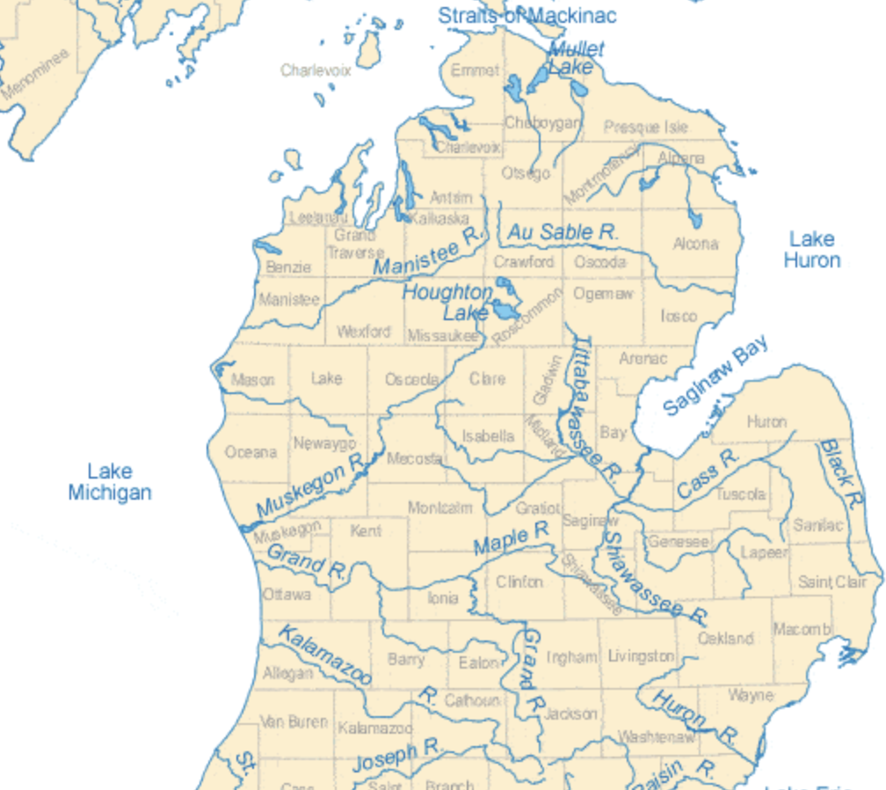
The Pine River Watershed is part of the Saginaw River Drainage Basin
Chippewa River
Pine River

Slide 8
Quick Summary of 2024 Findings

Slide 9
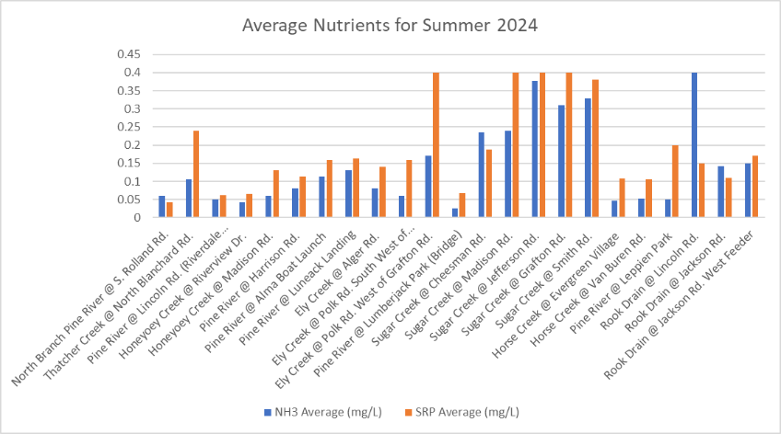
Overview of Summer 2024 Data
These concentrations exceed 100 times healthy stream concentrations
Concentrations of Nutrients for Healthy Streams
mg/L

Slide 10
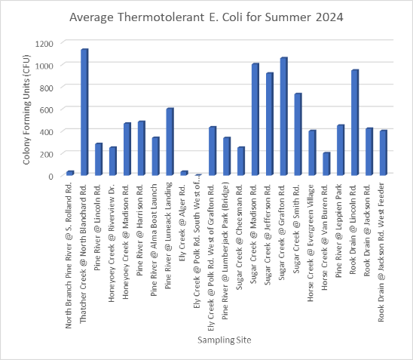
Limit for Direct Human Contact

Slide 11
How We Divided Up the Watershed
Headwaters Sites
Above Lumberjack Park
Mid-Section / Main Trunk
From Lumberjack Park to Alma Dam
Downstream Sites
Downstream of Alma Dam to St. Louis Dam

Slide 12
Status of the Headwaters

Slide 13
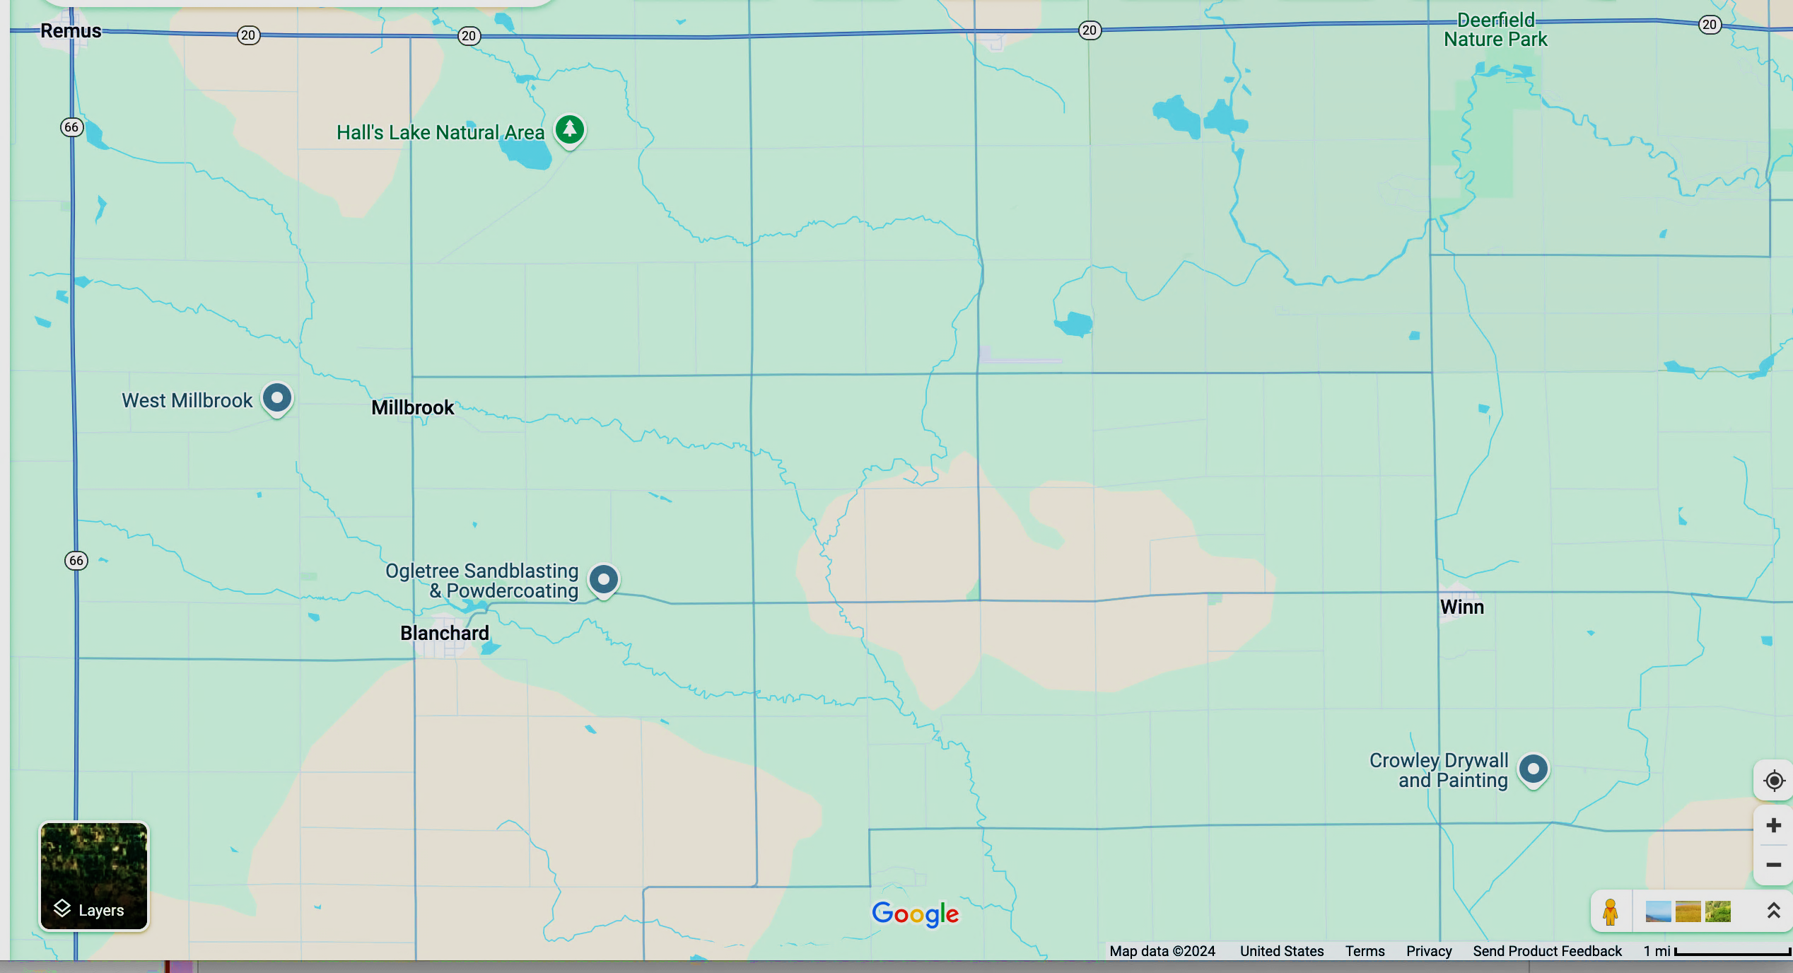
Headwaters Sampling Sites: 2024
Chippewa River Watershed
Pine River Watershed

Slide 14
Blanchard Rd. Site has gotten cleaner – perhaps as a result of the Peacock CAFO closing?
Mg/L

Slide 15
Thatcher Creek site needs to be monitored more often as it may be increasing in Thermotolerant E. coli.
CFU/100mL
Direct Human Contact Criteria

Slide 16
Status of the Mid-Section Sites

Slide 17
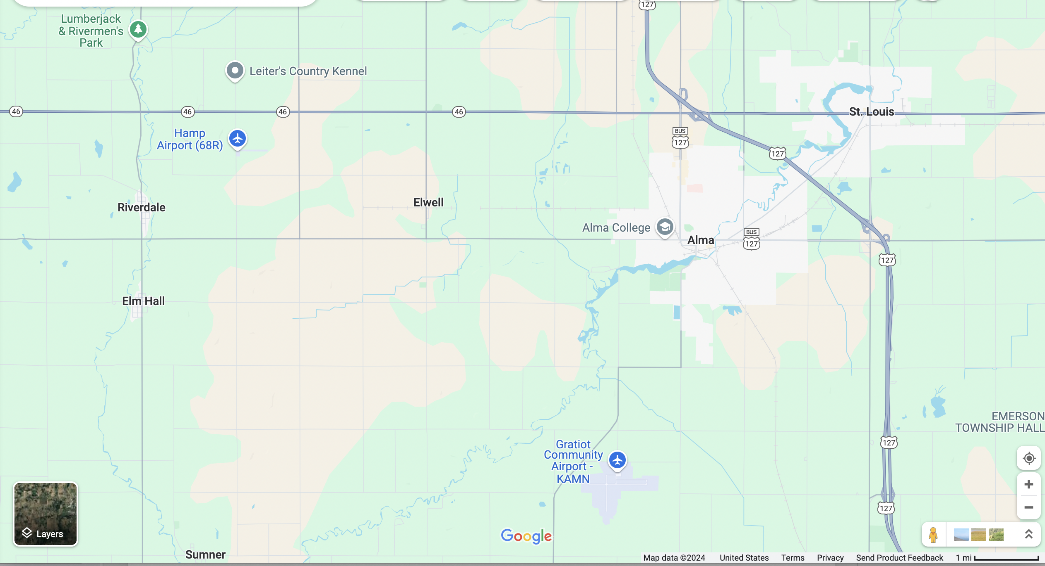
Sampling Sites for Mid-Section

Slide 18
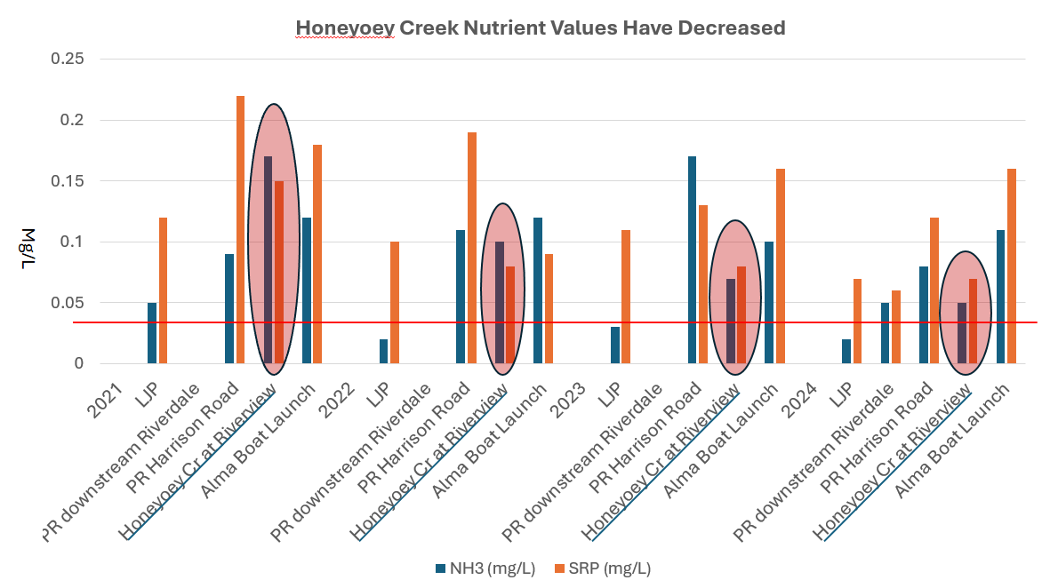
Honeyoey Creek appears to be improving – possibly because the source is moving to another outlet.

Slide 19
Mg/L

Slide 20
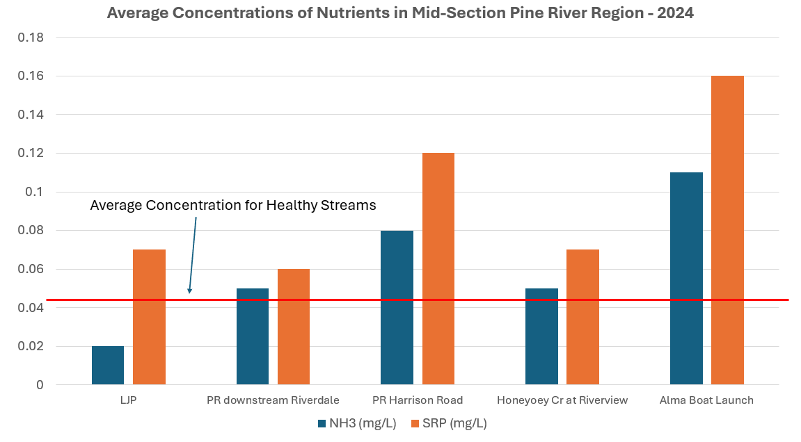
Compared with most other sites, Riverdale does not appear to have a significant impact on Pine River water quality

Slide 21
Direct Human Contact Criteria

Slide 22
Status of Downstream Sites

Slide 23
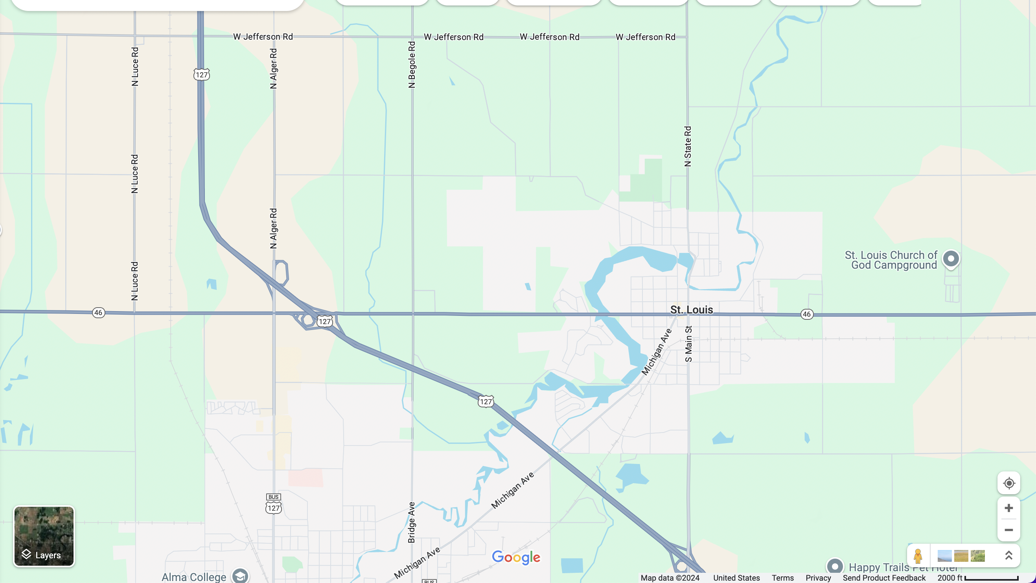
Downstream Sampling Sites

Slide 24
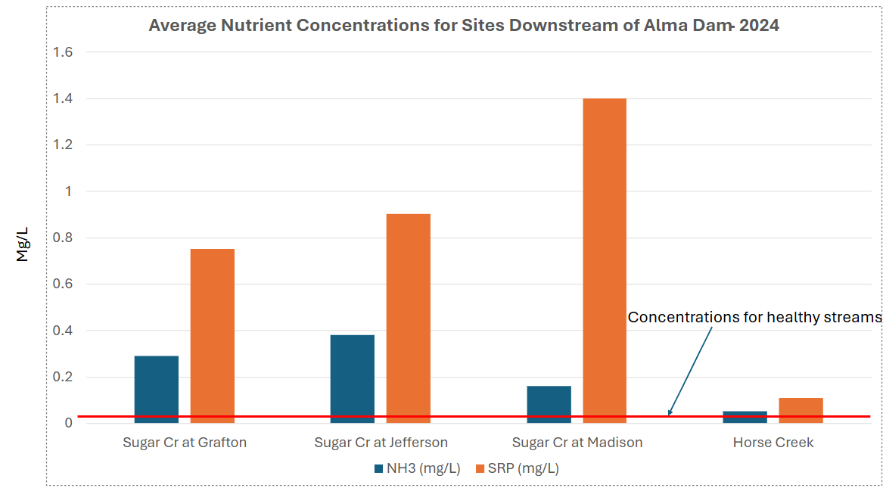

Slide 25
CFU/100mL
Limit for Direct Human Contact

Slide 26
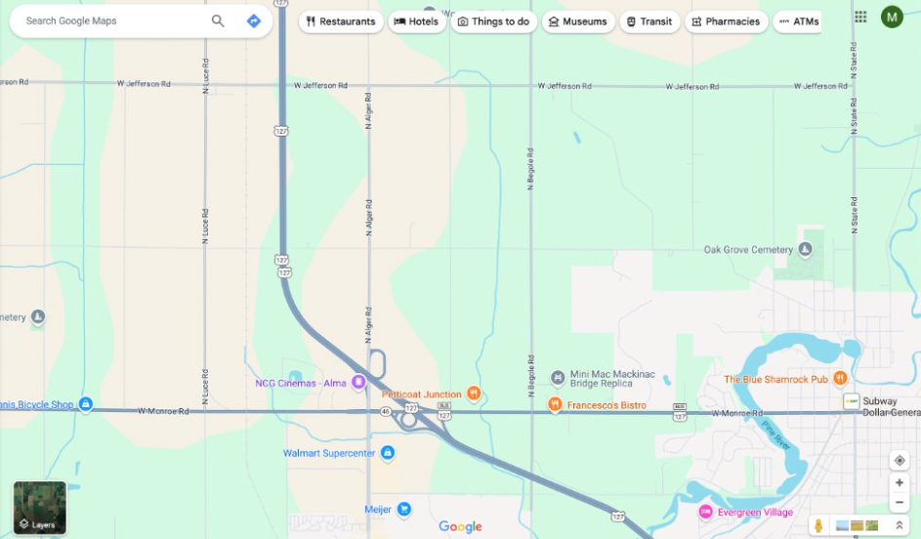

Slide 27
Nutrient Levels for Healthy Streams
Mg/L

Slide 28
Limit for Direct Human Contact
CFU/100mL

Slide 29
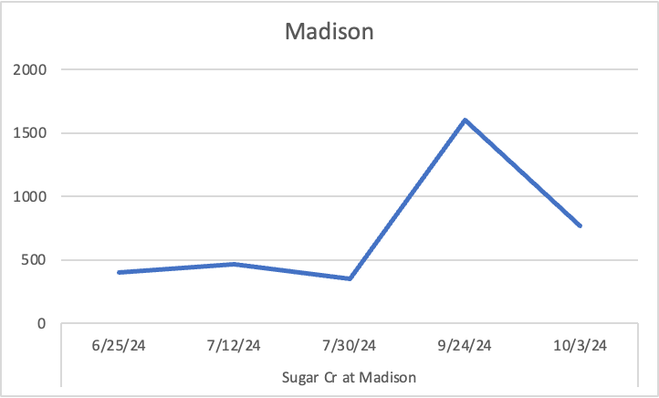
E. coli Concentrations for Summer, 2024 – Sugar Creek Sites

Slide 30
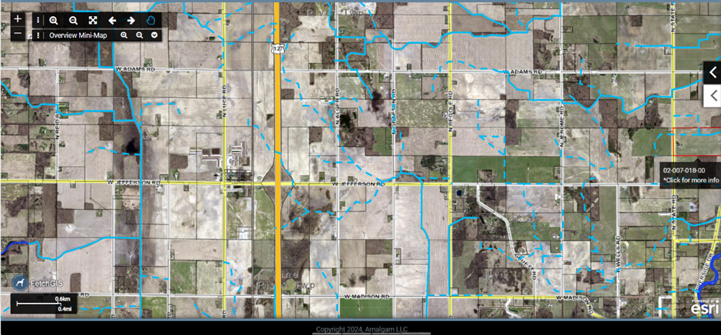

Slide 31
The Case of Rook Drain

Slide 32
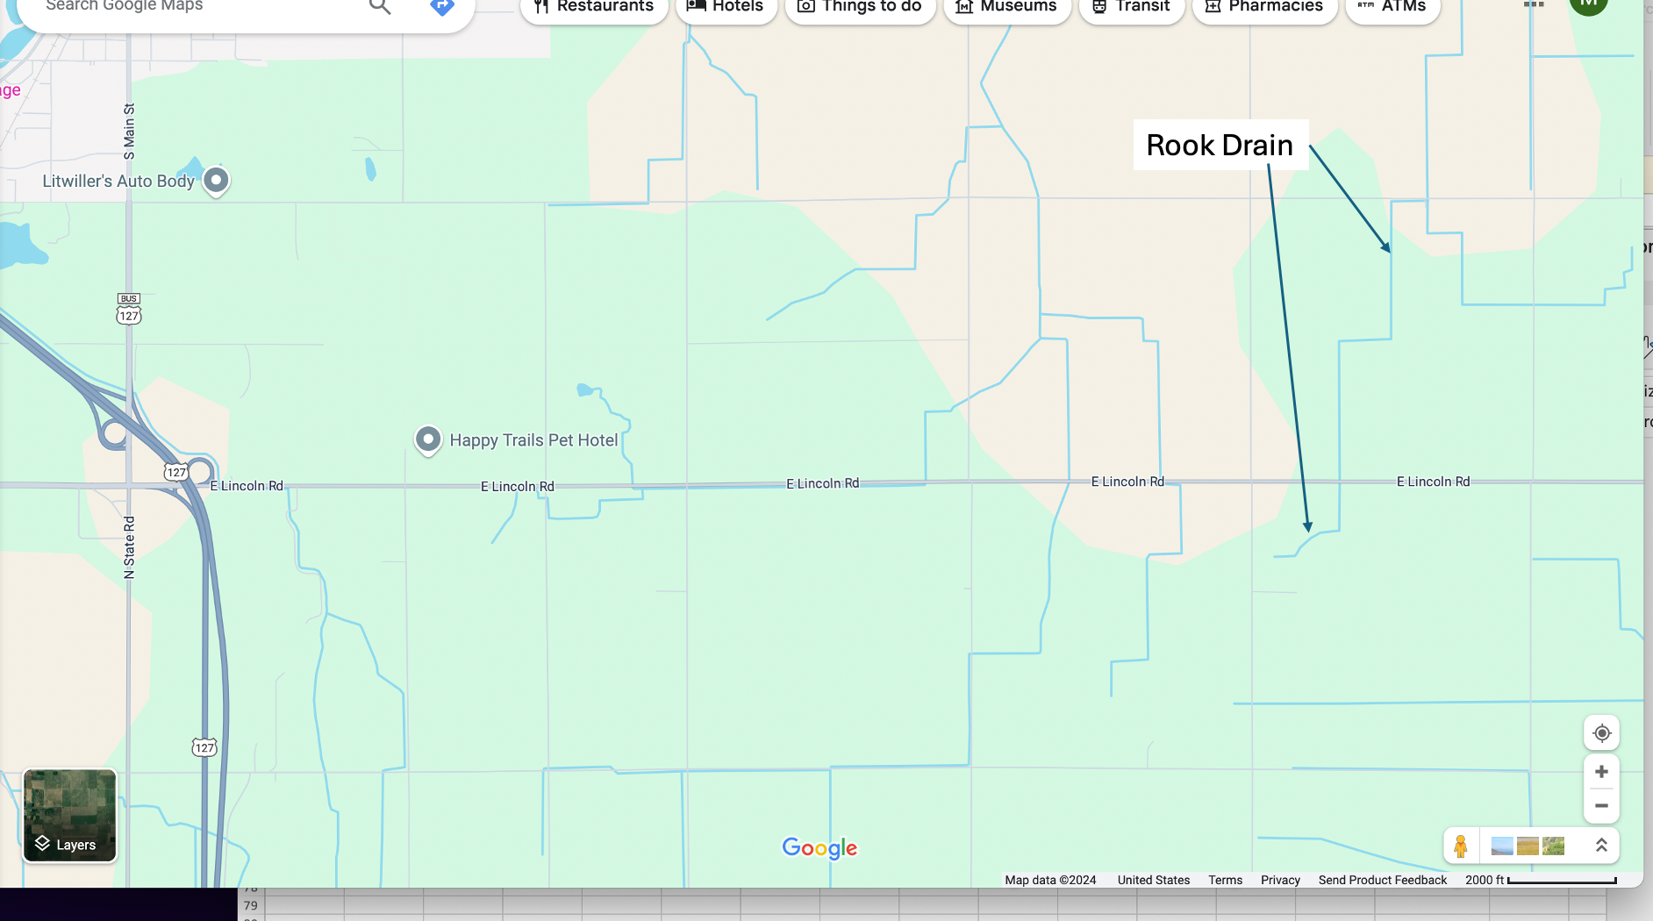
Jackson
West Feeder
Lincoln

Slide 33
Concentrations for healthy streams

Slide 36
Coming Up
Twenty year analysis of the watershed
Focus on "hot spots" and risks
Hazard Mitigation and Planning for the County
Implications for Dam Removal

