Slide 1
Pine River Problem: Where Do We Go From Here?
M. Borrello, Environmental Studies/Geology
Great Lakes Watershed Institute
B. Peterson, Center for College and Community Engagement
ALMA COLLEGE

Slide 2
Our Discussion This Evening…
What do we know about the state of the watershed?
What regulatory structure exists for change to be a reality?
What are some pathways we can explore?

Slide 3
What Do We Know About the Watershed?
Years of Research Shows:
The entire Upper Saginaw River Drainage Basin including parts of Chippewa and Pine River Watersheds is impaired due to agriculture and chemical pollution
From St. Louis, Michigan downstream, the Pine River is polluted from Velsicol Chemical Co. with legacy pollutants (DDT, PBB, etc...)
From St. Louis, Michigan upstream to the headwaters of the Pine River, agricultural impacts are significantly affected water quality and causing human and environmental health risks

Slide 4
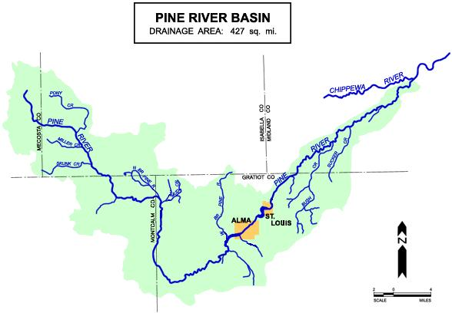

Slide 5
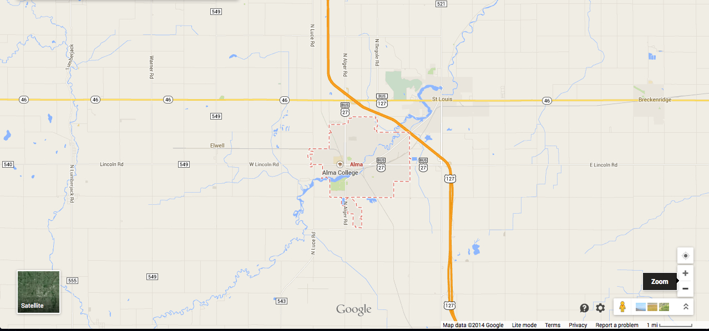
Pine River Land Use: Upstream/Downstream
of Alma Dam
Dominantly Agriculture
Industrial with Agricultural
Mixed

Slide 6
Focusing Upstream: Agricultural Impacts

Slide 7
Mill Pond, 1980s

Slide 8
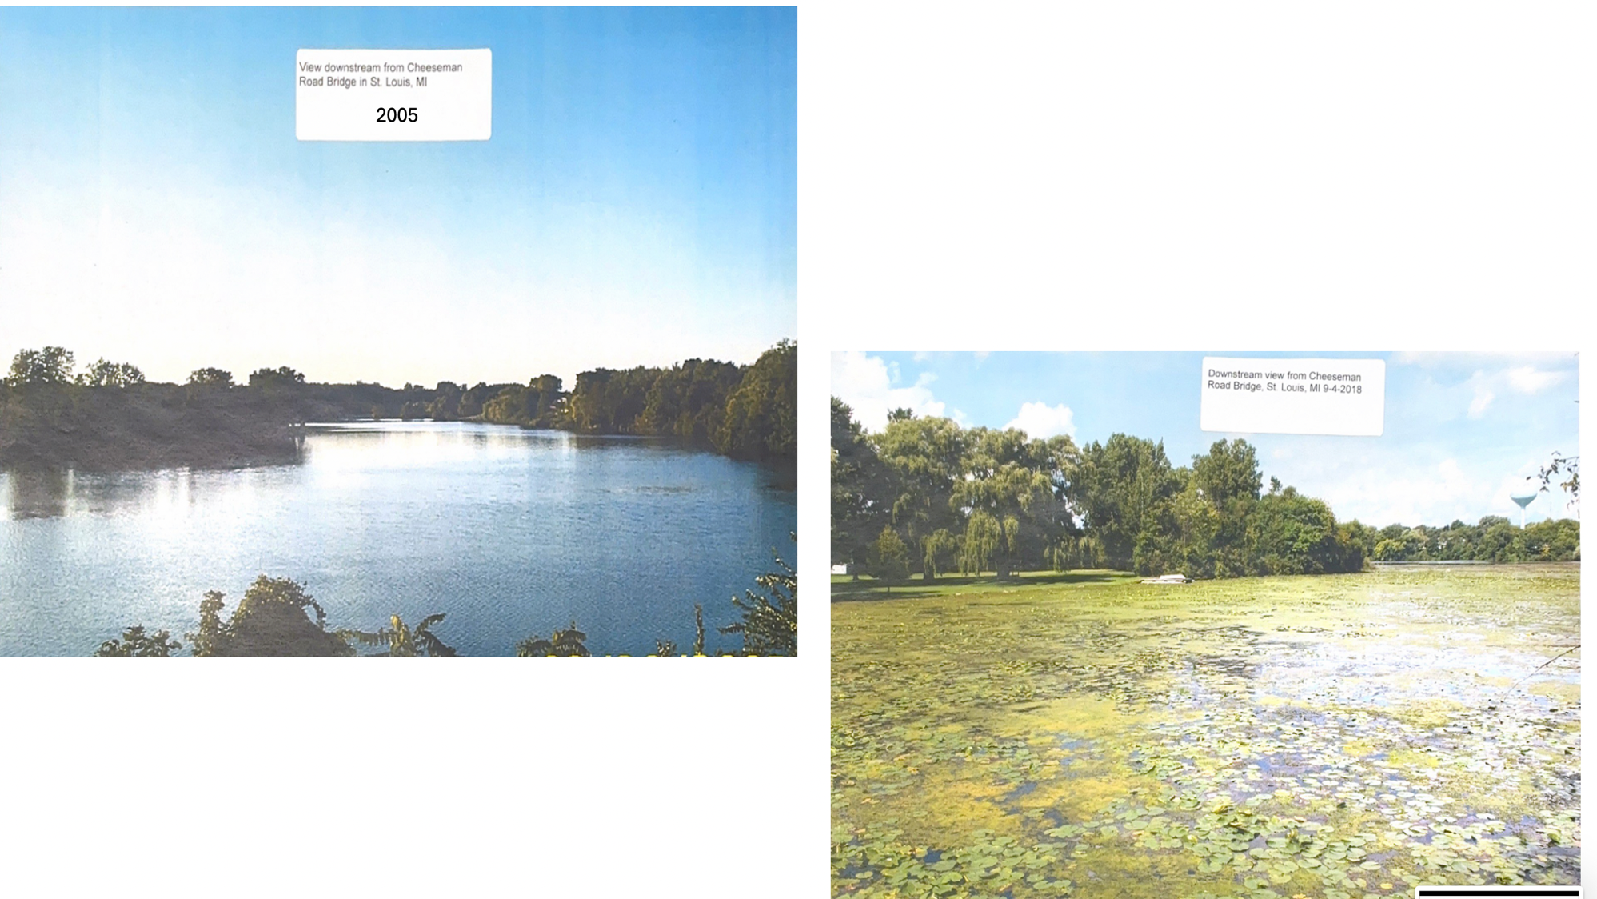
Looking downstream towards St. Louis at Cheesman Road bridge in St. Louis
2018

Slide 10
What Do We Know: Where are the Impacts Coming From?
CAFOs (large livestock facilities) are, themselves sources of manure input causing algal blooms and E. coli pollution
Manure application sites are sources of inputs of N, P and E. coli through tributaries into the Pine River

Slide 11
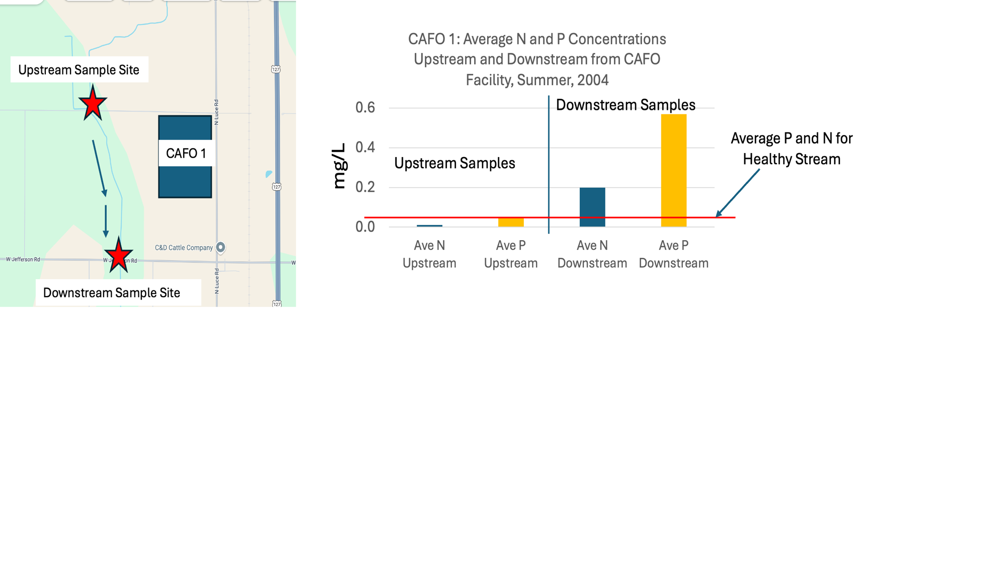
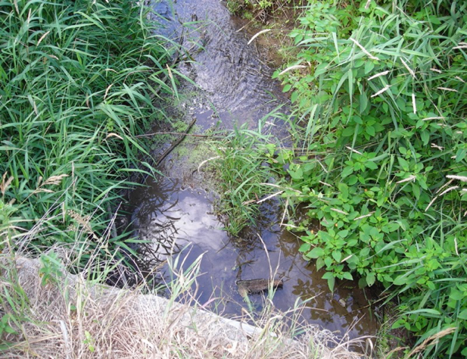
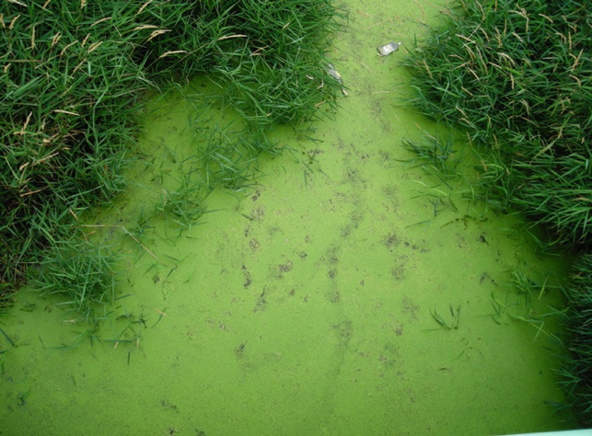
Upstream Site of CAFO 1 August 8, 2004
Downstream Site of CAFO 1 August 8, 2004

Slide 12
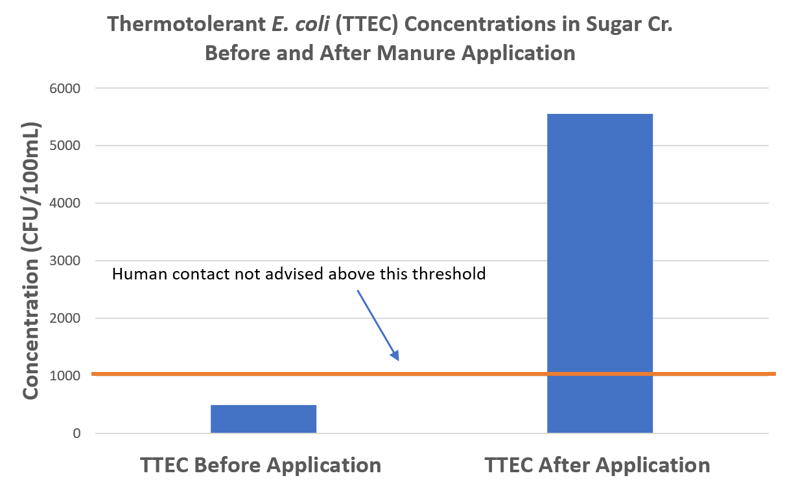

Slide 13
What Do We Know: What Impacts Do We See in the Pine River Watershed?
Heavy algal blooms: unsightly, potentially toxic, likely impacting the local and regional economy
E. coli levels are high enough to pose human health risks
E. coli is resistant to antibiotics: both livestock and human antibiotics
Dissolved oxygen levels are low impacting the ecosystem of the Pine River

Slide 14
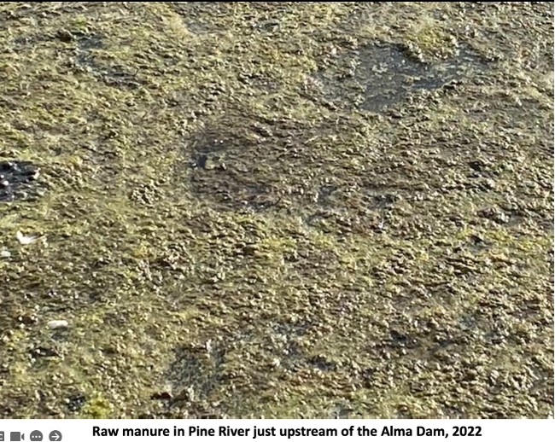
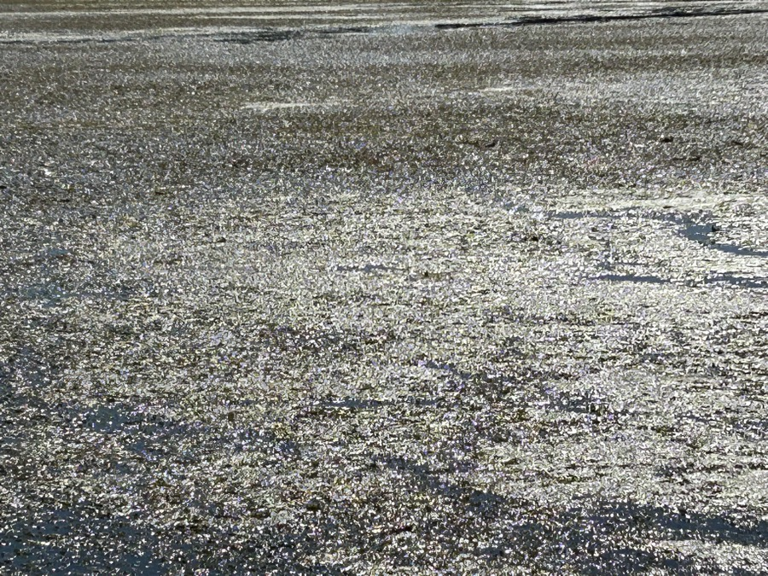
Manure dumps are now an annual occurrence sometimes occurring two or three times – usually in the area of the Pine River above the mill pond
Raw manure dump, Pine River, May, 2024
Notes:
This happens every spring

Slide 15
CFU/100 mL
No swimming criteria
Notes:
Over 30 sampling sites in watershed, we averaged all of those over these years from late may to October, and this is the average. Shows how much TTEC is in the river
Also add before and after manure application chart from 2019

Slide 16
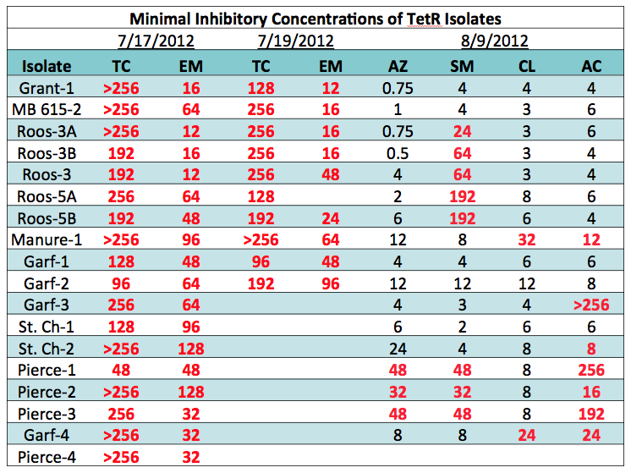
Bacteriology
• MICs provide more detailed information
regarding resistance
TC – tetracycline ribosome
EM – erythromycin ribosome
AZ – azithromycin ribosome
SM – streptomycin ribosome
CL – chloramphenicol ribosome
AC – ampicillin cell wall
Red values indicate resistance

Slide 17
ARG Prevalence: Maple River Watershed
Green numbers = Upstream Sites
Denominators = # of samples taken
Numerators = # of positive hits for TetW
Red numbers = Downstream Sites
CAFO Locations
General Flow
Direction
Notes:
This again, illustrates how the presence of this gene is relatively low prior to CAFO inputs and fields where manure is being spread, but as we look downstream from livestock operations (x’s), this increasingly becomes a problem.

Slide 18
What Changes Have Been Made Over 20 Years to Help the Problem in the Pine River?
Not much…
Lots of sampling: Alma College, EGLE, CMU, SVSU, Some non-profit organizations such as FLOW
Peer-reviewed papers showing what the problem is, and the likely cause
Involvement and concern from:
Cities of Alma and St. Louis
Mid-Michigan District Health Department
EGLE
Regulations were tightened a bit

Slide 19
Community Concerns…
More needs to be done:
There is a growing number of people who are concerned with water quality in the watershed
People are concerned about health risks
There is anger that nothing has been done
Preliminary data show some economic impact beginning with drinking water (GAWA) actions

Slide 20
Save the Pine,
Save our Community

Slide 21
Foundational Premises
Two things are true:
Agriculture is the life blood of central Michigan
It defines our economy and our culture; we cannot undermine it.
Nutrient and bacterial pollution in the Pine River is an on-going crisis
It undermines our economy, our health, and our sense of community

Slide 22
Understanding the Challenge
Any solution must address both truths
A solution must:
Address the pollution
Provide support to agriculture in central Michigan
While that seems like a contradiction, it is not.

Slide 23
Common Sense Solutions
Provide state funding and speed up permitting for anaerobic digesters
This addresses the issue, while providing new support for agriculture in Michigan
Expand on bipartisan work of Reps Neyer and Andrews in HB 4257 and 4265
Expand CREP funding for the creation of buffer zone
This will decrease contamination while also addressing potential overproduction issues as trade rebalances
Improve testing and regulation around waste treatment, and provide funding for remediation
New regulations should not be punitive; people should not be punished for following the rules in the past

Slide 24
Challenges
Each part of this requires state funding
A bipartisan coalition of farmers, environmentalists, citizens, and city officials disrupts policy stalemates
Anaerobic digesters are difficult to operate and maintain
This is why state subsidization and technical support is critical
Creating fair regulation is hard
But fair regulation and support for remediation can only come about if we work together

Slide 25
Saving the Pine Together
Our current policy stalemate results from division
Working together our community can restore the health of the Pine River
Our success will prove that our community transcends division

