Slide 1
Briefing on Summer, 2025 Pine River Watershed Research
Hannah Abner, Isa Bryans, Colin Coffey, Brady Crake, Emmerson Goodin
Alma College Great Lakes Watershed Institute

Slide 2
What We Did On Our Summer Vacation
Continued monitoring watershed
Addressed possible point sources for St. Louis algal bloom
Tried to find a “clean” representative sampling site in the watershed

Slide 3
Can We Find a Clean Site for Pine River Watershed?
Is there a site or sites anywhere in the watershed that represent water quality unimpacted by agricultural runoff?
If not, do we have to conclude the entire watershed is impacted and impaired?
We started with three sites:
Wolf Creek at Edgar Road
Wolf Creek at Vickeryville Road
Pine River at Rolland Road

Slide 4
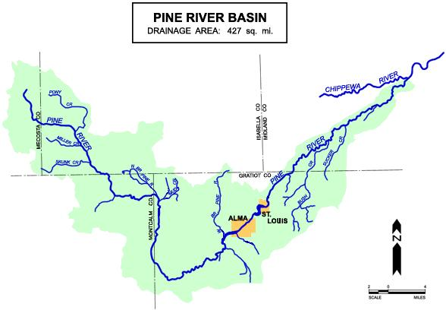
UPSTREAM (CLEAN?) SITES
Pine River at S. Rolland Rd.
PINE RIVER WATERSHED
Wolf Creek at Edgar and
Vickeryville Rds

Slide 5
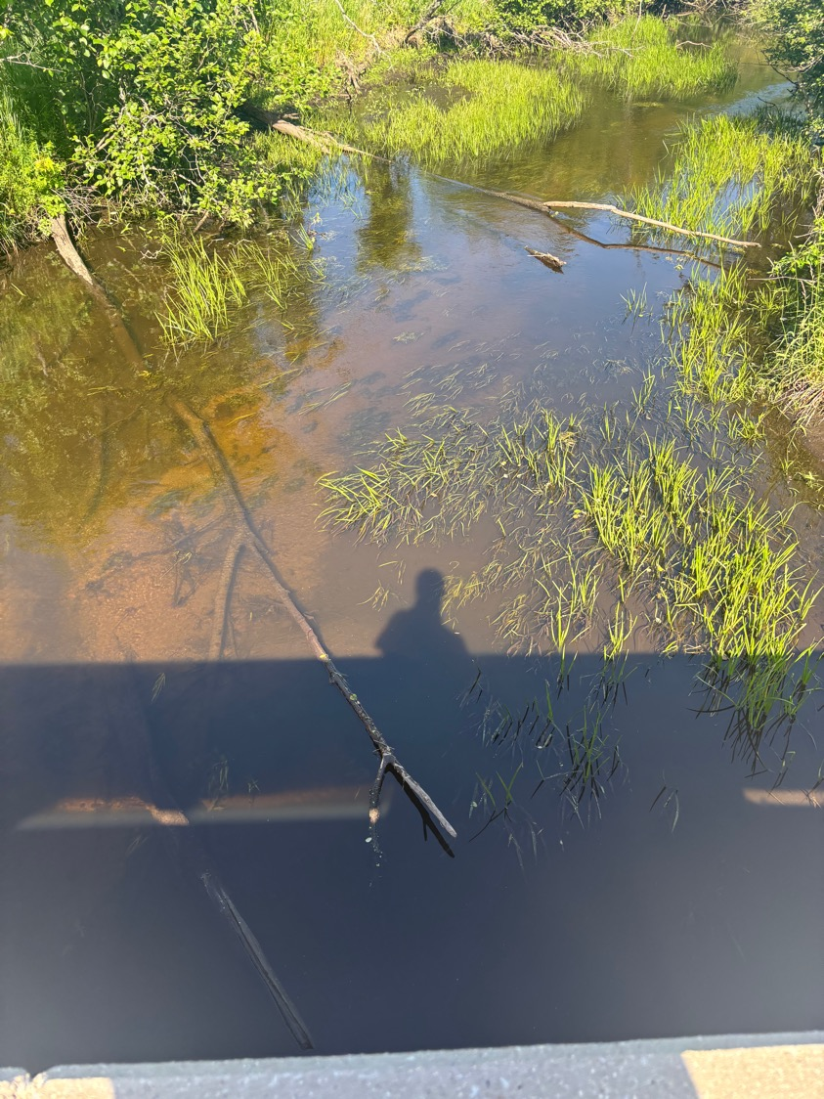
Pine River at S. Rolland:
Appeared less impacted compared with downstream sites by lack of surface algae, clarity of water and swift current. Typical sandy bottom and iron staining consistent with glacial till deposits (general glacial drift) in this region of the state.
We did find a fairly large sheen on the surface coming from an input point (pipe?) on the north side of the stream. There is an Amish farm nearby with animals (visibly: 6-8 horses and 6-8 cows). The area around the site is generally forested and sparsely populated. Sheen on next slide.

Slide 6
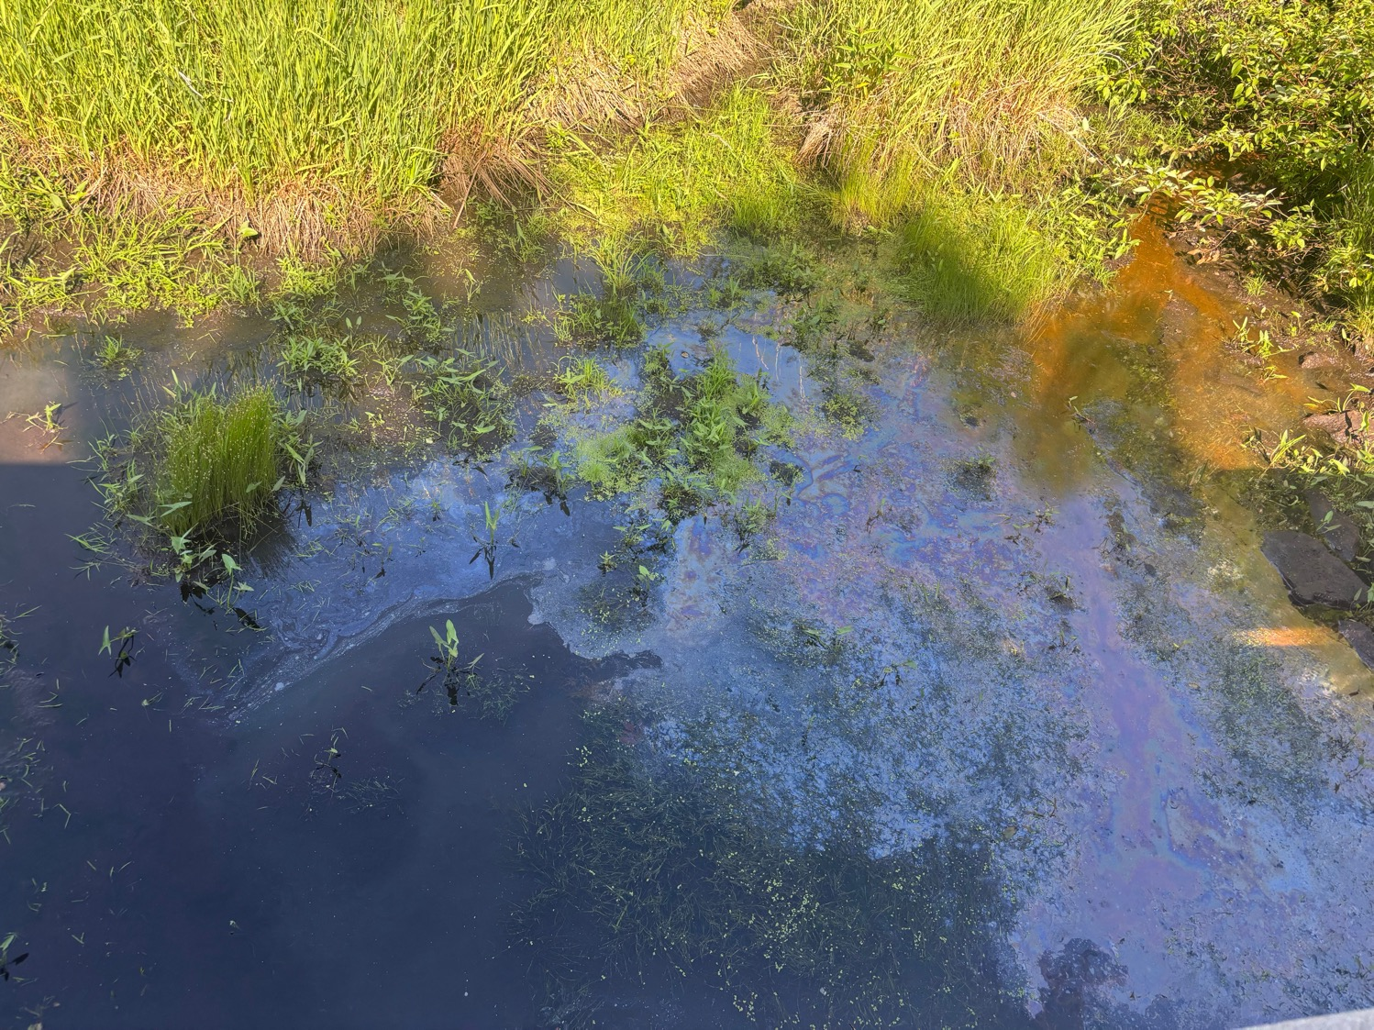
Input into PR
Surface sheen. Most likely bacterial due to the fact that it fragmented and did not reform when it was broken. Also, no petroleum smell or other signs of petroleum source

Slide 7
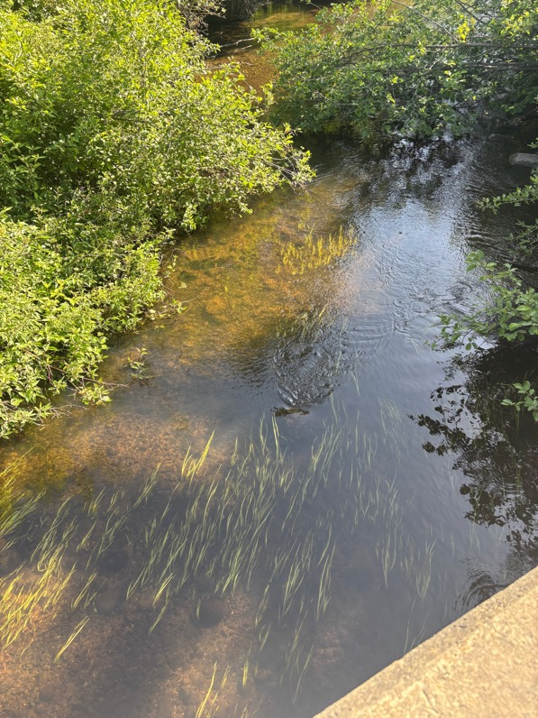
Wolf Creek at Edgar Road:
Appeared less impacted compared with downstream sites by lack of surface algae, swift current and rocky bottom. Area was forested and isolated. Few nearby farms and homes.

Slide 8
mg/L
Nutrient Levels for a Healthy Stream

Slide 9
CONCENTRATION ABOVE WHICH IS RISK TO HUMAN HEALTH

Slide 10
Conclusions
Pine River at S. Rolland does not appear to be a good candidate for an unimpacted area of the watershed. Concentrations are high as are E. coli.
Wolf Creek sites do not appear much better
More work needs to be done

Slide 11
Site That May be Clean????
Bush Creek?

Slide 12
What’s Causing St. Louis’ Algal Bloom
2025 was worst year as far as extent and persistence of algae and aquatic vegetation – beginning at fishing derby!
We are able to narrow down two potential inputs
A little more work needs to be done to be sure

Slide 13
Recap From Last Year
Only 4 potential input sites that could contribute to algal blooms
N and P coming over Alma Dam
Sugar Creek inputs
Horse Creek inputs
Alma Wastewater Treatment Plant discharge

Slide 14
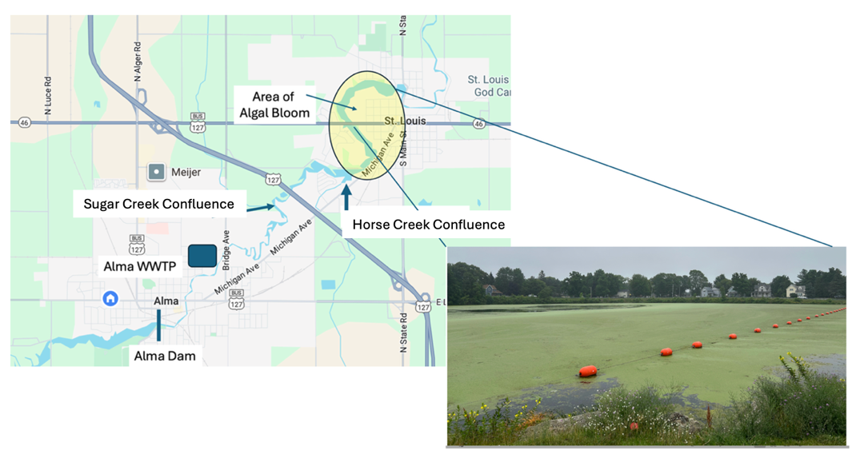

Slide 15
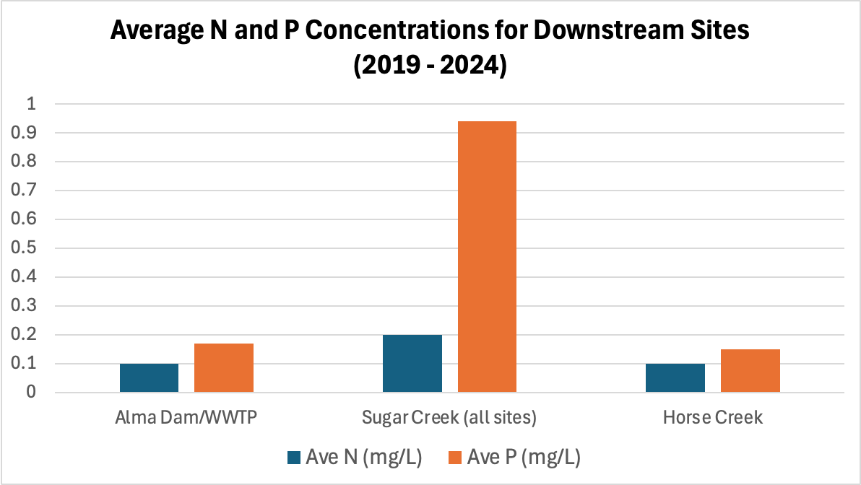
Which Downstream Sites Have the Most Impact?
mg/L
Nutrient levels for healthy stream

Slide 16
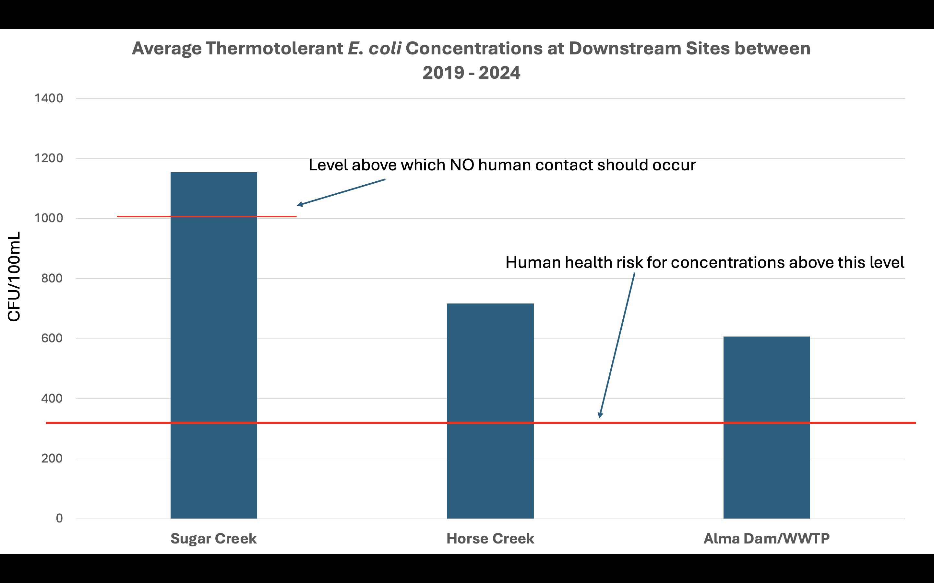
Notes:
Looking at Sugar Creek, Horse Creek, and Alma Dam from 2019-2024. The bottom red line represents at what point human health risks occur. The top red line represents at what point no human contact should ever occur. Sugar creek is more than 100 colony forming units above the level where no human contact should occur.

Slide 17
Conclusions of Findings From 2024…
Sugar Creek is the dominant source for N and P (chemicals that cause algal growth)
Sugar Creek produces a lot of E. coli indicating that the input is most likely animals (waste from livestock or people)

Slide 18
What About 2025?

Slide 19
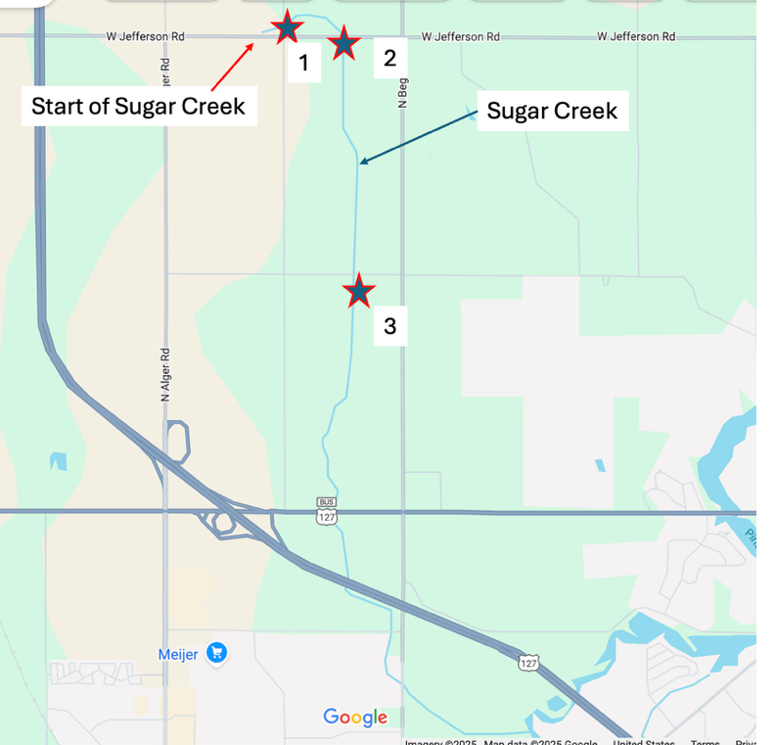
Sampling Sites:
Sugar Cr at Grafton
Sugar Cr at Jefferson
Sugar Cr at Madison

Slide 20
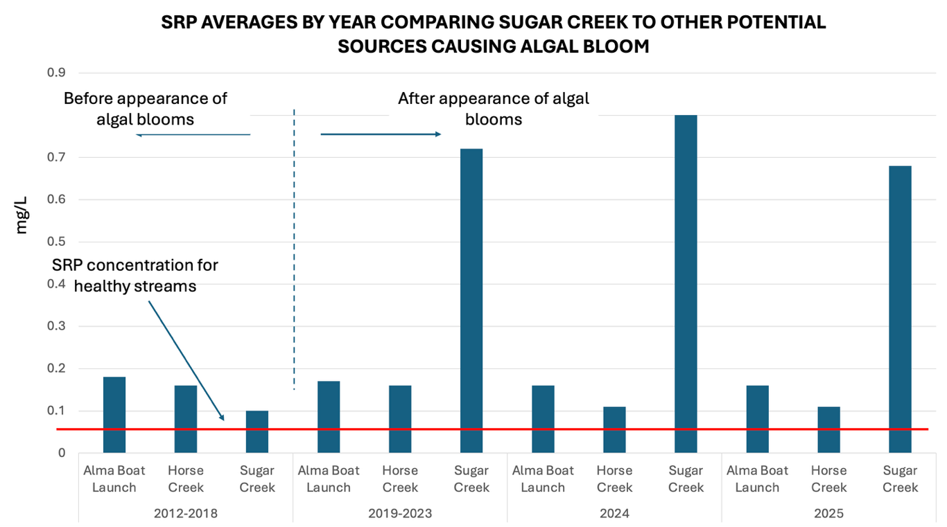
Sugar Creek Continues
To Be Dominant Source
Of N and P

Slide 21
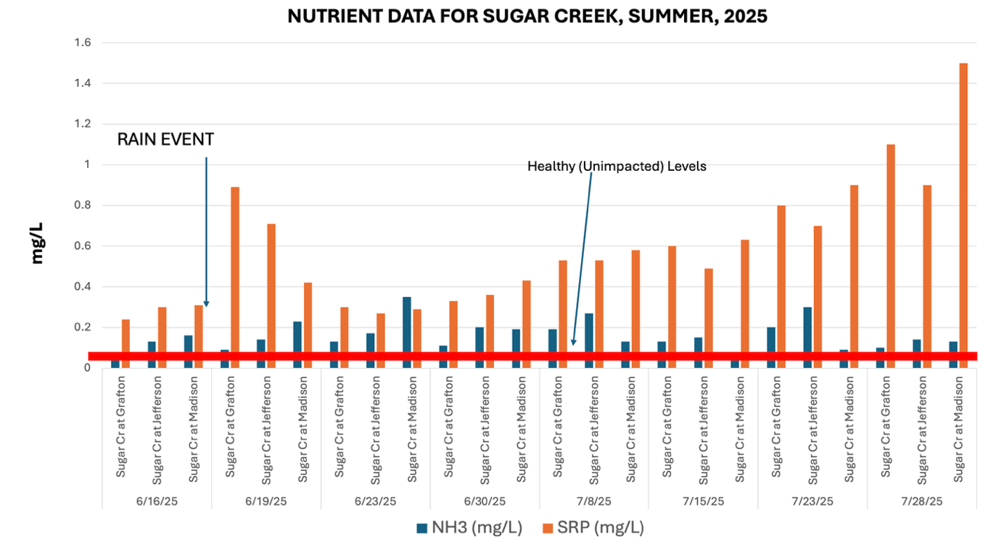

Slide 22
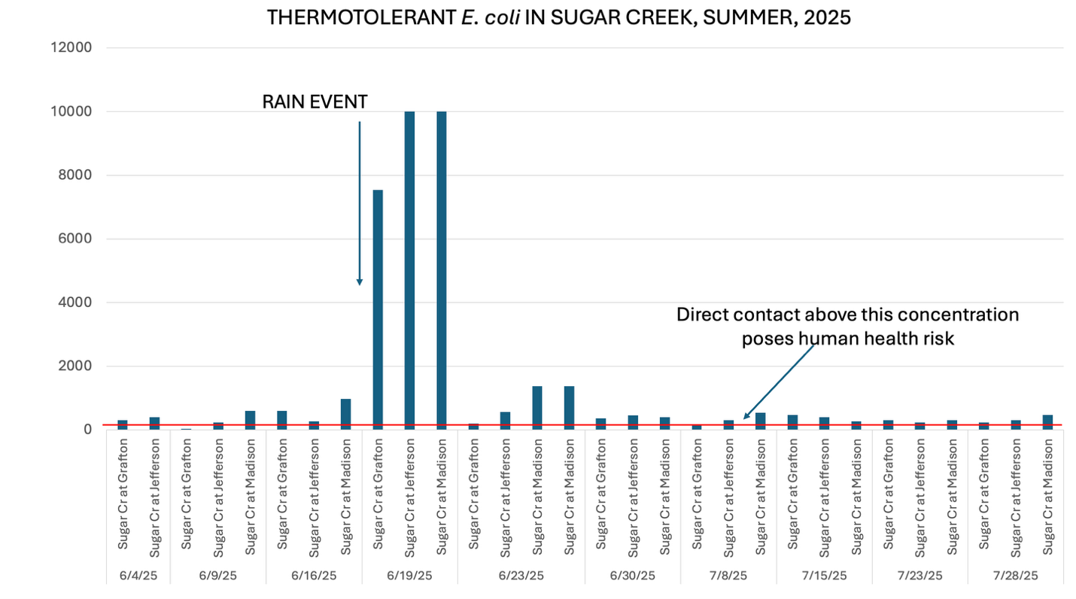

Slide 23


Slide 24
Conclusions…
Sugar Creek shows high levels of N and P (possibly causing algae in PR) and E. coli even though there are no obvious sources right at the headwaters
There must be some other source that is feeding into the start of the creek

Slide 25
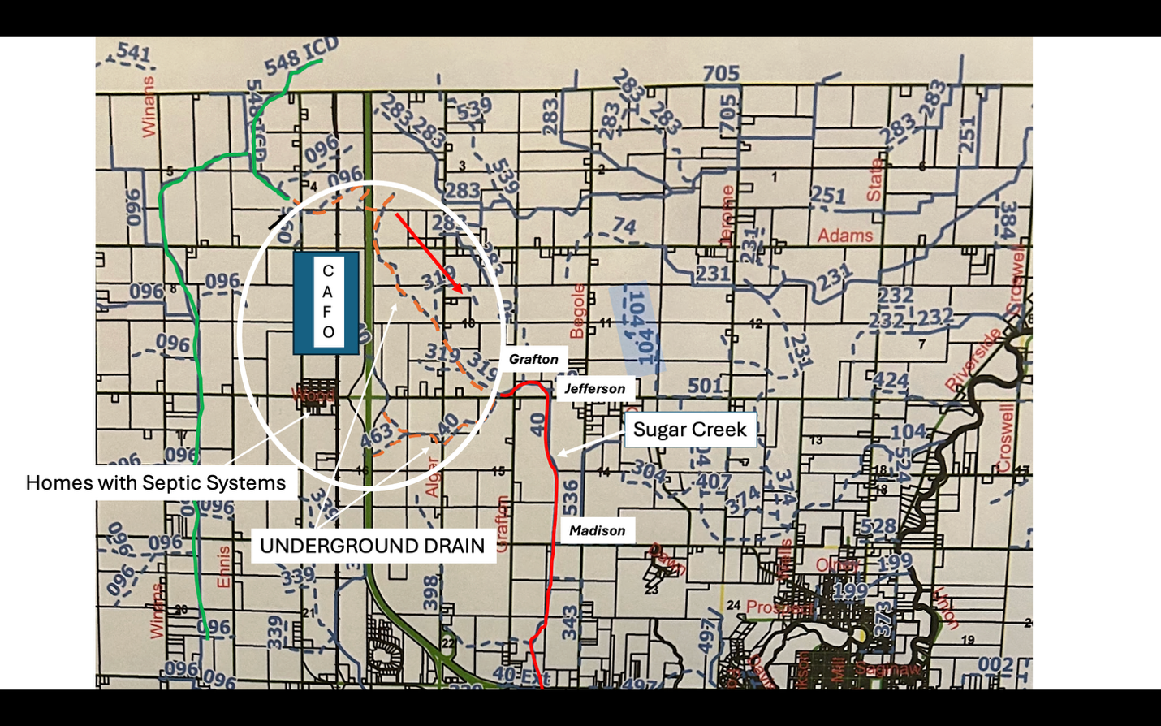
There appears to be an underground drain that feeds directly into Sugar Creek.

Slide 26
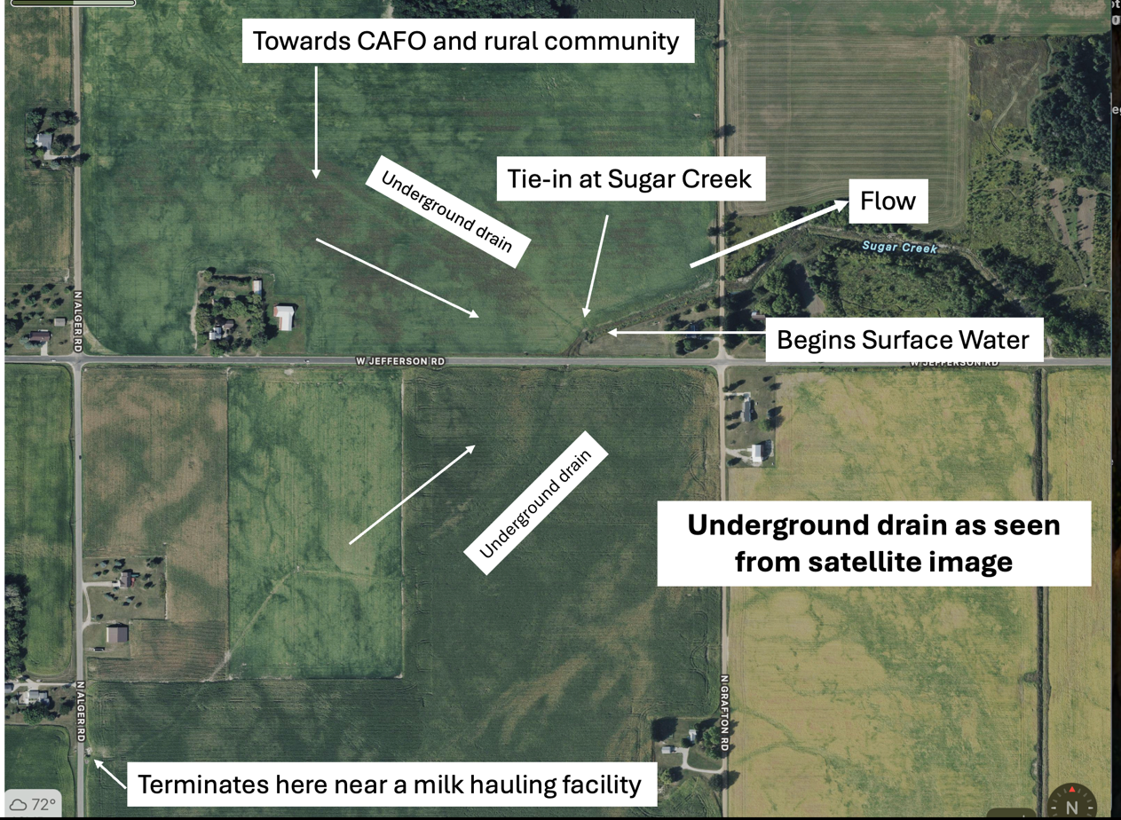

Slide 27
Meeting With the Gratiot County Drain Commissioner
Bernie Barnes (Drain Commissioner) agreed that the underground drain may be impacting Sugar Creek
Bernie suggests possible sources could be home septic systems in Forest Hills or incident CAFO runoff
More research needs to be done to see which if either of these are significant inputss

Slide 28
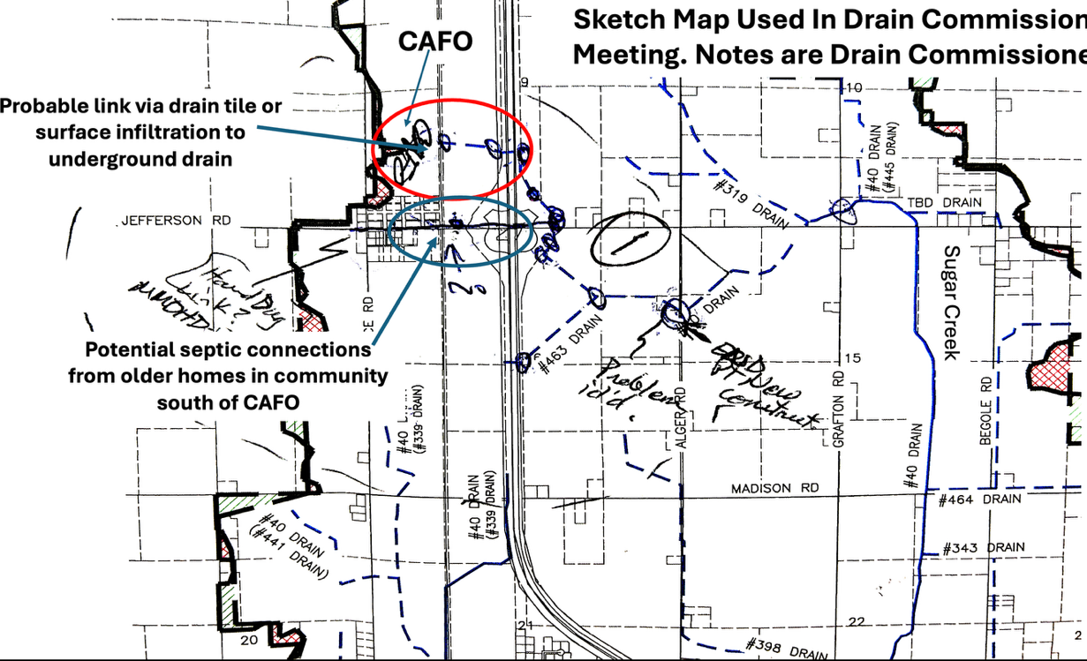

Slide 29
Next Steps…
Summer: 2026
Do more sampling on Bush Creek – is this a clean site?
Work with the Drain Commissioner to get samples from the underground drain
Possibly working with Mid Michigan District Health Department on surveying septic systems in Forest Hill

Slide 30
THANK YOU!!!!!
Healthy Pine River Group
FOR ALL YOUR YEARS OF SUPPORT!

Slide 31
QUESTIONS?

