Slide 1
Update on the Status of the Upper Saginaw River Drainage Basin, Pine River Watershed
Central, Lower Michigan
Presented to the Healthy Pine River Group
October 8, 2026
Alma College Great Lakes Watershed Institute
Alma College Environmental Studies Program
Montcalm Community College

Slide 2
Presentation Summary: What Questions Will We Answer?
Are there indicators showing improvement in the watershed?
Are we sampling in the correct places?
Is Is the entire watershed heavily impacted by agricultural and rural inputs?
Are there risks to the ecology of the watershed? If so, where?
What can we expect in the future?

Slide 3
2026 Summary: What We Did on Our Summer ”Vacation”
Paige Kitts: Alma College Using GIS to Assess Our Efforts So Far
Are we sampling in places that make sense?
Are there areas where we should be sampling that we are not?

Slide 4
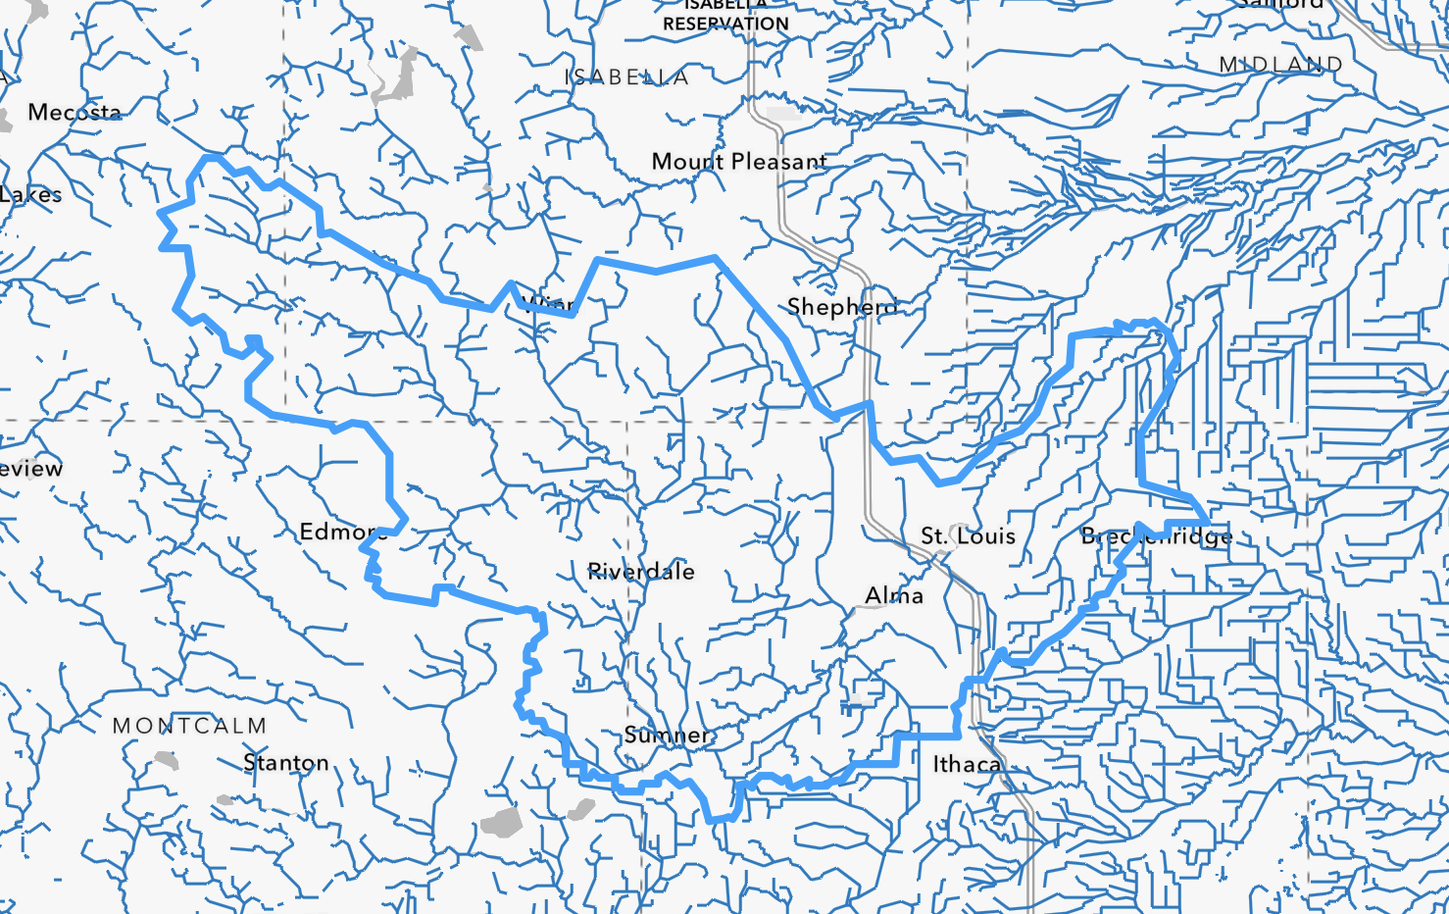
ALL TRIBUTARIES AND STREAMS FEEDING INTO THE PINE RIVER WATERSHED
Pine River Watershed Boundary

Slide 5
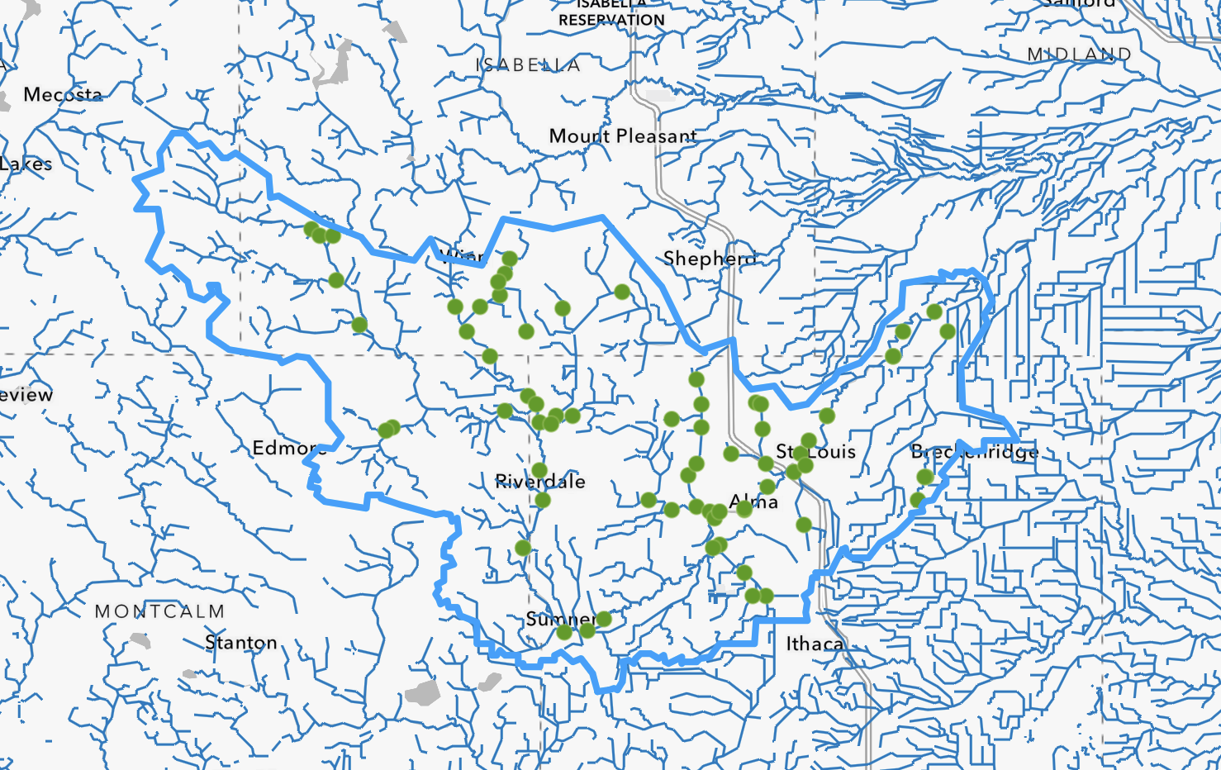

Slide 6
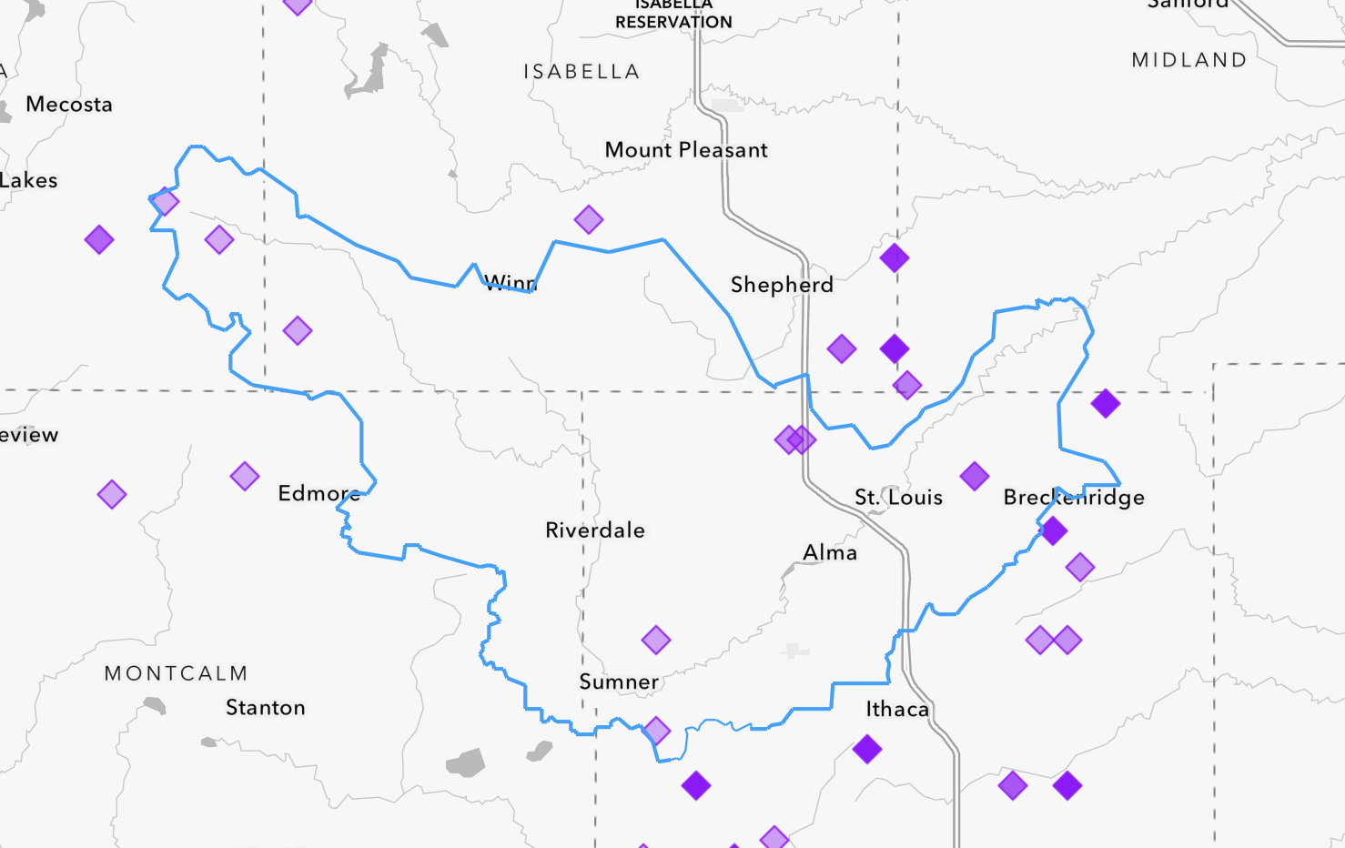
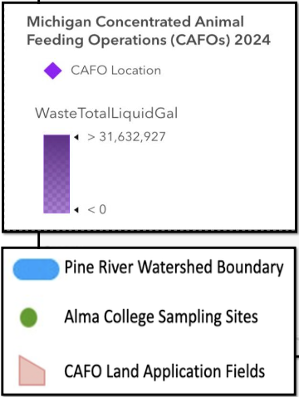
Pine River Watershed Boundary

Slide 7
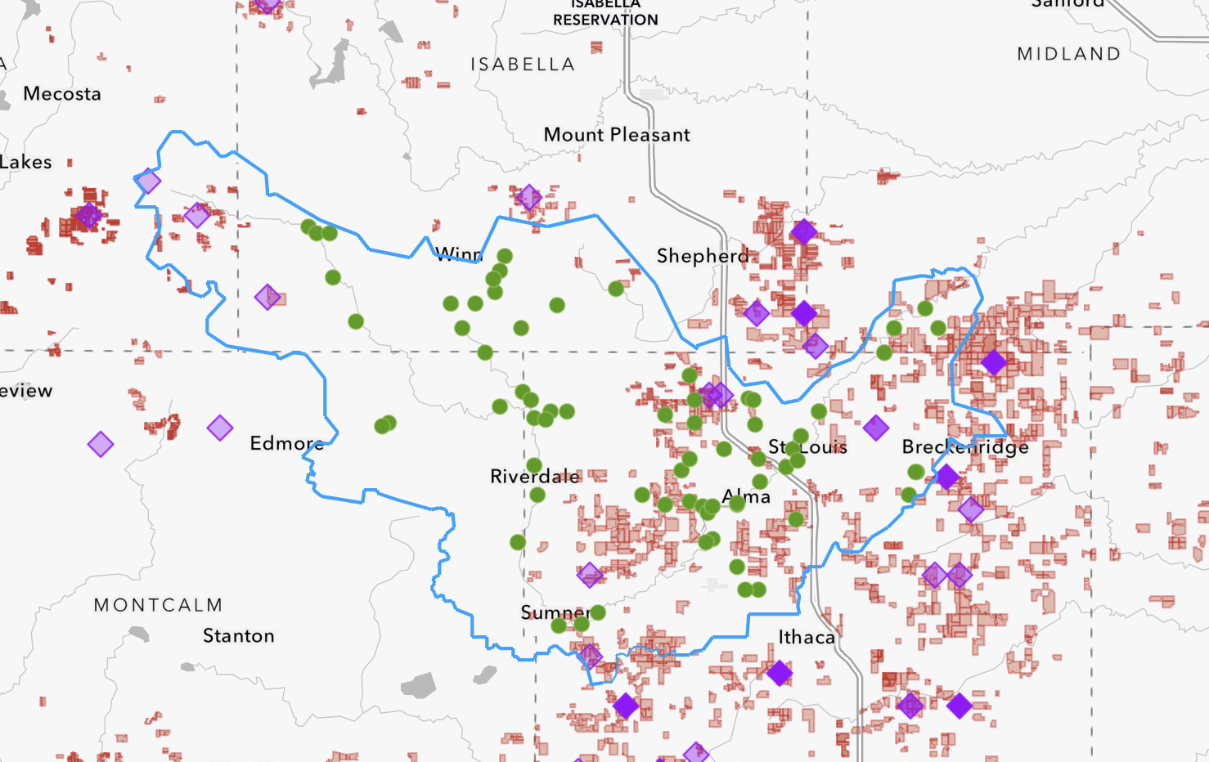

Slide 8
What Did We Learn From Our GIS Work?

Slide 9
Trying to Find a “Clean” Part of the Watershed
Brooke Hetherington (AC) and Bre Welch (Montcalm CC)
How impacted is the watershed?
Are there places in the upper headwaters that exhibit relatively unimpacted conditions?

Slide 10
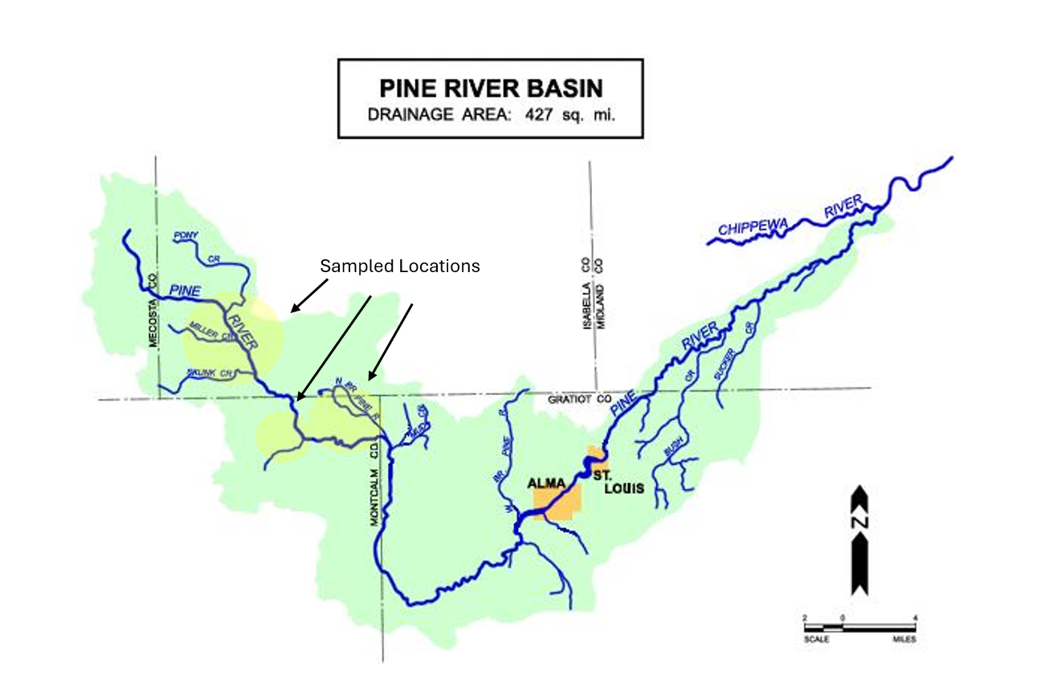

Slide 11
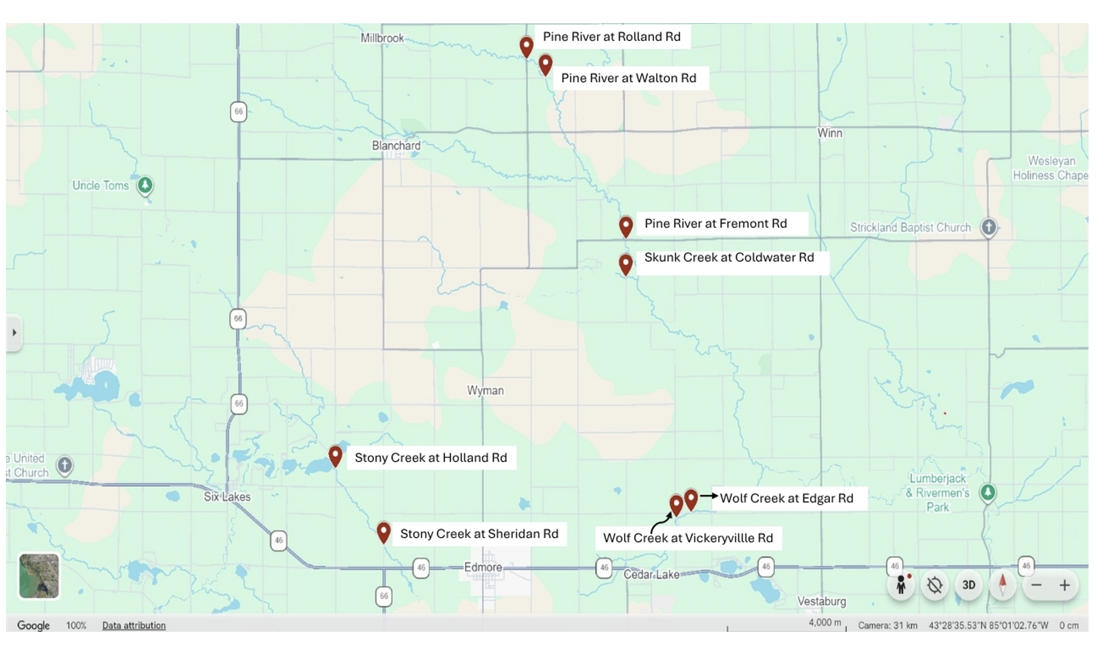

Slide 12
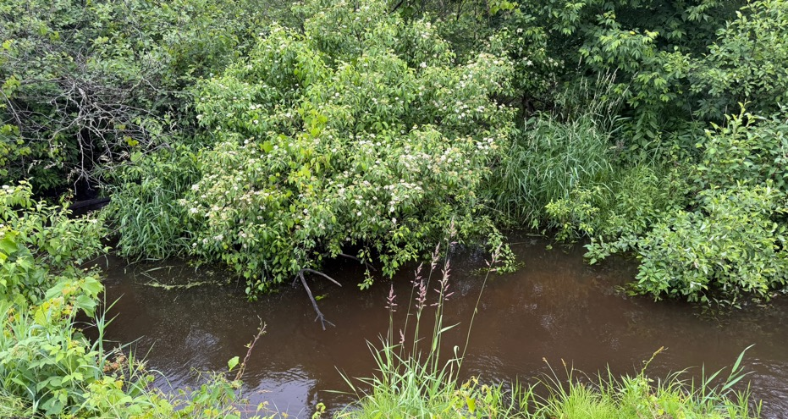
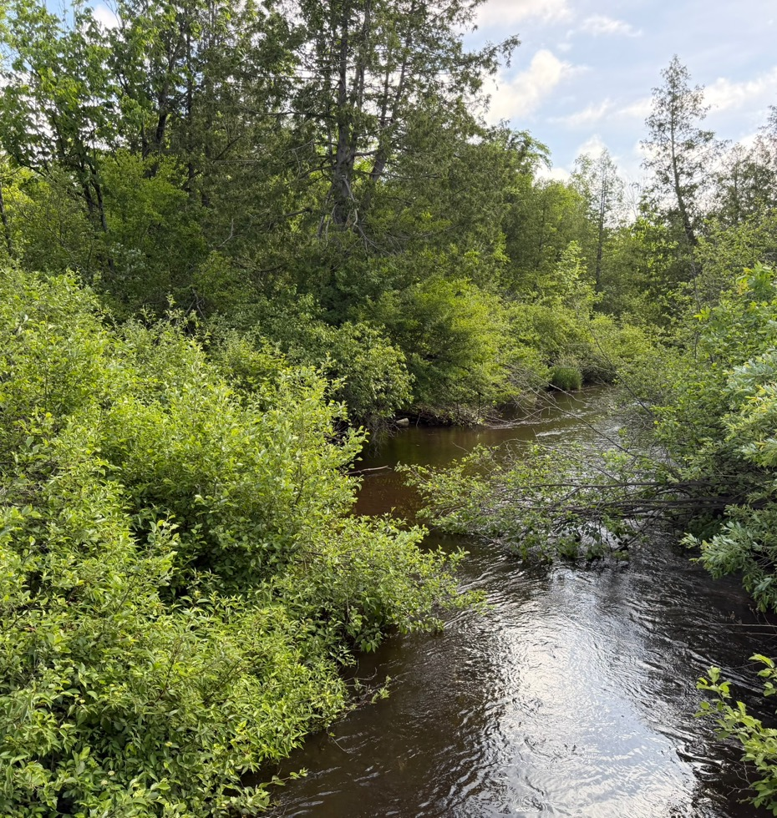
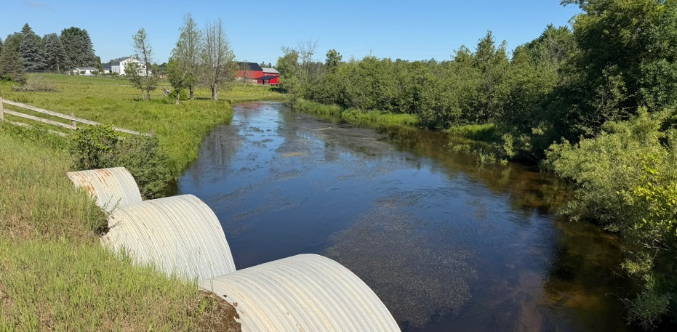

Slide 13
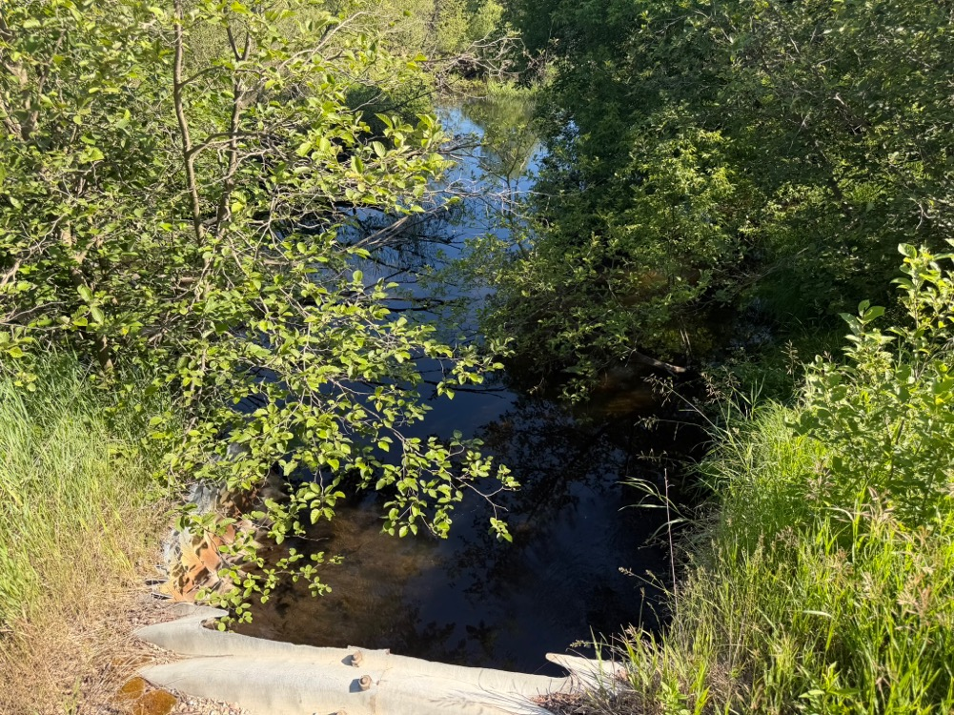
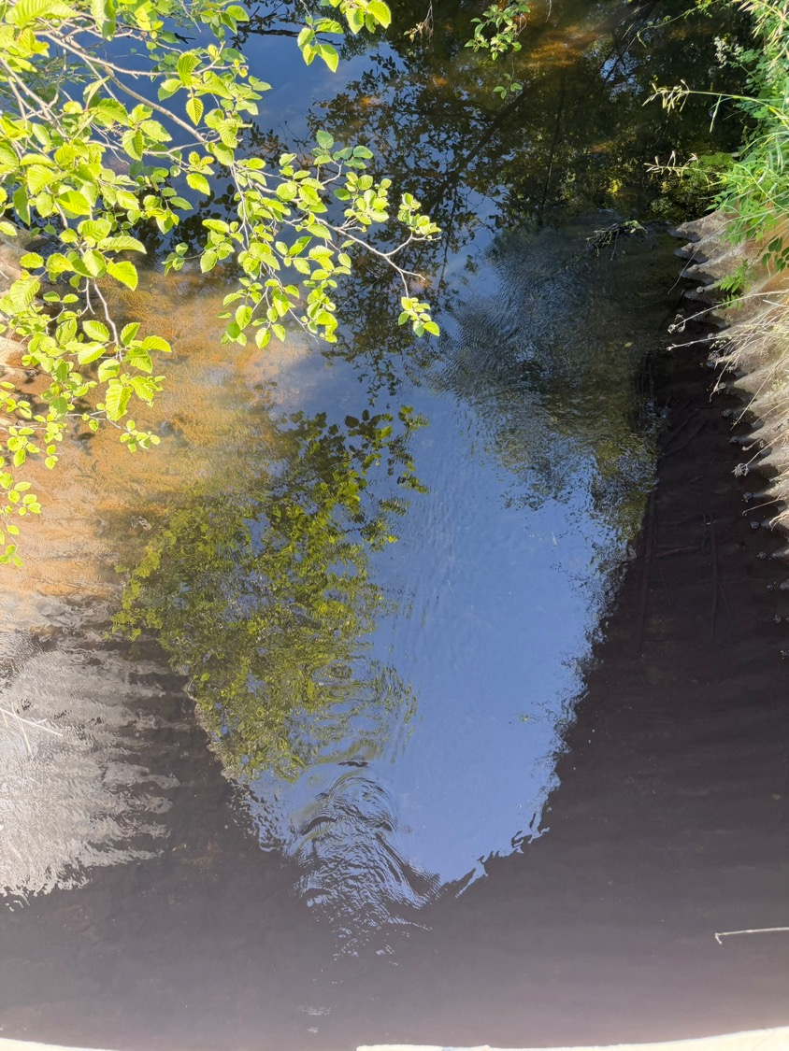
Pine River at Walton Road

Slide 14
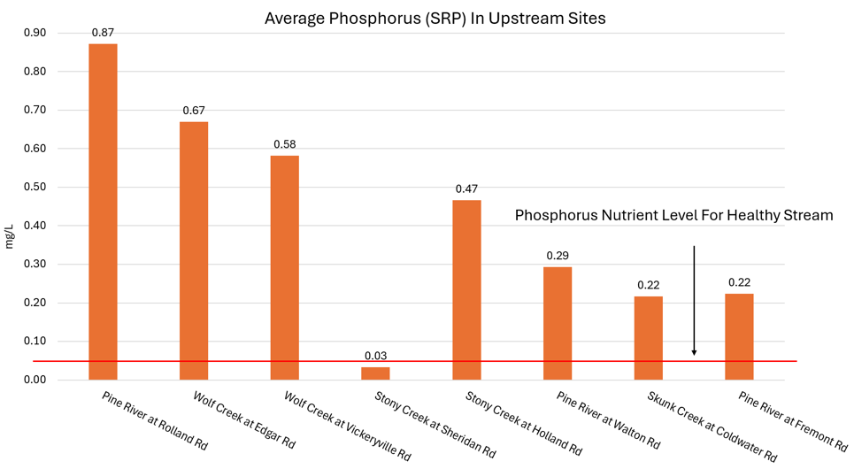
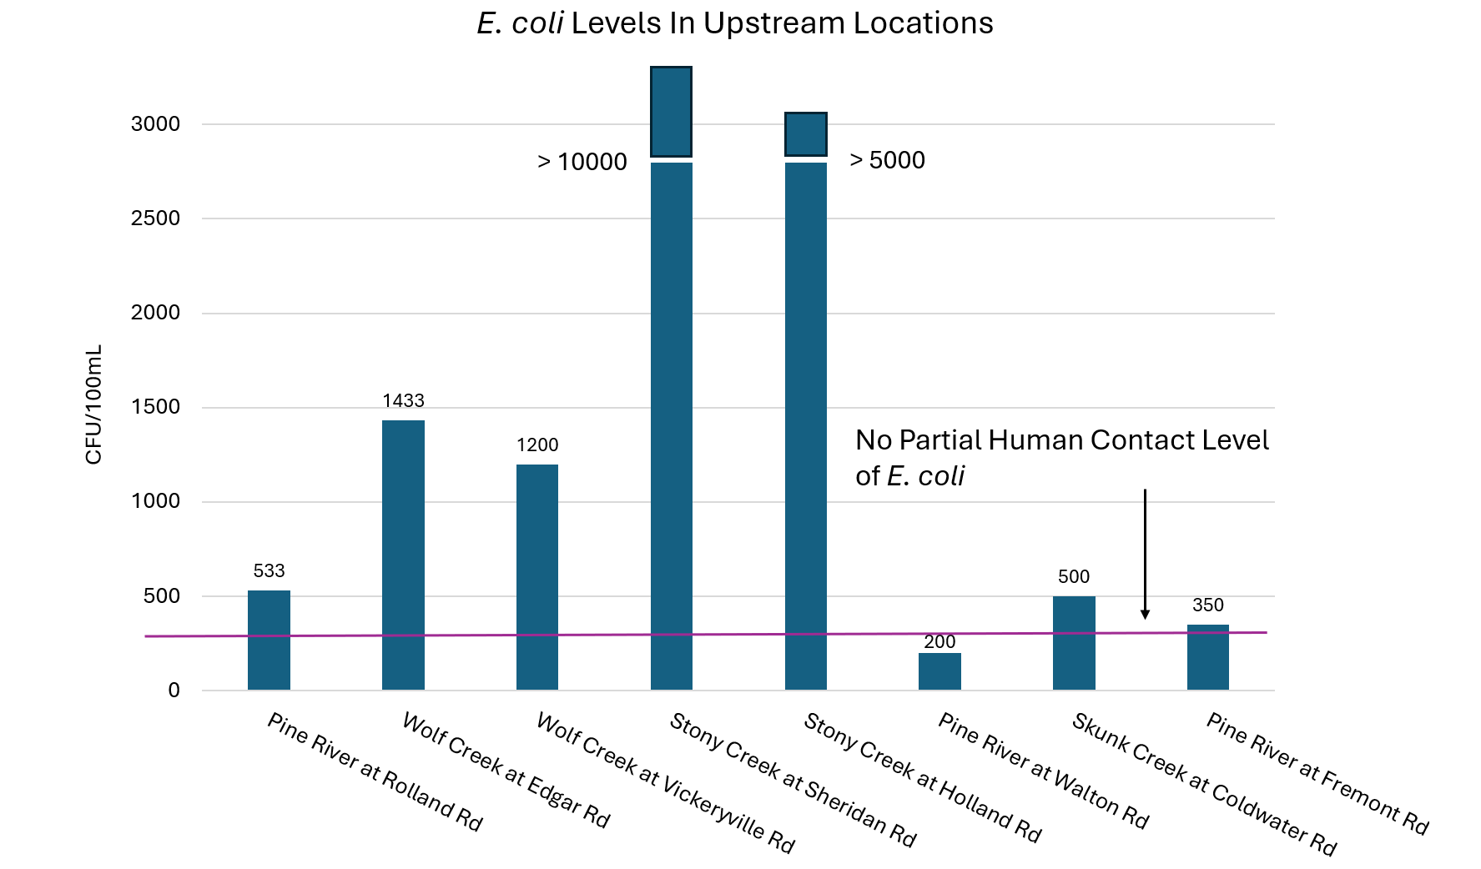

Slide 15
Summary: Headwaters Status
Out of the eight sites that were sampled, only one site had somewhat promising data suggesting that it may be unimpacted. Pine River at Walton Rd.
The data collected is showing that the watershed is impacted by industrial agriculture, though there was some evidence of residential (septic) impacts as well
More testing needs to be done to fully determine if the Pine River at Walton Rd. site is unimpacted and for more conclusive results overall.

Slide 16
How Impacted is the Watershed From an Ecological Perspective?
Madison Ramirez and Nichole Heeschen: Alma College
Are we finding evidence that the ecosystems in the watershed are being impacted by agricultural and rural pollution?
Comparative analysis between Lumberjack Park and Sugar Creek

Slide 17
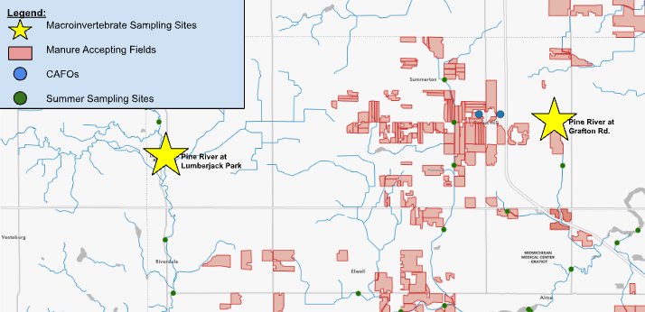
Sugar Creek at
Grafton
Pine River at
Lumberjack Park

Slide 18
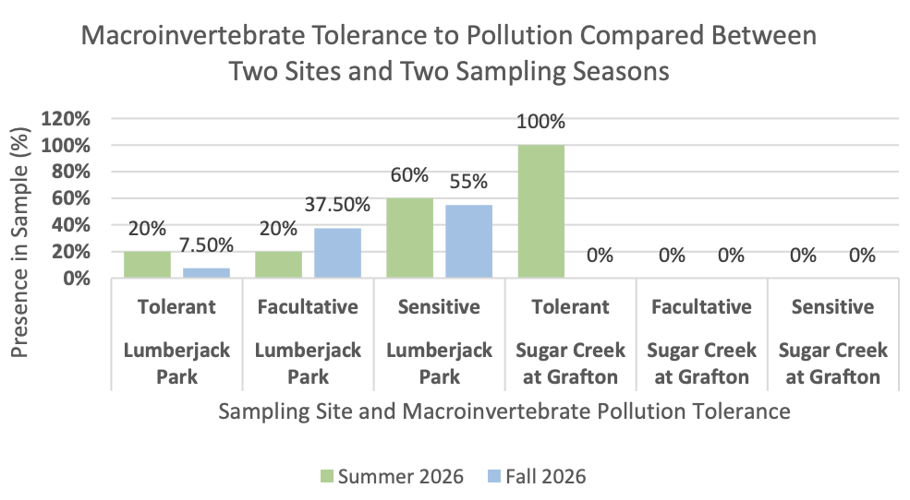
LJP (Pine River)
Grafton (Sugar Creek)

Slide 19
Historic
mg/L
Fall
Summer
Historic

Slide 20
Summer

Slide 21
CFU/100mL

Slide 22
Summary: Takeaways from our Macroinvertebrate Study

Slide 23
What Can We Expect in the Future?
Ruby Frisch: Alma College
What impact, if any does climate change have on river conditions?
Given climate models for this part of Michigan, what is likely to happen if no change occurs?

Slide 24
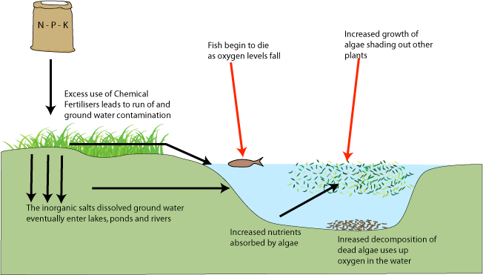
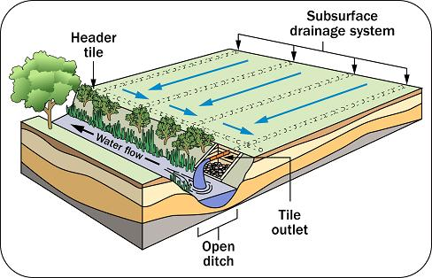
Phosphorus (P) and Agal Blooms - Basics
Manure and fertilizer are full of phosphorus
Excessive phosphorus levels can contribute to algal blooms and “Dead Zones”
High water temp and increased precipitation can increase algal blooms

Slide 25
What I Did…
Averaged the entire Pine River temperatures from 2004-2024 using Alma College Data and NOAA database
Looked at Gratiot Co. / PR watershed summer and winter temperatures
Looked at precipitation rates

Slide 26
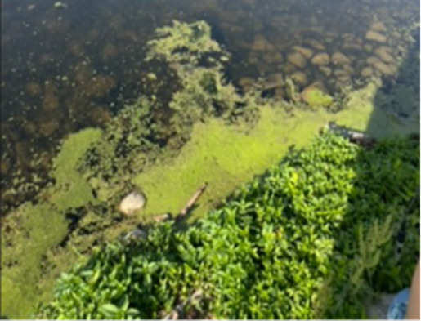
What I Found
Air temperatures in Gratiot County have risen from June to August, 2004-2024
Air temperatures in Gratiot County have risen from January to March, 2004-2024
Water temperature of the Pine River watershed has risen from 2004-2024
Precipitation rates have increased
Algae blooms have the potential to appear earlier and stay later

Slide 27
Are There Human Health Risks Due to E. coli in the Pine River Watershed?
Talia Thompson (Montcalm CC)
Survey of three sites in which people are most likely to interact with the river
Comparing bacterial concentrations over time with health department standards

Slide 28
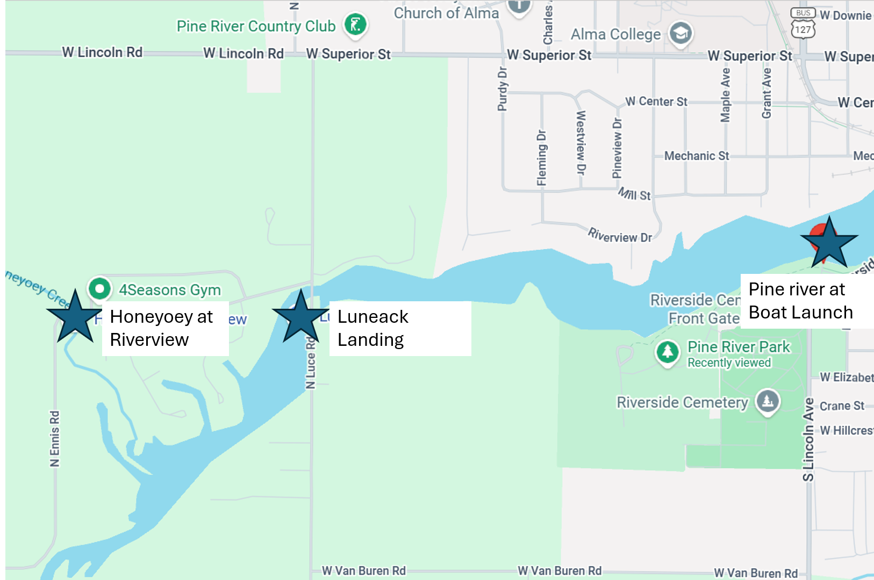
Sites most likely to be access points for people fishing or boating in the river

Slide 29
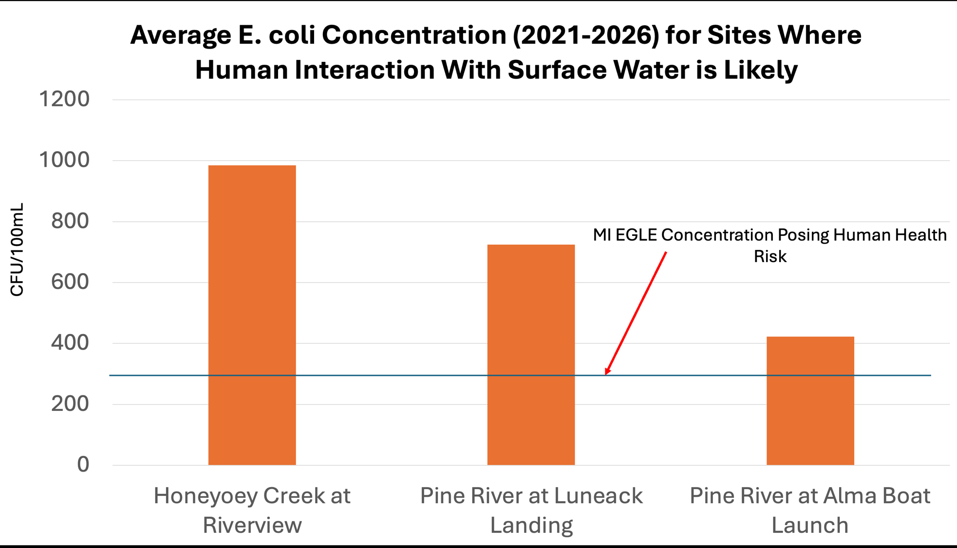

Slide 30
Work Done By ENV 310 Class, 2024
Ref: Jack Yodzevicis, Karol Pucek, Marlow Dillon, Kyle Scheck, Emmerson Goodin

Slide 31
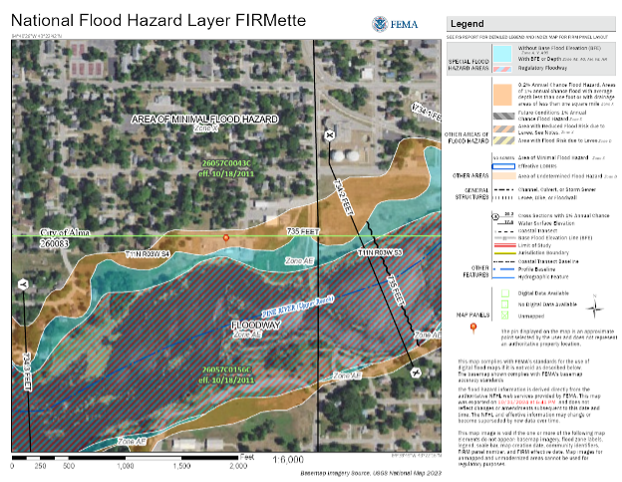
FEMA Flood Map
Many of the areas vulnerable to flooding are in areas with lower than average property values, associated with higher vulnerability
  Yellow box
    Property value: $90,000-150,000
    Property taxes: $4,000-5,000
  Red box
    Property value: $30,800-57,000
    Property taxes: $1,500-2,000
  Purple box
    electrical site at 550 mill st
Impacts
  Many people living in these areas are of lower socioeconomic status and unlikely to have funds to evacuate their homes.
    When the Pine River floods into these homes and are exposed to E.Coli from the river.
    Harmful contaminants will be extremely expensive to clean

Slide 32
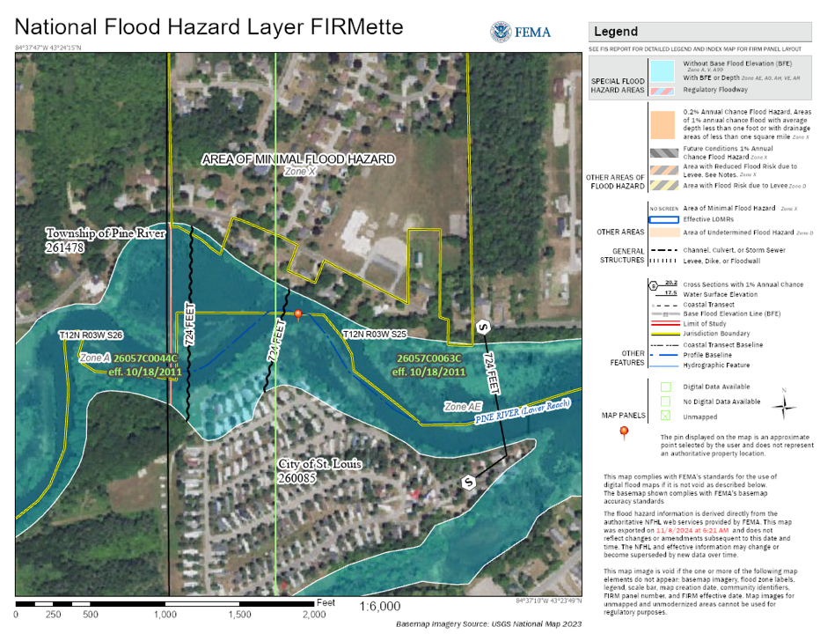
Evergreen Housing
Red box
  Unit value: $2k - $4k

Slide 33
Wrap-Up
Nearly the entire Pine River Watershed from the headwaters to St. Louis dam (and downstream) is impaired due to agricultural inputs as well as septic system leakage
Agricultural inputs dominate the degradation of the watershed by far, though human inputs should not be ignored
Over the past 25 years, the watershed has deteriorated to the degree that there are few, if any sites that represent even a modestly clean environment
Many sites people use to access the river exhibit high bacterial and nutrient loading- especially after rain events
The future of the watershed, unless there are drastic changes made is for further degradation and longer periods of health risks (ecological and human) due to a changing climate

Slide 34
THANK YOU!!!!
Without the continued financial support from the Healthy Pine River Group, none of this would be possible.
We thank you very much for your continued interest and support!!!!
Remember: You not only help us understand the watershed, but you make a difference in the lives and careers of our students!!!

Slide 35
QUESTIONS?
????????????????????????????????????????????????????????????????????????????????????????????????????????????????????

